Slide 1

Duty of Care
Tutor: Okwudili O. ONWURAH, LL.B. (Nigeria); BL (Abuja, Nigeria); LLM (Exeter, UK); LLM (Qingdao, PRC); LLM (Shanghai, PRC)
PhD in Law (Hong Kong)
Dr Okwudili O. Onwurah

Slide 2
Minor House Keeping
The purpose of the online lesson is to encourage you to participate actively in achieving your needs and simplifying your legal education. I want you to be the best!
Will make the learning process more interactive discussions and feel free to ask any question or you can speak.
You have the right to choose whether to turn on your video or not.
Participation prepares you for your exam and learning needs with ease.

Slide 3
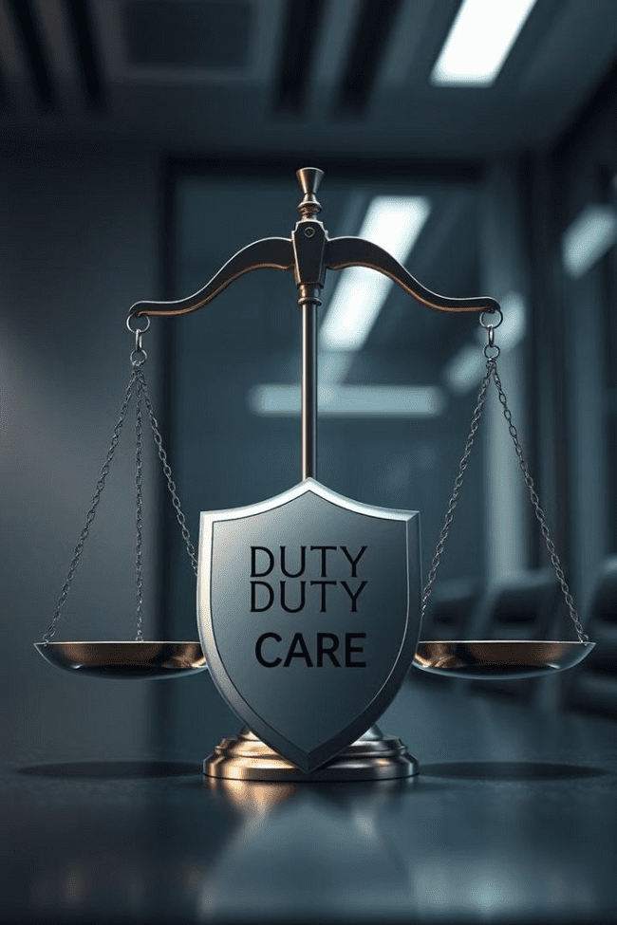
The Duty of Care: A Legal Cornerstone
Fundamental principle in tort law of negligence.
Establishes legal obligations to prevent harm.
Essential for understanding negligence claims.

Slide 4


Historical Development and Neighbor Principle
1
Pre-20th Century
Limited duty based on specific relationships.
2
1932: Donoghue v Stevenson
Established modern duty of care concept.
3
Neighbor Principle
Extended duty to foreseeable persons affected.

Slide 5

Caparo Test: Three-Pronged Approach
Foreseeability
Could defendant reasonably foresee harm?
Proximity
Close relationship between parties required.
Fair, Just, and Reasonable
Imposing duty must be equitable.

Slide 6
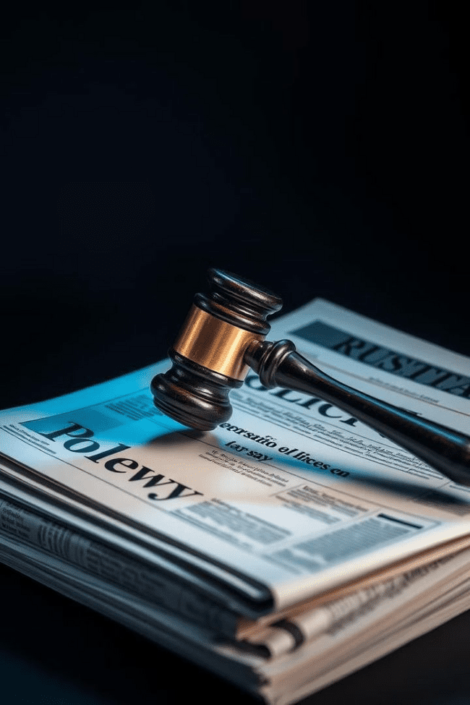
Public Policy Considerations
1
Societal Impact
Balancing individual rights with community interests.
2
Economic Factors
Considering financial implications of imposing duty.
3
Floodgate Argument
Preventing excessive litigation and claims.

Slide 7
Duty of Care in Professional Contexts
Medical
Legal
Financial
High standard of care for patient well-being.
Obligation to provide competent representation.
Responsibility to safeguard clients' interests.

Slide 8
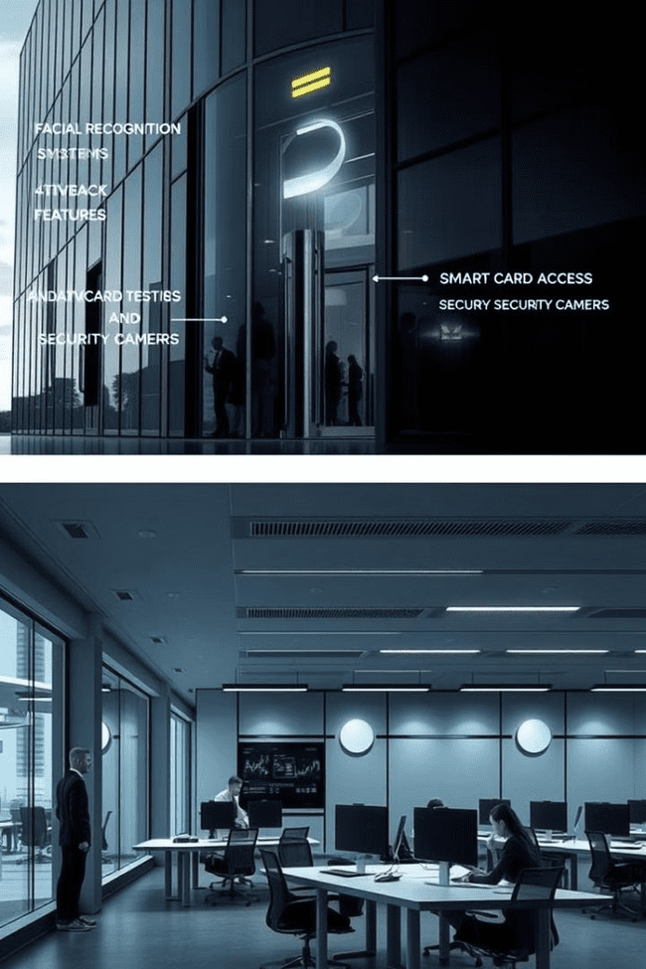
Occupiers' and Employers' Liability
Occupiers
Ensure premises safety for visitors
Employers
Provide safe working environment
Scope
Extends to employees and third parties

Slide 9



Duty of Care in Road Traffic
Drivers
Operate vehicles with reasonable care.
Pedestrians
Exercise caution when using roads.
Local Authorities
Maintain safe road infrastructure.

Slide 10




Case Studies: Landmark Decisions
Caparo Industries plc v Dickman
Defined three-stage test for duty of care.
Hill v Chief Constable of West Yorkshire
Limited police duty to general public.
Hedley Byrne v Heller
Extended duty to negligent misstatement.

Slide 11


Recent Developments and Reforms
Technological Impact
Evolving Standards
AI and automation influencing legal standards.
Adapting duty of care to contemporary challenges.

Slide 12
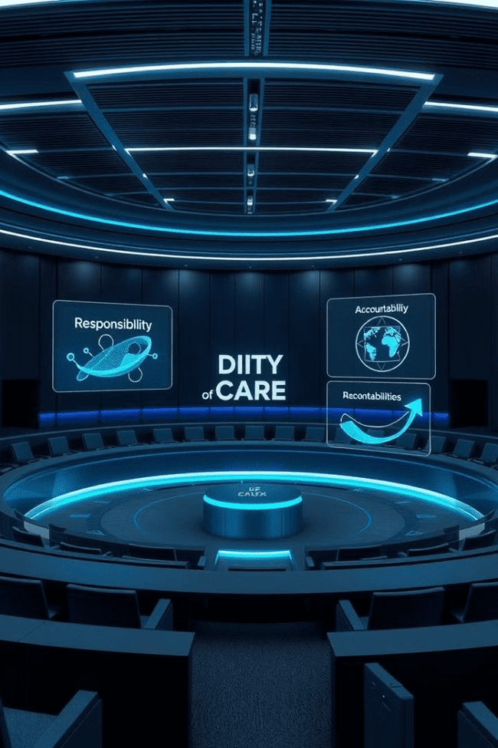
Conclusion: The Future of Duty of Care
1
Ongoing Relevance
Remains crucial in modern tort law.
2
Adaptability
Evolving to address new societal needs.
3
Balancing Act
Maintaining fairness in changing legal landscape.

