Slide 1
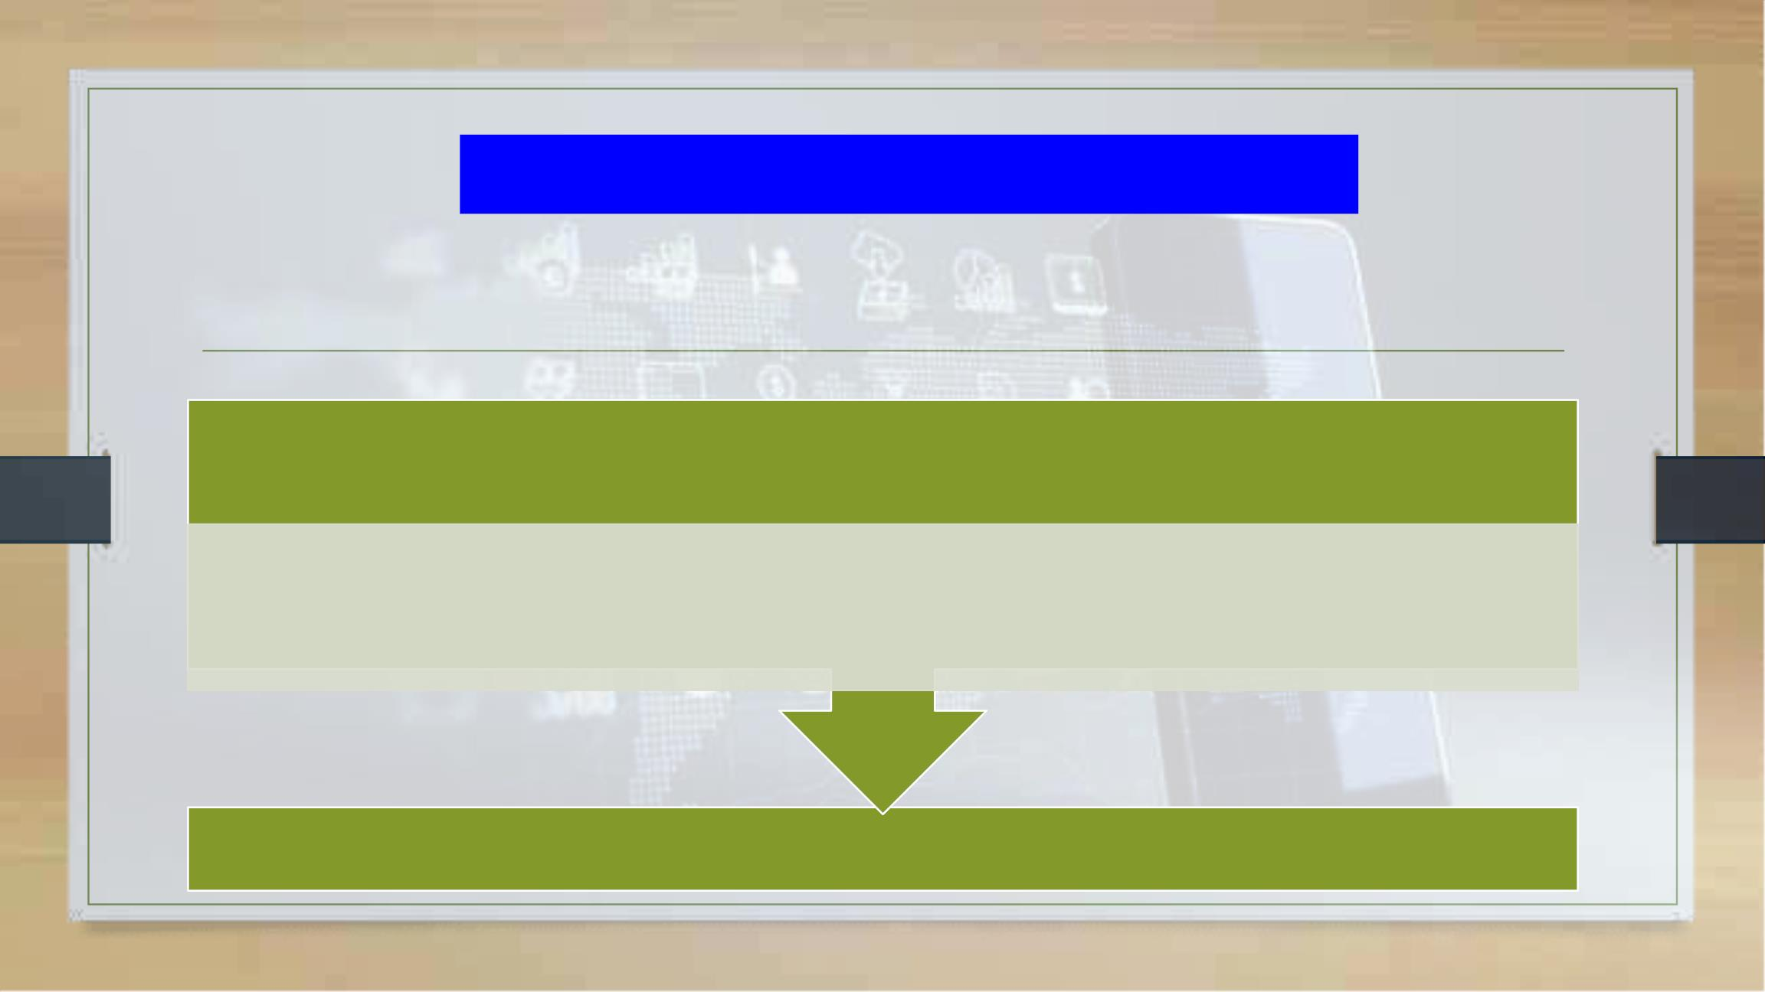
Defences to Vicarious Liability:
Scope of Employment and Frolic
Tutor: Okwudili O. ONWURAH, LL.B. (Nigeria); BL (Abuja, Nigeria); LLM (Exeter,
UK); LLM (Qingdao, PRC); LLM (Shanghai, PRC)
PhD in Law (Hong Kong)
Dr Okwudili O. Onwurah
11/28/2024
1

Slide 2

The purpose of the online lesson is to encourage you
to participate actively in achieving your needs and
simplifying your legal education. I want you to be the
best!
Minor
House
Will make the learning process more interactive
discussions and feel free to ask any question or you
can speak.
Keeping
You have the right to choose whether to turn on
your video or not.
Participation prepares you for your exam and
learning needs with ease.
11/28/2024
2

Slide 3

Introduction
This presentation explores the crucial legal concepts of scope of employment and frolic
as defenses to vicarious liability. We will examine the legal framework, key case law, and
practical applications of these defenses in both English and Hong Kong jurisdictions.
Through an analysis of landmark cases and hypothetical scenarios, we aim to provide a
comprehensive understanding of how employers can limit their liability and the challenges
in proving detour versus frolic in employee conduct.

Slide 4

Scope of Employment: Legal Framework and
Limitations
Definition
Key Factors
The scope of employment refers to actions performed by an
employee that are authorised by or benefiting the employer. It
sets the boundaries within which an employer can be held
vicariously liable for an employee's actions.
Courts consider factors such as the nature of employment, time
and place of the act, and the extent to which it serves the
employer's interests when determining if an action falls within the
scope of employment.
Limitations
Grey Areas
Actions clearly outside the employee's duties or contrary to the
employer's interests may fall outside the scope of employment,
potentially absolving the employer of liability.
Challenges arise in cases where an employee's actions are
partially related to their job duties but also serve personal
interests, leading to complex legal interpretations.

Slide 5
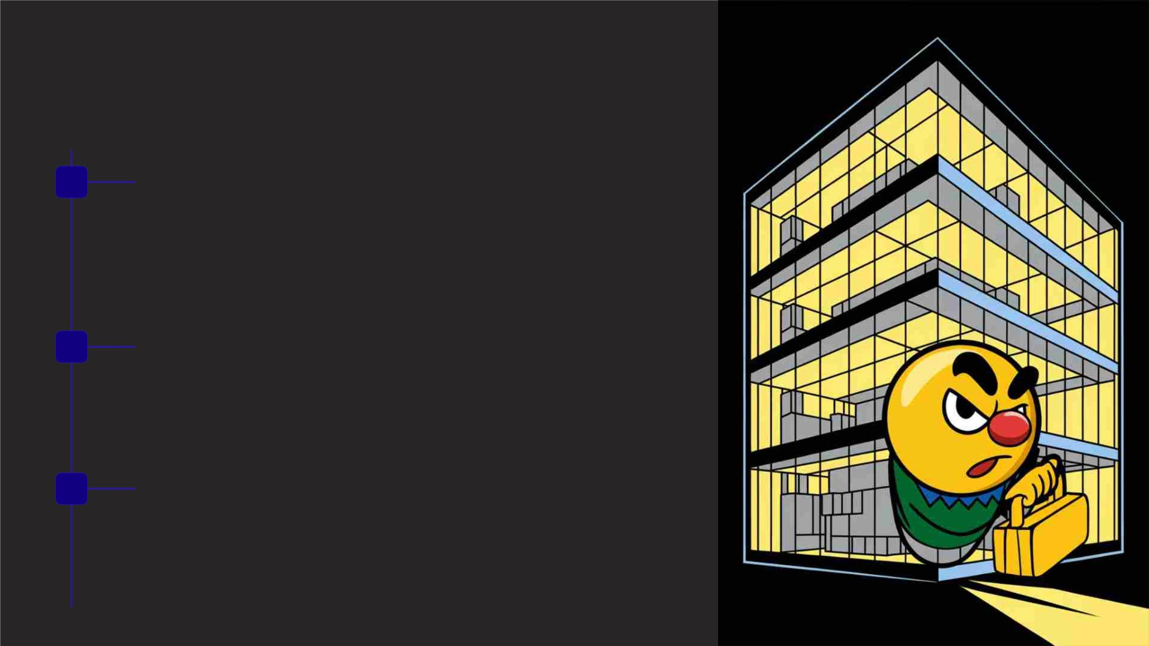
Frolic Defense: Definition and
Application
1
Definition of Frolic
A frolic refers to an employee's significant departure from their employment duties for
personal purposes, often considered outside the scope of employment. This concept is
crucial in determining an employer's vicarious liability.
2
3
Legal Significance
When an employee is on a frolic, their actions are typically considered to be outside the
scope of employment, potentially relieving the employer of vicarious liability for any
resulting damages or injuries.
Application in Court
Courts carefully examine the nature, duration, and extent of the employee's deviation
from their duties when determining whether an action constitutes a frolic. This
assessment is often highly fact-specific and can lead to varying outcomes.

Slide 6

Case Law: Joel v Morison (1834)
Case Background
Court's Decision
Legal Impact
In Joel v Morison (1834), a servant driving
his master's horse and cart deviated from
his assigned route to visit a friend. During
this detour, he negligently ran over a
pedestrian. The case raised questions
about the extent of an employer's liability
for an employee's actions during a
deviation from duty.
The court held that the master could still
be liable if the servant was on a "frolic of
his own" but had not completely
Joel v Morison established a nuanced
approach to vicarious liability, recognising
that not all deviations from duty are equal.
It laid the groundwork for future cases to
consider the degree of departure from
employment duties when determining
employer liability.
abandoned his master's business. This
ruling introduced the concept of a "detour"
as distinct from a complete "frolic,"
suggesting that minor deviations might
not absolve the employer of liability.

Slide 7

Case Law: Century Insurance Co Ltd v Northern Ireland
Road Transport Board (1942)
1
2
3
4
Case Facts
Legal Analysis
Ruling
Precedent Set
A petrol tanker driver, while
making a delivery, lit a cigarette
and negligently threw the
The House of Lords considered
whether the driver's act of
lighting a cigarette was within
the scope of his employment or
a personal frolic. They
The court held the employer
vicariously liable, reasoning
that the driver's act was not so
unconnected with his
This case established that
actions incidental to
employment, even if not
explicitly authorised, could fall
within the scope of
match on the ground, causing
an explosion. The question
arose whether the employer
could be held liable for this act.
employment as to be
examined the nature of his job
and the risks associated with
handling petrol.
considered a frolic. The
negligent disposal of the match
was seen as incidental to his
job duties.
employment, broadening the
concept of vicarious liability.

Slide 8

Challenges in Proving "Detour vs. Frolic"
1
Blurred Lines
2
Technological Influence
One of the primary challenges in distinguishing between a detour
and a frolic is the often blurred line between work-related
activities and personal pursuits. Many modern work
environments offer flexibility, making it difficult to clearly delineate
when an employee has completely abandoned their employment
duties.
The advent of mobile technology and remote work has further
complicated the issue. Employees can easily mix personal and
professional activities, making it challenging to determine when
they are truly "on the job" or engaged in a frolic.
3
Intention vs. Action
4
Contextual Factors
Courts must grapple with the employee's intention versus their
actual actions. An employee might intend a brief detour but end
up in a situation more akin to a frolic. Proving the exact moment
when a detour becomes a frolic can be highly subjective and
contentious.
The nature of the job, industry norms, and specific circumstances
of each case add layers of complexity. What might be considered
a frolic in one context could be seen as a reasonable detour in
another, requiring careful consideration of all relevant factors.

Slide 9
Hong Kong Applications: Employer Liability
Limitations
Legal Framework
Key Cases
Liability Limitations
Hong Kong's approach to vicarious liability
closely follows English common law
principles. The courts consider factors
such as the nature of employment, the
employee's assigned duties, and the
degree of connection between the
wrongful act and the employment when
determining employer liability.
In Ming An Insurance Co (HK) Ltd v Ritz-
Carlton Ltd [2002], the Hong Kong Court
of Final Appeal emphasised the
Hong Kong courts have shown a
willingness to limit employer liability in
cases where the employee's actions
clearly fall outside their scope of
employment. However, they maintain a
broad interpretation of employment
scope, particularly in cases involving
customer interactions or use of company
property.
importance of examining whether the
employee's act was so closely connected
with their employment that it would be fair
to hold the employer liable. This case
refined the scope of vicarious liability in
Hong Kong.

Slide 10

Practical Scenarios: Employee Conduct Outside
Work Hours
Social Events
Remote Work
Commuting
On-Call Duties
Company-sponsored social
events or after-work gatherings
can blur the lines between
professional and personal time.
Courts may consider factors
such as the event's purpose,
employer encouragement, and
benefit to the business when
determining liability.
With the rise of remote work,
distinguishing between work
and personal time becomes
challenging. Employers may
face liability for actions taken
during flexible working hours if
they are sufficiently connected
to employment duties.
Generally, employers are not
liable for employee actions
during normal commutes.
Employees on-call or required
to respond to work matters
outside regular hours may still
However, exceptions may apply be considered within the scope
if the employee is performing
work-related tasks or using a
company vehicle.
of employment, potentially
extending employer liability.

Slide 11

Guidelines for Employers to Establish Boundaries
Clear Policies
Develop and communicate comprehensive policies outlining acceptable employee conduct both during and outside work hours. These policies should clearly define the scope of
employment and expectations regarding work-related activities.
Training Programs
Implement regular training sessions to educate employees on company policies, professional boundaries, and the potential consequences of actions that may be considered outside the
scope of employment.
Documentation
Maintain detailed job descriptions and employment contracts that clearly outline an employee's duties and responsibilities. This documentation can serve as crucial evidence in
determining whether an action falls within the scope of employment.
Technology Use Guidelines
Establish clear guidelines for the use of company technology and resources, including policies on personal use of work devices and conduct on social media platforms, to help delineate
between work-related and personal activities.
Regular Review and Updates
Periodically review and update policies to address evolving work practices, technological advancements, and legal developments. This proactive approach helps maintain relevant and
enforceable boundaries.

Slide 12

Hypothetical Frolic Defense: The Delivery Driver Detour
Scenario
A delivery driver for an online retailer decides to stop at a
Employer Argument
café for a quick lunch during their route. While parking,
they accidentally hit a pedestrian. The company argues
this was a frolic, outside the scope of employment.
The company maintains that personal meal breaks are
not part of the job description and represent a departure
from employment duties.
1
2
3
4
Employee Argument
Legal Analysis
The driver contends that taking short breaks is necessary
for safe and efficient driving, making the stop a
reasonable detour rather than a frolic.
Courts would likely consider factors such as company
policies on breaks, the duration of the stop, and whether
such breaks are customary in the industry.

Slide 13
Hypothetical Frolic Defense: The Overzealous
Salesperson
Scenario
Legal Considerations
Potential Outcome
A salesperson takes a potential client to
an expensive dinner and drinks, far
exceeding the company's entertainment
budget. During the outing, the
Courts would examine company policies
on client entertainment, industry norms,
and the extent to which the salesperson's
actions were intended to benefit the
company. The inappropriate comments
might be seen as a personal frolic, while
the expensive dinner could be viewed as
an overzealous attempt at business
development.
This case highlights the complexity of
determining frolics in business settings.
While the excessive spending might be
seen as within the scope of employment
(albeit against policy), the inappropriate
behaviour could be deemed a personal
frolic, potentially limiting the employer's
liability for that specific aspect.
salesperson makes inappropriate
comments, offending the client. The
employer argues this extravagant outing
constitutes a frolic.

Slide 14

Hypothetical Frolic Defense: The Remote Worker's
Mishap
Scenario
Employee's Position
A remote employee, during their designated work hours,
decides to quickly run a personal errand. While out, they cause
a car accident. The employer argues this personal errand
constitutes a frolic, absolving them of liability.
The employee contends that flexible work arrangements blur
the lines between personal and professional time, making this
brief errand akin to a coffee break in a traditional office setting.
Employer's Stance
Legal Analysis
The company maintains that leaving home during designated
work hours for personal matters clearly falls outside the scope
of employment, especially when using a personal vehicle.
Courts would likely consider factors such as the nature of the
remote work arrangement, company policies on work hours
and breaks, and the degree of flexibility typically afforded to
remote employees in the industry.

Slide 15

Hypothetical Frolic Defense: The Social Media Mishap
1
2
3
4
Scenario
An employee posts offensive content on their personal social media account during work hours using a company device. The post goes viral, causing
reputational damage to the company. The employer argues this personal use of social media constitutes a frolic.
Legal Considerations
Courts would examine company policies on social media use, whether the employee's role involves social media management, and the extent to which
the post was related to work or the company.
Potential Arguments
The employee might argue that occasional personal use of work devices is common and tolerated. The employer could contend that creating offensive
content clearly falls outside any reasonable scope of employment.
Complexity of Modern Work
This scenario highlights the challenges of defining scope of employment in the digital age, where personal and professional lines are increasingly blurred.

Slide 16

Hypothetical Frolic Defense: The
Workplace Celebration Gone Wrong
Event Context
Incident
An office hosts a workplace celebration for a
colleague's promotion. The event is held after
hours but on company premises.
An intoxicated employee injures a co-worker
during the celebration. The company argues that
attending the after-hours event and consuming
alcohol constitutes a frolic.
Legal Analysis
Balancing Act
Courts would consider factors such as whether
attendance was mandatory, if the event was
company-sponsored, and the extent to which it
benefited the employer through team building or
employee morale.
This case illustrates the delicate balance between
fostering a positive work environment and
maintaining clear boundaries for employer liability
in social situations.

Slide 17

Conclusion: Navigating the Complexities of Vicarious
Liability
Evolving Landscape
Balancing Interests
Proactive Measures
Future Considerations
The concepts of scope of
There is an ongoing need to
balance employer liability with
employee autonomy. Overly broad
interpretations of scope of
employment could stifle workplace
flexibility, while too narrow a view
might leave victims without
recourse.
Employers can mitigate risks by
implementing clear policies,
providing regular training, and
staying informed about legal
developments. Employees should
be aware of their responsibilities
and the potential consequences of
their actions.
As work continues to evolve,
particularly in light of technological
advancements and changing
social norms, the legal framework
surrounding vicarious liability will
need to adapt, potentially leading
to new tests or standards for
determining scope of employment
and frolic.
employment and frolic continue to
evolve as work environments and
practices change. Courts must
adapt their interpretations to new
scenarios presented by remote
work, digital communications, and
flexible schedules.

