Slide 1

Nuisance and Public Health:
Legal Responses to Pollution and Contamination
Tutor: Okwudili O. ONWURAH, LL.B. (Nigeria); BL (Abuja, Nigeria); LLM (Exeter, UK); LLM (Qingdao, PRC); LLM (Shanghai, PRC)
PhD in Law (Hong Kong)
Dr Okwudili O. Onwurah

Slide 2
Minor House Keeping
The purpose of the online lesson is to encourage you to participate actively in achieving your needs and simplifying your legal education. I want you to be the best!
Will make the learning process more interactive discussions and feel free to ask any question or you can speak.
You have the right to choose whether to turn on your video or not.
Participation prepares you for your exam and learning needs with ease.

Slide 3
Introduction
This presentation explores the intersection of public health and environmental law. We'll examine legal responses to pollution and contamination, analysing landmark cases and future trends in this critical area of jurisprudence.
3

Slide 4
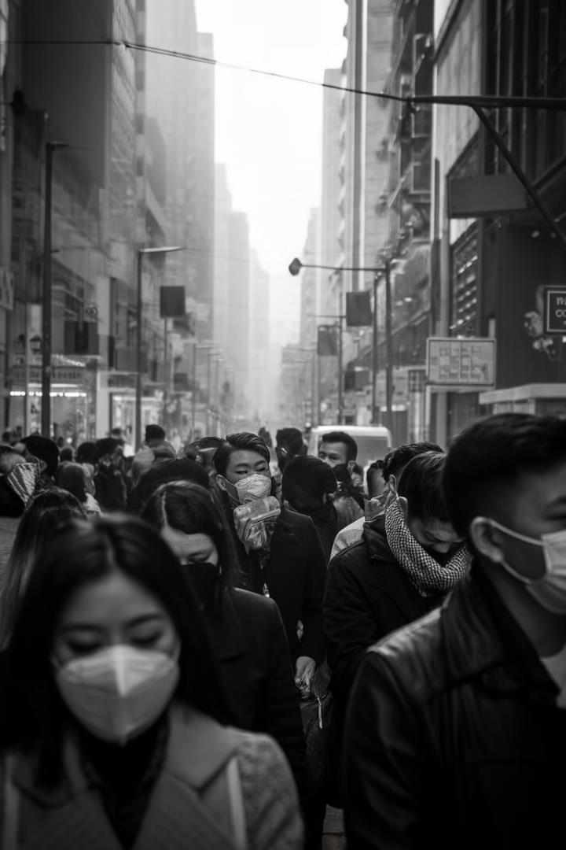
Introduction to Public Health Nuisance
1
Definition
Public health nuisance refers refers to conditions that threaten community well- being. It encompasses various forms of pollution and and contamination affecting affecting air, water, and soil.
Societal Impact
2
Legal Significance
Understanding public health health nuisance is crucial for addressing environmental hazards. It forms the basis for for regulatory frameworks and court decisions.
3
Public health nuisances affect quality of life and economic prosperity. prosperity. They pose significant challenges to urban development development and sustainability.

Slide 5

Historical Background
1
19th Century
The Industrial Revolution sparked early public health laws. The UK Public Health Act 1848 addressed sanitation and disease prevention.
2
Early 20th Century
Landmark case Rylands v Fletcher (1868) established strict liability for environmental damage. It influenced subsequent nuisance law development.
3
Post-World War II
Environmental awareness grew. The Clean Air Act 1956 responded to London's Great Smog of 1952.
4
Modern Era
Environmental Protection Act 1990 consolidated UK environmental regulations. It addressed various forms of pollution comprehensively.

Slide 6
Legal Framework
UK Legislation
EU Influence
International Agreements
Environmental Protection Act 1990 1990 is the cornerstone. It covers air, water, and land pollution. The Environment Act 2021 introduced new measures.
Despite Brexit, EU directives still shape UK environmental law. The Water Framework Directive remains influential in water management policies.
The UK is party to various international environmental treaties. treaties. These include the Paris Agreement and the Convention on on Biological Diversity.

Slide 7
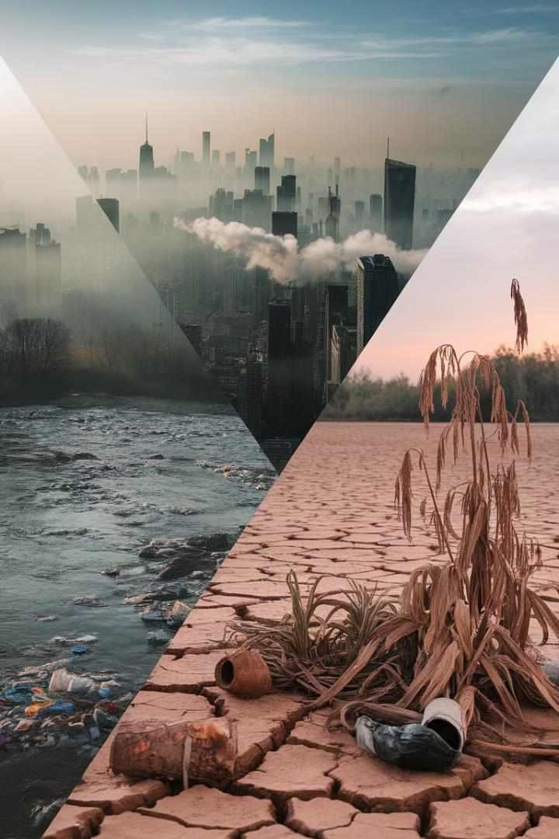
Types of Pollution
Air Pollution
Includes emissions from vehicles, industries, and households. Key pollutants are particulate matter, nitrogen dioxide, and sulphur dioxide.
Water Pollution
Encompasses contamination of rivers, lakes, and groundwater. Sources include industrial effluents, agricultural runoff, runoff, and sewage discharge.
Soil Contamination
Results from industrial activities, improper waste disposal, and and agricultural practices. It affects land use and ecosystem health.

Slide 8

Case Study: Air Pollution
1
Case: Ella Adoo-Kissi-Debrah
In 2020, a coroner ruled air pollution as a cause of death. This landmark case involved a 9-year-old girl in London.
2
Legal Implications
The ruling highlighted government's responsibility to address air pollution. It set a precedent for future environmental health cases.
3
Policy Changes
The case prompted review of air quality guidelines. It accelerated implementation of Low Emission Zones in UK UK cities.

Slide 9
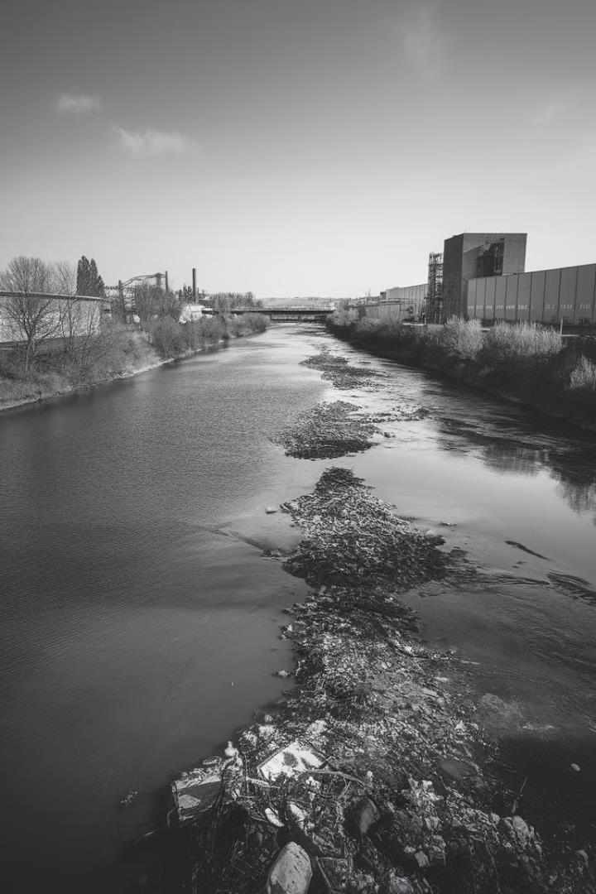

Case Study: Water Pollution
Case: Blue Circle Industries plc v Ministry of
Defence
This 1999 case involved radioactive contamination of land by the Ministry of Defence. It established liability for long-term environmental damage.
Legal Principles
The case reinforced the 'polluter pays' principle. It emphasized the importance of thorough environmental assessments in property transactions.
Ongoing Impact
The ruling influences current water pollution cases. It's particularly relevant in disputes involving historical contamination.

Slide 10

Case Study: Soil Contamination
Case Name | Corby Group Litigation v Corby District Council (2009)
 | (2009)
Issue | Birth defects linked to
 | contaminated land
 | reclamation
Ruling | Council found negligent in land reclamation practices
Impact | Strengthened duty of care in in brownfield development

Slide 11
Health Impacts of Pollution
Short-term Effects
Long-term Consequences
Vulnerable Populations
Immediate health issues include respiratory problems and skin irritations. These are often seen in cases of acute exposure to pollutants.
Chronic exposure can lead to cancer, cardiovascular diseases, and neurological disorders. The Minimata disease case in Japan illustrates long-term mercury poisoning effects.
Children, elderly, and those with pre-existing conditions are most at risk. Environmental justice issues often arise in pollution-related health impacts.

Slide 12
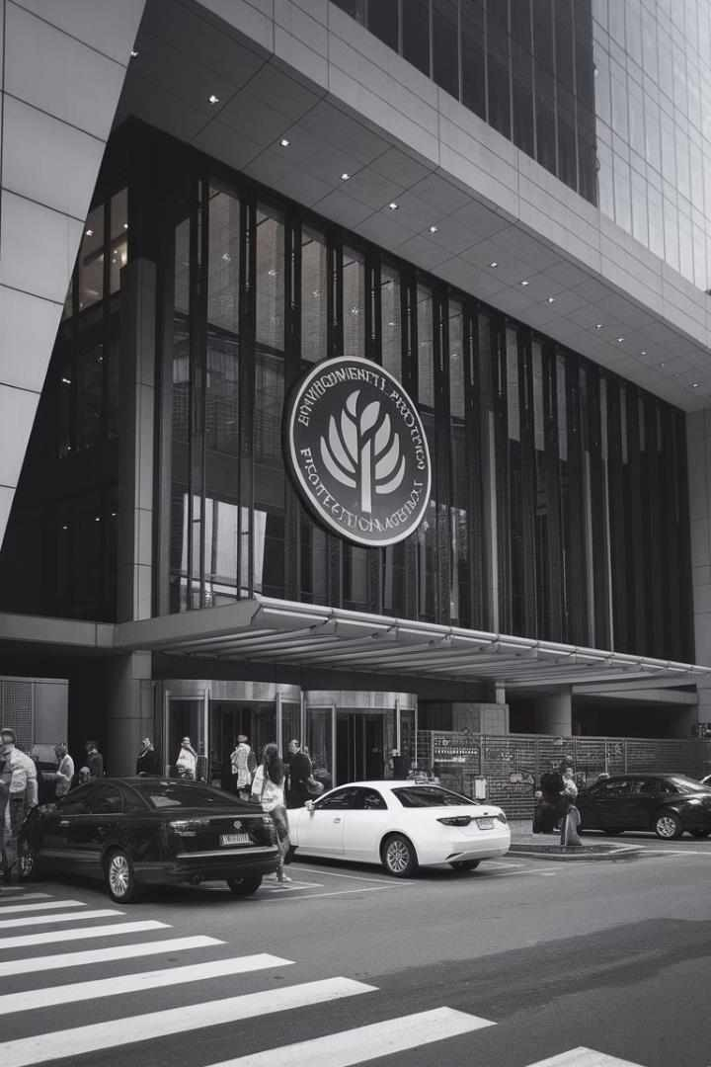



Role of Government Agencies
Environment Agency
Primary body for environmental protection in England. It enforces regulations and conducts environmental assessments.
Natural England
Focuses on nature conservation and biodiversity. It advises on environmental impact of of development projects.
Local Authorities
Play crucial role in local environmental management. They handle noise complaints and and certain pollution incidents.

Slide 13

NGOs and Activists in Environmental Law
1
Legal Challenges
NGOs like ClientEarth have successfully challenged government inaction on air pollution. Their litigation has forced policy changes.
2
Public Awareness
Organisations like Greenpeace raise public consciousness about environmental issues.
This influences public opinion and political action.
3
Policy Influence
Environmental NGOs often participate in policy consultations. They provide expertise and advocate for stronger environmental protections.

Slide 14
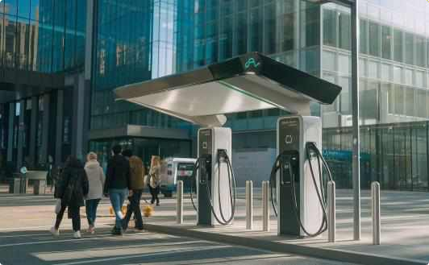
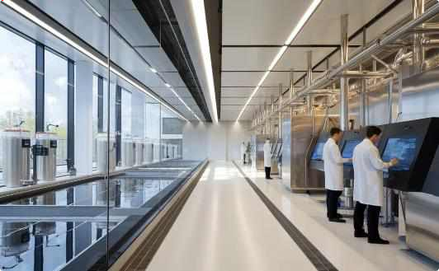
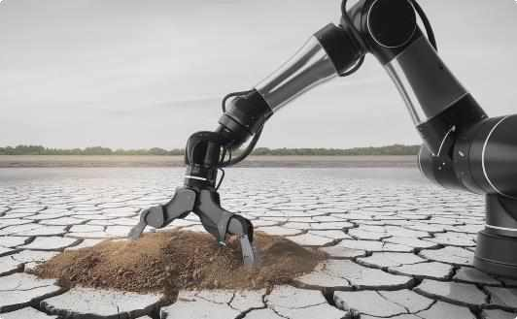
Technological Solutions to Pollution
Electric Vehicles
Widespread adoption of electric vehicles significantly reduces urban air pollution. UK plans to ban new petrol and diesel cars by 2030.
Advanced Water Treatment
Membrane technology and UV disinfection improve water quality. These technologies are increasingly used in UK water treatment plants.
Soil Remediation Tech
Bioremediation and phytoremediation phytoremediation offer eco-friendly friendly soil cleanup solutions. These These methods are gaining traction in in brownfield redevelopment projects. projects.

Slide 15


Future Trends in Public Health Nuisance Law
Climate Litigation
Expect increase in climate change-related lawsuits. Cases may target both governments and corporations for environmental damage.
AI in Environmental Monitoring
Artificial intelligence will enhance pollution detection and prediction. prediction. This may lead to more precise and timely legal interventions.
International Cooperation
Growing emphasis on transboundary pollution issues. This may result in stronger international environmental agreements and enforcement mechanisms.

Slide 16
Practical Tips for Environmental Compliance
Regular Audits
Conduct frequent environmental audits to ensure compliance. This proactive approach can prevent legal issues and reputational damage.
Staff Training
Invest in comprehensive environmental training for employees. Well-informed staff can can significantly reduce the risk of environmental violations.
Technology Integration
Implement modern environmental management systems. These can help track compliance, manage data, data, and streamline reporting processes.
Stakeholder Engagement
Maintain open communication with with local communities and regulatory bodies. This can foster goodwill and facilitate smoother operations.

Slide 17
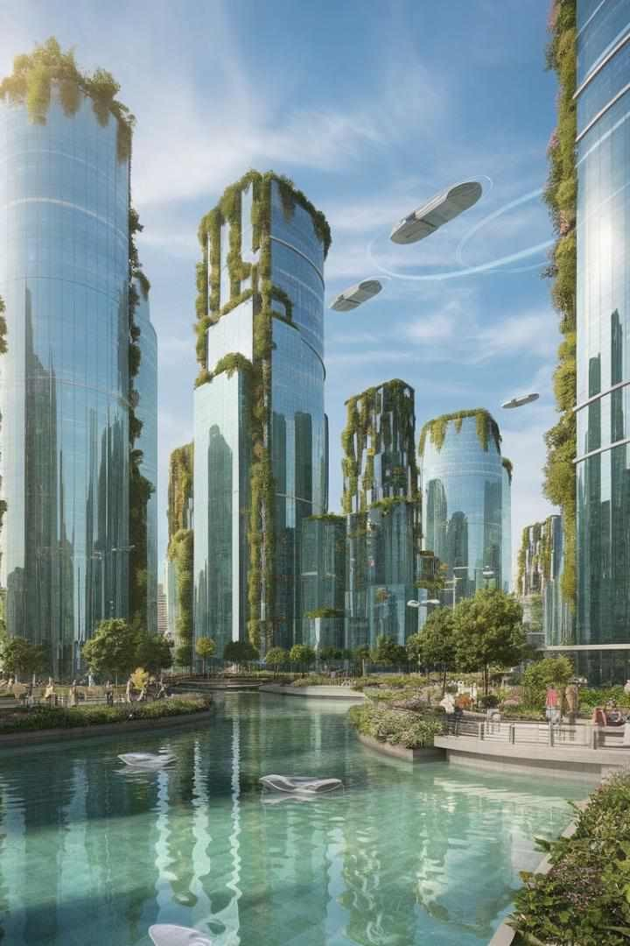
Conclusion: The Future of Environmental Health Law
1
Integrated Approach
Future environmental health law will likely adopt a more holistic approach. It will consider interconnected impacts of various pollutants on public health.
2
Preventive Focus
Emphasis will shift towards preventing environmental damage. This proactive stance stance will require new legal frameworks and enforcement enforcement mechanisms.
3
Global Collaboration
International cooperation will be crucial in addressing global environmental challenges. Harmonisation of environmental standards standards across jurisdictions may increase.

