Slide 1

Introduction
Business and Law in Hong Kong
Tutor: Okwudili O. ONWURAH, LL.B. (Nigeria); BL (Abuja, Nigeria); LLM (Exeter, UK); LLM (Qingdao, PRC); LLM (Shanghai, PRC)
PhD in Law (Hong Kong)
Dr Okwudili O. Onwurah

Slide 2

Minor House Keeping
The purpose of the online lesson is to encourage you to participate actively in achieving your needs and simplifying your legal education. I want you to be the best!
Will make the learning process more interactive discussions and feel free to ask any question or you can speak.
You have the right to choose whether to turn on your video or not.
Participation prepares you for your exam and learning needs with ease.

Slide 3
Scope of Law and Business in Hong Kong
(TEAC²H or C²HEAT)
Tort
Law
Employment Law
Contract Law
Commercial Law
Hong Kong Legal System
Alternative Dispute Resolution (ADR)

Slide 4

Why Law and Business?
Do you think Law is relevant to Business? Why?
  To be a business lawyer?
  To think like a lawyer? To know how to ask questions or perhaps legal questions?
  To know all the laws? Is that possible?
  To know your rights and duties as a businessperson?
  To gain insight and understanding of legal analysis methodology systematically? Most important!

Slide 5
‘IRAC’ or ‘IPAC’
IRAC is an acronym that generally stands for:
  Issue,
  Rule,
  Application/Analysis, and
  Conclusion.
It functions as a methodology for legal analysis. It is often used in procedural law application.
The IRAC format is mostly used in hypothetical (problem) questions in law school and bar exams.
It can also be referred to as IPAC where the P stands for ‘principles’
Some criticized it because of its
  strict and unwieldy format, and
  oversimplifying of the complexity of proper legal analysis.

Slide 6
I = ‘Issue(s)’ (Legal)
An issue is a legal question involved in a case.
There can be more than one legal issue in a case.
Knowledge of legal rules and principles is paramount in determining the existence of a legal issue.
Courts of Common Law jurisdictions uses the identification of legal issues in proper determination of a case.

Slide 7
R = ‘Rule(s)’ or ‘Principle(s)’
The rule section of an IRAC is the statement of the rules pertinent in deciding the issue stated.
Rules or principles are the laws as contained primarily in;
  Statutes/Constitution/Legislations,
  Case laws or Precedents (Judicial Decisions) based on the doctrine of stare decisis.
There are other sources of rules like the Secondary sources of law, e.g. Commentaries on a Statute, authoritative literatures like Black’s Law Dictionary.
Other sources may include Rules of Court on procedures.
The rules help you to make a correct legal analysis of the issue at hand using the facts of the case.
The rules section needs to be a legal summary of all the rules.

Slide 8

A = ‘Application’/ ‘Analysis’
The Application (or Analysis) applies the rules to the specific facts of the issue at hand.
It uses only the rules stated in the rules section of the IRAC and usually utilizes all the rules stated including exceptions as is required by the analysis.
It is important in this section to apply the rules to the facts of the case and explain or argue why a particular rule applies or does not apply in the case presented.
The application/analysis section is the most important section of an IRAC because it develops the answer to the issue at hand. (ADD YOUR OPINION OR VIEWS)
It is useful to think like a lawyer, arguing the facts of the matter from both sides while sticking to the rules before coming to a decision.

Slide 9


C = ‘Conclusion’
The Conclusion directly answers the question presented in the issue section of the IRAC.
It is important for the methodology of the IRAC that the conclusion section of the IRAC does not introduce any new rules or analysis.
This section restates the issue and provides the final answer in a summary manner or two to three sentences.

Slide 10
Sample IRAC
“(I) Whether a bailment for the mutual benefit of Rough & Touch and Howard existed?
(R) A pawn is a form of bailment, made for the mutual benefit of bailee and bailor, arising when goods are delivered to another as a pawn for security to him on money borrowed by the bailor. Jacobs v. Grossman, 141 N.E. 714, 715 (III. App.Ct. 1923). In Jacobs, the court found that a bailment for mutual benefit did arise because the plaintiff pawned a ring as collateral for a $70 loan given to him by the defendant. Id.
(A) In our problem, Howard pawned her ring as collateral to secure an $800 loan given to her by Rough & Tough. This satisfies the rules requirement in my view.
(C) Therefore, Howard and Rough & Tough probably created a bailment for mutual benefit."
(Cite: Hope Viner Samborn and Andrea B. Yelin, Basic Legal Writing for Paralegals, 3rd ed. Aspen, 2010)

Slide 11
Case Summary
Citation
Case Facts
Legal Issues (usually more than one issues in a case)
Legal Principle
Key Statutes (if available)
Common Law system: Case Law (Judge-Made law)

Slide 12
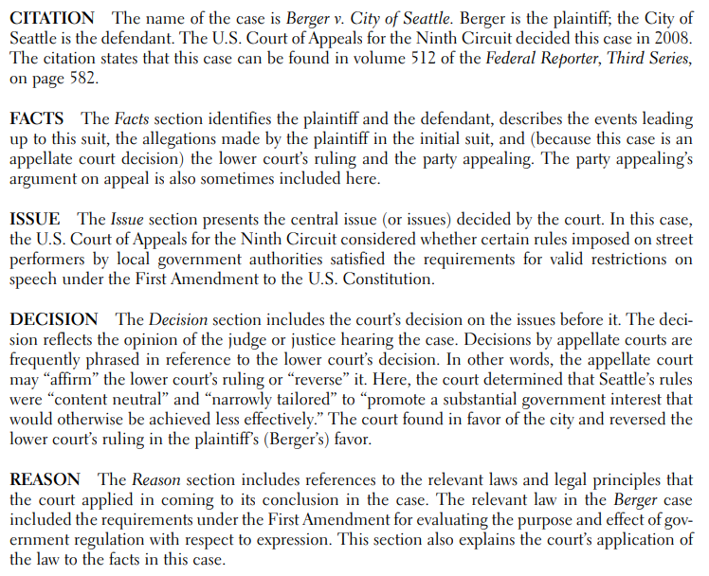
Case Summary Example

Slide 13

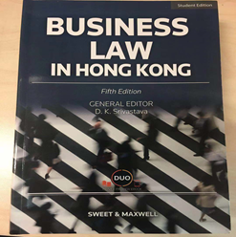
Recommendations/ Tips
Practise Case Summary
Adopt a Clear & Succinct Legal Writing Style
Use Proper Citation (e.g. OSCOLA for Law)
Law Resources (Can access from CityU if you can or from other schools)
  Law Databases: (http://lbsystem.lib.cityu.edu.hk/ereslist/index.php?type=db&format=subj&subj=law)
  Law Library Workshops: (http://www.cityu.edu.hk/lib/instruct/course/law.htm)
Further Reading on IRAC: Chris Iijima and Beth Cohen, ‘Reflections of IRAC’ (1995) Western New England University School of Law, The Second Draft (The Legal Writing Institute) Nov. 9 <https://digitalcommons.law.wne.edu/facschol/118/>

