Slide 1

The Doctrine of Vicarious Liability:
Historical Development and Modern Applications
Tutor: Okwudili O. ONWURAH, LL.B. (Nigeria); BL (Abuja, Nigeria); LLM (Exeter, UK); LLM (Qingdao, PRC); LLM (Shanghai, PRC)
PhD in Law (Hong Kong)
Dr Okwudili O. Onwurah

Slide 2
Minor House Keeping
The purpose of the online lesson is to encourage you to participate actively in achieving your needs and simplifying your legal education. I want you to be the best!
Will make the learning process more interactive discussions and feel free to ask any question or you can speak.
You have the right to choose whether to turn on your video or not.
Participation prepares you for your exam and learning needs with ease.

Slide 3

Introduction
Welcome to this comprehensive exploration of vicarious liability in tort law. This presentation will guide you through the historical roots, key developments, and modern applications of this complex legal doctrine. We'll examine landmark cases from English and Hong Kong courts, analyse statutory frameworks, and consider academic critiques. By the end, you'll have a thorough understanding of how vicarious liability has evolved and its significance in contemporary legal practice.

Slide 4

Definition of Vicarious Liability
Core Concept
Legal Rationale
Vicarious liability is a principle in tort law where one party, typically an employer, is held responsible for the wrongful acts of another, usually an employee, even if the first party is not directly at fault.
This doctrine is based on the idea that the party with control over the situation and the ability to prevent harm should bear responsibility for any resulting damages.
Policy Considerations
Scope
Vicarious liability serves to ensure that victims have recourse to compensation from parties with deeper pockets, and to incentivise employers to maintain safe practices.
While traditionally applied to employer-employee relationships, the doctrine has expanded to cover various other relationships in modern jurisprudence.

Slide 5

Historical Roots: Master-Servant Relationship
1
Ancient Origins
The concept of vicarious liability can be traced back to Roman law, where the head of a household (paterfamilias) was held responsible for the actions of family members and slaves.
2
Medieval Development
In medieval England, the doctrine evolved within the context of the feudal system, where lords were sometimes held accountable for the actions of their vassals.
3
Industrial Revolution
The master-servant relationship became more prominent during the Industrial Revolution, as employers were increasingly held liable for injuries caused by their employees in the course of employment.
4
Modern Adaptation
The doctrine has since been refined and expanded to adapt to changing social and economic realities, moving beyond the traditional master-servant framework.

Slide 6
Early Case Law: Quarman v Burnett (1840)
Case Background
Legal Issue
Court's Decision
Quarman v Burnett (1840) 6 M&W 499 is a seminal case in the development of vicarious liability. The case involved a coachman who negligently injured a third party while driving a carriage for his employers, the Burnetts.
The court had to determine whether the Burnetts could be held liable for the coachman's negligence, even though he was not their permanent employee but hired from a stable keeper.
The court ruled that the Burnetts were not vicariously liable, as they did not have sufficient control over the coachman. This decision established the importance of control as a key factor in determining vicarious liability.

Slide 7
Modern Expansion: Lister v Hesley Hall Ltd (2001)
1
Case Overview
2
Legal Innovation
Lister v Hesley Hall Ltd [2001] UKHL 22 marked a significant expansion of vicarious liability in English law. The case involved sexual abuse committed by a warden at a boarding school against students.
The House of Lords introduced the "close connection" test, which expanded the scope of vicarious liability beyond acts done in the course of employment to include those closely connected to the employee's duties.
3
Reasoning
4
Impact
Lord Steyn argued that the traditional "course of employment" test was too narrow and failed to address modern workplace realities and the need for victim protection.
This decision significantly broadened the circumstances under which employers could be held vicariously liable, particularly in cases of intentional wrongdoing by employees.

Slide 8

Statutory Frameworks in Hong Kong and the UK
Jurisdiction
Key Legislation
Notable Provisions
Hong Kong
Occupiers Liability Ordinance (Cap. 314)
Imposes vicarious liability on occupiers for acts of independent contractors
Hong Kong
Employees' Compensation Ordinance (Cap. 282)
Establishes employer liability for work-related injuries
UK
Employers' Liability (Compulsory Insurance) Act 1969
Requires employers to insure against liability for employee injuries
UK
Equality Act 2010
Extends vicarious liability to discrimination cases

Slide 9




Key Principles: Control, Relationship, and Connection
Control
The degree of control an employer exercises over an employee's actions remains a crucial factor in determining vicarious liability. This includes the power to direct how work is performed and the ability to prevent misconduct.
Relationship
The nature of the relationship between the parties is essential. Courts consider factors such as integration into the organisation, financial arrangements, and the mutuality of obligations to determine if a relationship gives rise to vicarious liability.
Connection
Following Lister v Hesley Hall Ltd, courts assess whether there is a sufficiently close connection between the wrongful act and the employee's duties. This principle has expanded vicarious liability to cover a wider range of scenarios.

Slide 10





The Doctrine's Evolution in the Gig Economy
Traditional Employment
Vicarious liability traditionally applied to clear employer-employee relationships with defined roles and responsibilities.
Rise of Gig Economy
The emergence of platform-based work and independent contractors has challenged traditional notions of employment and liability.
Legal Challenges
Courts have grappled with applying vicarious liability to gig economy relationships, considering factors like control, integration, and economic reality.
Adaptive Jurisprudence
Recent cases have shown a willingness to extend vicarious liability to some gig economy scenarios, adapting the doctrine to modern work arrangements.

Slide 11
Academic Critique of Vicarious Liability
Theoretical Foundations
Economic Efficiency
Fairness and Justice
Some scholars argue that vicarious liability lacks a coherent theoretical basis, criticising its development as ad hoc and policy-driven rather than principled.
Proponents of law and economics approaches debate whether vicarious liability promotes efficient risk allocation or creates perverse incentives in the labour market.
Critics question the fairness of holding parties liable for acts they did not commit, while supporters argue it ensures just compensation for victims and incentivises proper supervision.

Slide 12

Quiz: Vicarious Liability Basics
Question 1
Question 2
What is the primary rationale behind the doctrine of vicarious liability?
In which landmark case was the "close connection" test established?
Question 3
Question 4
Name two key factors courts consider when determining vicarious liability.
How has the gig economy challenged traditional notions of vicarious liability?

Slide 13
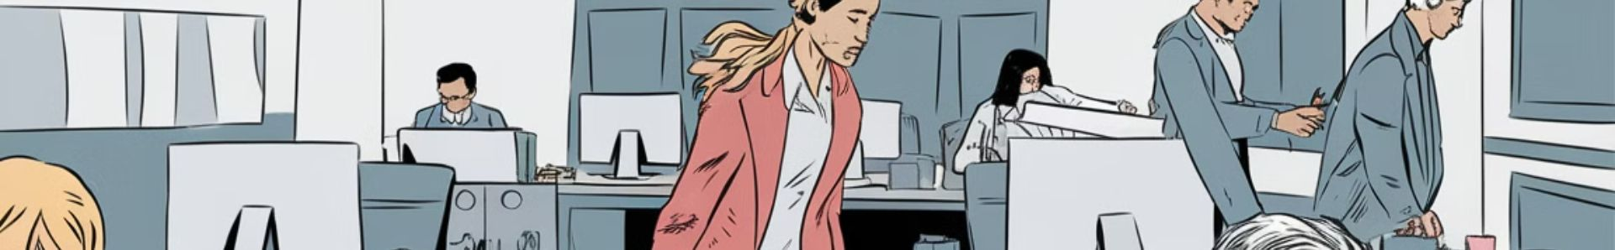
Case Study: Vicarious Liability in Practice
Incident
1
An employee at a financial firm inappropriately accesses and leaks sensitive client data.
2
Legal Action
Affected clients sue both the employee and the firm for damages resulting from the data breach.
Court Analysis
3
The court applies the "close connection" test to determine if the firm should be held vicariously liable.
4
Judgment
The firm is found vicariously liable due to the close connection between the employee's duties and the wrongful act.

Slide 14

Vicarious Liability in Hong Kong: Unique Aspects
1
Legal System
2
Statutory Innovations
Hong Kong's common law system, inherited from British rule, provides a familiar framework for vicarious liability, but with unique local developments.
The Occupiers Liability Ordinance extends vicarious liability to cover acts of independent contractors, going beyond traditional employer-employee relationships.
3
Case Law
4
Cultural Considerations
Hong Kong courts have shown a willingness to consider UK precedents while developing their own jurisprudence, as seen in cases like Yeung Mei Hoi v Tam Cheuk Shing [2015] HKCFA 109.
Hong Kong's unique business culture and employment practices sometimes require courts to adapt vicarious liability principles to local contexts.

Slide 15
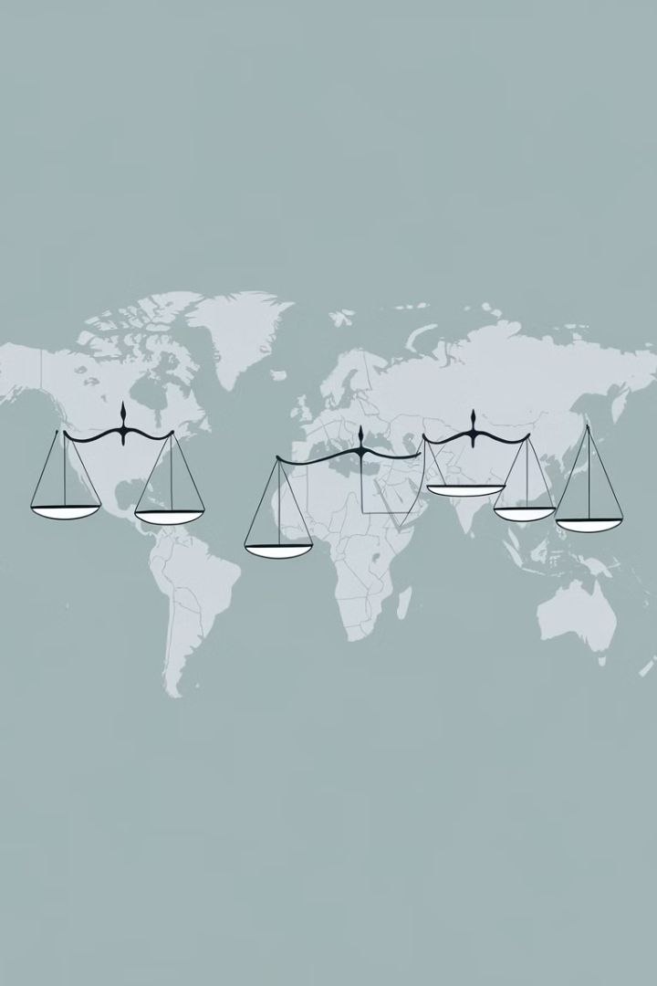
Comparative Analysis: Vicarious Liability Across Jurisdictions
Jurisdiction
Approach to Vicarious Liability
Notable Differences
England and Wales
Broad application, "close connection" test
Expansive interpretation in recent years
Hong Kong
Similar to UK, with local statutory additions
Extended to some independent contractor scenarios
United States
Varies by state, often more limited
Greater emphasis on "scope of employment"
Civil Law Countries
Often codified in civil codes
May have stricter limits on application

Slide 16





Future Trends in Vicarious Liability
Gig Economy Adaptation
Courts and legislators will likely continue to grapple with applying vicarious liability to platform-based work and other non-traditional employment relationships.
AI and Automation
The increasing use of AI and automated systems in workplaces may lead to new questions about vicarious liability for algorithmic decision-making and robot-caused harm.
Global Harmonisation
As businesses become more international, there may be efforts to harmonise vicarious liability principles across jurisdictions to provide greater certainty for multinational corporations.
Statutory Reform
Some jurisdictions may consider statutory reforms to codify or modify vicarious liability principles in light of changing social and economic realities.

Slide 17
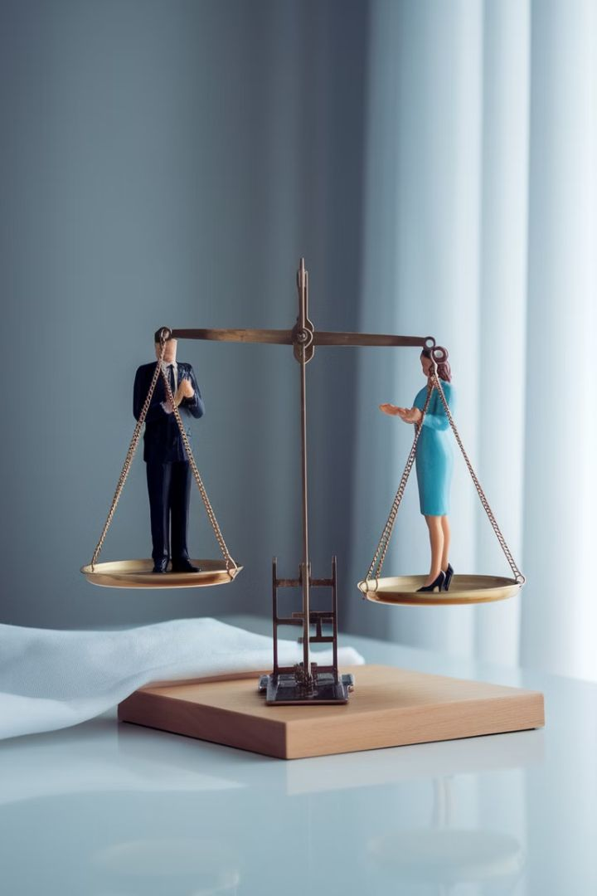
Conclusion: The Enduring Relevance of Vicarious Liability
Legal Evolution
Policy Objectives
The doctrine of vicarious liability has shown remarkable adaptability, evolving from its roots in master-servant relationships to address complex modern scenarios.
Despite criticism, vicarious liability continues to serve important policy objectives, including victim compensation and the promotion of responsible business practices.
Future Challenges
Practical Importance
As work relationships and technologies change, the doctrine will face new challenges, requiring ongoing legal innovation and careful judicial consideration.
Understanding vicarious liability remains crucial for legal professionals, businesses, and policymakers in navigating the complex landscape of tort law and employment relations.

