Slide 1

Vicarious Liability in the Digital Age:
Social Media and Online Conduct
Tutor: Okwudili O. ONWURAH, LL.B. (Nigeria); BL (Abuja, Nigeria); LLM (Exeter, UK); LLM (Qingdao, PRC); LLM (Shanghai, PRC)
PhD in Law (Hong Kong)
Dr Okwudili O. Onwurah

Slide 2
Minor House Keeping
The purpose of the online lesson is to encourage you to participate actively in achieving your needs and simplifying your legal education. I want you to be the best!
Will make the learning process more interactive discussions and feel free to ask any question or you can speak.
You have the right to choose whether to turn on your video or not.
Participation prepares you for your exam and learning needs with ease.

Slide 3

Introduction
As we navigate the complexities of the digital age, the legal concept of vicarious liability has expanded into uncharted territories. This presentation explores how social media and online conduct have reshaped employer responsibilities, examining key cases and legal frameworks in the UK and Hong Kong. We'll delve into the challenges faced by employers in managing employee conduct in the virtual realm and provide practical guidance for mitigating risks in this ever-evolving landscape.

Slide 4

Expansion of Vicarious Liability into Online Activities
1
Traditional Scope
Historically, vicarious liability applied to physical workplace conduct and actions taken in the course of employment.
2
Digital Transition
With the rise of the internet and social media, the boundaries of the workplace have blurred, extending potential liability to online spaces.
3
Current Landscape
Courts now grapple with applying vicarious liability principles to employee conduct on social media platforms and other digital forums.
4
Future Implications
As technology evolves, the scope of vicarious liability is likely to expand further, potentially encompassing virtual and augmented reality workspaces.

Slide 5
Employee Misconduct on Social Media Platforms
Types of Misconduct
Legal Implications
Challenges
Defamatory posts
Employers may be held liable for employee actions on social media if there's a sufficient connection to the workplace or if the conduct occurs during work hours or using company resources.
Determining the extent of employer control over personal social media accounts and balancing employee privacy rights with employer interests.
Confidentiality breaches
Harassment or bullying
Reputational damage

Slide 6
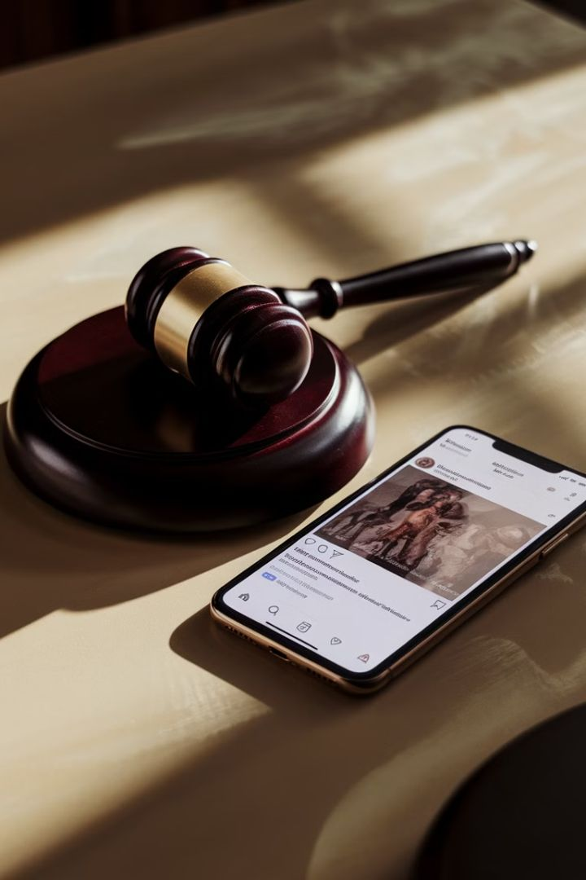
Case Law: Otomewo v Carphone Warehouse Ltd (2012)
1
Case Overview
2
Tribunal Decision
Mr. Otomewo's colleagues posted a status update on his Facebook page without his permission, stating he was gay when he was not. This occurred at work using his phone.
The Employment Tribunal held that Carphone Warehouse was vicariously liable for the harassment suffered by Mr. Otomewo due to his colleagues' actions.
3
Legal Reasoning
4
Implications
The tribunal found that the act was done in the course of employment, as it occurred at the workplace during working hours using company property.
This case set a precedent for employer liability in social media misconduct cases, emphasising the importance of clear workplace policies on social media use.

Slide 7

Hong Kong's Personal Data (Privacy) Ordinance
Scope of the Ordinance
Employer Obligations
The Personal Data (Privacy) Ordinance (PDPO) regulates the collection, use, and handling of personal data in Hong Kong, including online activities.
Employers must ensure compliance with data protection principles when handling employee and customer data, including on social media platforms.
Vicarious Liability Implications
Recent Amendments
Employers may be held vicariously liable for employee breaches of the PDPO if proper safeguards and policies are not in place.
The 2021 amendments to the PDPO introduced new offences related to doxxing, potentially expanding the scope of vicarious liability for online misconduct.

Slide 8
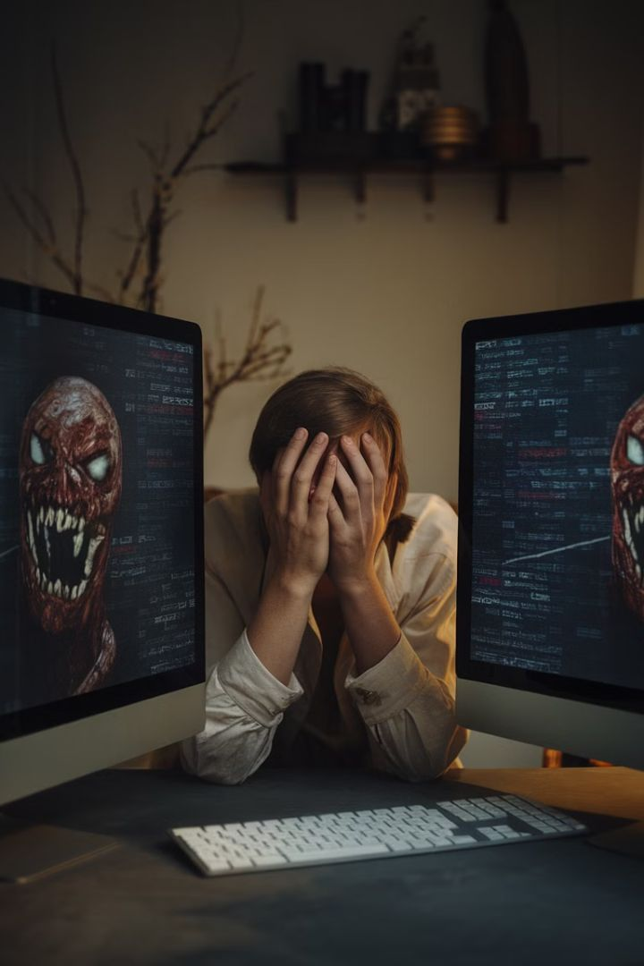
Employer Liability for Cyberbullying or Harassment
1
Pre-Digital Era
Workplace bullying and harassment were largely confined to physical spaces, making it easier for employers to monitor and prevent.
2
Rise of Cyberbullying
With the advent of social media and digital communication, bullying and harassment have extended into online spaces, blurring the lines between work and personal life.
3
Legal Developments
Courts have begun to recognise employer liability for online harassment, as seen in cases like Teggart v TeleTech UK Ltd (2012), where an employee was dismissed for Facebook posts harassing a colleague.
4
Future Outlook
As virtual workspaces become more common, employers may face increased liability for digital interactions, necessitating robust policies and monitoring systems.

Slide 9





Practical Guidelines for Social Media Policies
Clear Documentation
Employee Training
Develop a comprehensive, easily accessible social media policy that outlines acceptable online behaviour and potential consequences for violations.
Conduct regular training sessions to educate employees on responsible social media use and the potential impact of their online actions on the company.
Monitoring Systems
Regular Updates
Implement ethical monitoring practices to identify potential policy violations while respecting employee privacy rights.
Review and update social media policies regularly to address emerging platforms and evolving legal standards in the digital landscape.

Slide 10
Challenges in Distinguishing Personal vs. Professional Conduct
Blurred Boundaries
Legal Considerations
Employee Privacy Rights
The integration of work and personal life on social media platforms makes it difficult to clearly delineate between professional and private conduct.
Courts must consider factors such as the nature of the post, its connection to employment, and the potential impact on the employer's reputation when determining liability.
Balancing employer interests with employee rights to privacy and freedom of expression presents ongoing challenges in crafting and enforcing social media policies.

Slide 11





Mitigating Risks of Online Vicarious Liability
Risk Assessment
Conduct thorough risk assessments to identify potential areas of vulnerability in online employee conduct and social media use.
Policy Implementation
Develop and implement comprehensive social media and online conduct policies tailored to your organisation's specific needs and risk profile.
Training and Awareness
Provide regular training sessions and awareness campaigns to ensure all employees understand their responsibilities and the potential consequences of online misconduct.
Monitoring and Enforcement
Establish ethical monitoring practices and consistent enforcement procedures to address policy violations promptly and fairly.
Legal Consultation
Seek regular legal advice to stay informed of evolving case law and regulatory changes affecting online vicarious liability.

Slide 12
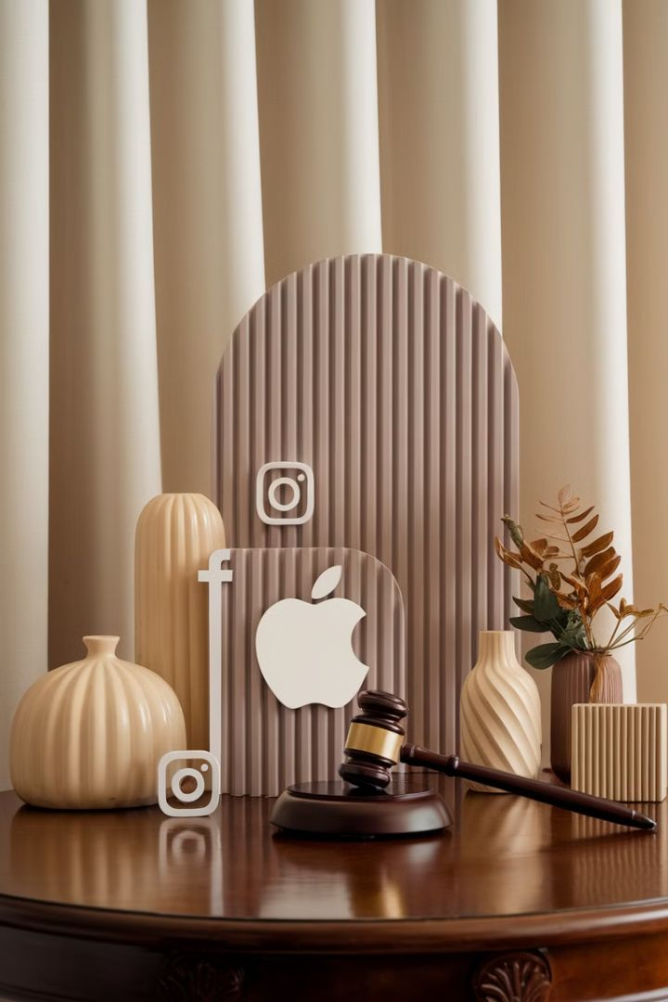
Case Study Analysis: Crisp v Apple Retail UK Limited (2011)
Background
Company Action
Mr. Crisp, an Apple employee, made derogatory comments about Apple products on Facebook, visible to his friends list which included colleagues.
Apple dismissed Mr. Crisp for gross misconduct, citing violation of social media policy and potential reputational damage.
Legal Outcome
Implications
The Employment Tribunal upheld Apple's decision, finding that the dismissal was fair given the clear social media policy and potential harm to Apple's reputation.
This case highlights the importance of clear social media policies and the potential consequences of employee online conduct, even on personal accounts.

Slide 13

Case Study Analysis: Williams v Maxis Noodles Ltd (2018)
1
Incident
A Maxis Noodles employee posted racist comments on their personal Facebook page, which were reported to the company by a customer.
2
Company Response
Maxis Noodles conducted an investigation and subsequently dismissed the employee for gross misconduct.
3
Employee Claim
The employee filed an unfair dismissal claim, arguing that the posts were made outside of work hours on a personal account.
4
Tribunal Decision
The Employment Tribunal ruled in favour of Maxis Noodles, finding that the dismissal was fair given the potential reputational damage and clear social media policy.

Slide 14
Case Study Analysis: Forbes v LHR Airport Ltd (2019)
Incident Details
Legal Question
Court Decision
An LHR Airport employee shared an offensive image on Facebook, which was later shown to a colleague at work who was offended and raised a formal grievance.
The key issue was whether the employer could be held vicariously liable for the employee's conduct on a personal Facebook account outside of work hours.
The Employment Appeal Tribunal found that LHR Airport was not vicariously liable, as the Facebook post was not made in the course of employment.

Slide 15
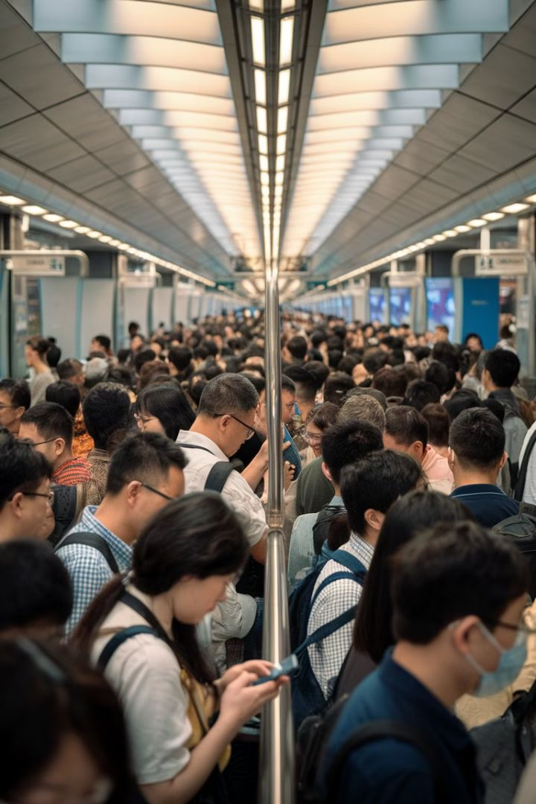
Case Study Analysis: Hong Kong Case: Leung v MTR Corporation Ltd (2015)
1
Background
2
Company Action
An MTR employee posted confidential information about train schedules and operational issues on a public forum, leading to public criticism of the company.
MTR Corporation terminated the employee's contract, citing breach of confidentiality and damage to the company's reputation.
3
Legal Proceedings
4
Tribunal Decision
The employee challenged the dismissal in the Labour Tribunal, arguing that the posts were made with the intent to improve public services.
The Labour Tribunal upheld MTR's decision, emphasising the importance of maintaining confidentiality and the potential harm caused by unauthorised disclosures on social media.

Slide 16
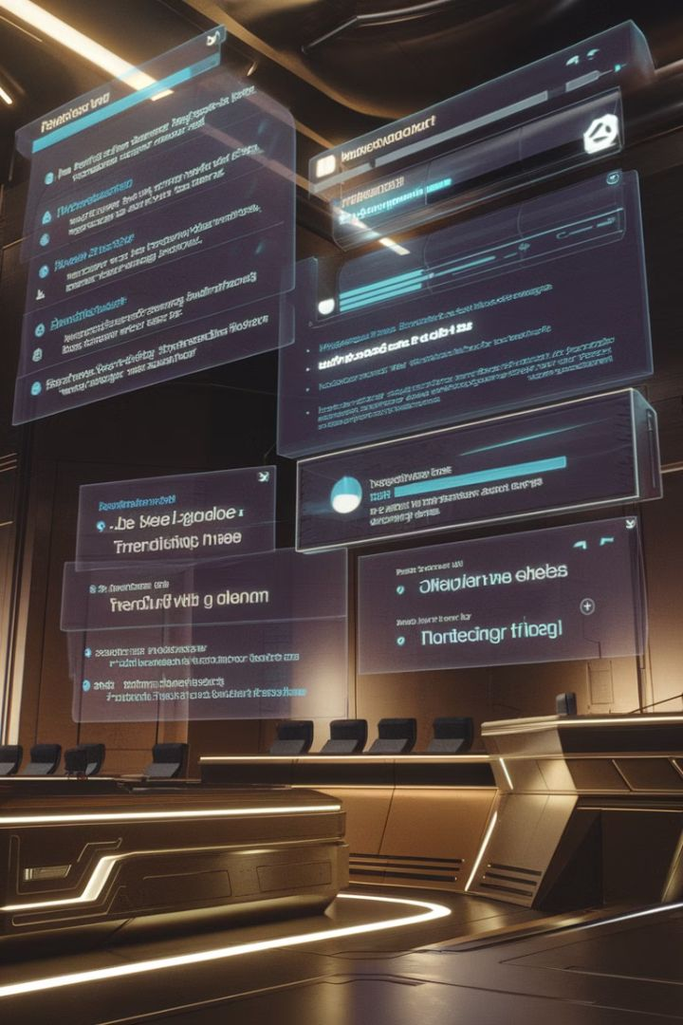




Emerging Trends in Online Vicarious Liability
AI and Automation
Global Workforce
The rise of AI-driven social media management tools may create new challenges in determining liability for automated posts or interactions.
With remote work becoming more common, employers face increased complexity in managing online conduct across different jurisdictions and cultural norms.
Virtual Reality
Blockchain and Decentralisation
As virtual and augmented reality platforms become more prevalent in the workplace, new forms of online misconduct may emerge, requiring novel approaches to vicarious liability.
The growth of decentralised social media platforms may challenge traditional notions of employer control and liability in the digital space.

Slide 17
Conclusion: The Future of Vicarious Liability in the Digital Age
Evolving Legal Landscape
Proactive Risk Management
As technology continues to advance, courts and legislators will need to adapt vicarious liability principles to address new forms of online conduct and emerging digital platforms.
Employers must stay vigilant and proactive in developing comprehensive social media policies, training programmes, and monitoring systems to mitigate the risks of online vicarious liability.
Balancing Interests
Global Harmonisation
The challenge for legal systems will be to strike a balance between protecting employer interests, safeguarding employee rights, and addressing the realities of an increasingly digital workplace.
As online interactions transcend geographical boundaries, there may be a need for greater international cooperation and harmonisation of vicarious liability standards in the digital realm.

