Slide 1

Vicarious Liability in Sports: Legal Responsibilities of Teams and Coaches
Tutor: Okwudili O. ONWURAH, LL.B. (Nigeria); BL (Abuja, Nigeria); LLM (Exeter, UK); LLM (Qingdao, PRC); LLM (Shanghai, PRC)
PhD in Law (Hong Kong)
Dr Okwudili O. Onwurah

Slide 2
Minor House Keeping
The purpose of the online lesson is to encourage you to participate actively in achieving your needs and simplifying your legal education. I want you to be the best!
Will make the learning process more interactive discussions and feel free to ask any question or you can speak.
You have the right to choose whether to turn on your video or not.
Participation prepares you for your exam and learning needs with ease.

Slide 3
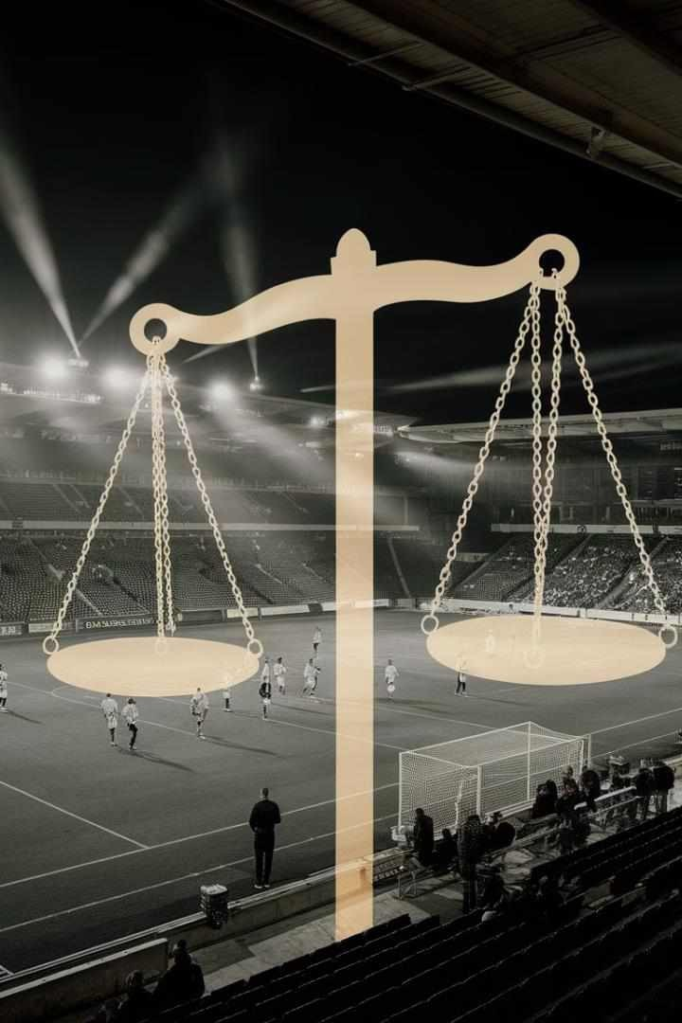
Introduction
The intersection of sports and law presents a complex landscape of legal responsibilities, particularly in the realm of vicarious liability. This presentation delves into the intricate web of legal obligations that teams and coaches face for the actions of their players and staff. We'll explore landmark cases, analyse practical examples, and discuss emerging trends in this dynamic field of sports law. Join us as we unravel the legal intricacies that shape the responsibilities of sports organisations and individuals, providing valuable insights for law students, legal professionals, and academics interested in tort law and sports jurisprudence.

Slide 4
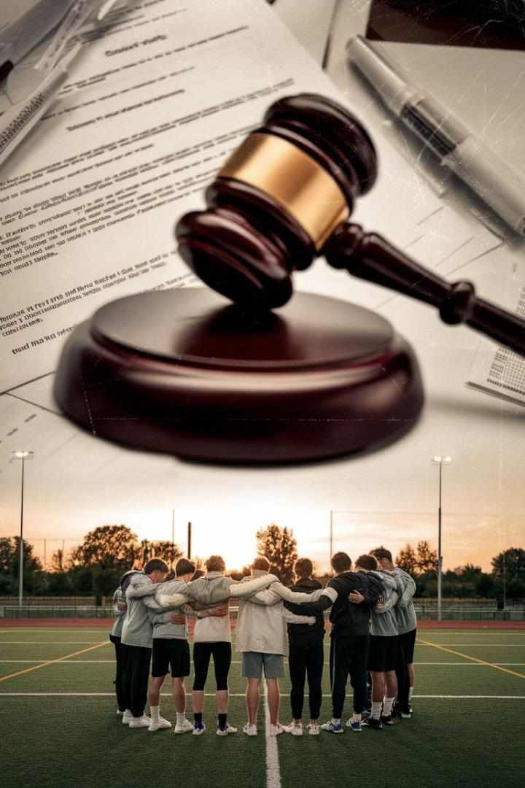
Application of Vicarious Liability in Sports
1
Historical Context
Vicarious liability in sports has evolved from early 20th-century cases, where courts were reluctant to impose liability on teams for player actions, to the modern era where a more nuanced approach is taken.
2
Modern Application
Today, vicarious liability in sports is applied based on the principle of 'course of employment'. Teams and organisations may be held liable for actions that occur within the scope of an athlete's or coach's duties.
3
Future Trends
The future of vicarious liability in sports is likely to see increased focus on mental health issues, off-field conduct, and the expanding role of technology in sports management and performance.

Slide 5
Legal Responsibilities of Teams for Player Actions
On-Field Conduct
Teams may be held liable for injuries caused by their players during matches if the actions go beyond the normal course of play. This includes deliberate fouls or reckless behaviour that falls outside the rules of the game.
Off-Field Behaviour
Organisations can be responsible for player conduct off the field if it's connected to their employment. This might include actions at team events or while representing the team in public appearances.
Training and Supervision
Teams have a duty to properly train and supervise players, which extends to ensuring they understand the rules and safety protocols of the sport. Failure to do so could result in liability for resulting injuries or misconduct.
Equipment and Facilities
Organisations are responsible for providing safe equipment and facilities. Liability may arise if injuries occur due to faulty gear or poorly maintained playing surfaces.

Slide 6
Case Law: Vowles v Evans and Welsh Rugby Union Ltd (2003)
Case Background
Court's Decision
Impact on Sports Law
In this landmark case, Richard Vowles suffered severe spinal injuries during an amateur rugby match. The injury occurred when a scrum collapsed, and Vowles alleged negligence against the referee, David Evans, and the Welsh Rugby Union (WRU).
The Court of Appeal held that the WRU was vicariously liable for the referee's negligence. The court found that the referee had failed to ensure the safety of the players by allowing the match to continue with inexperienced players in key positions in the scrum.
This case set a precedent for vicarious liability in sports, establishing that governing bodies can be held responsible for the actions of match officials. It emphasised the duty of care owed by referees and the organisations that appoint them.

Slide 7

Liability for Coach Misconduct: Various Claimants v Barry Bennell
1
Case Background
Barry Bennell, a former youth football coach, was convicted of numerous sexual offences against young players. Several claimants brought a case against Manchester City Football Club, alleging vicarious liability for Bennell's actions.
2
Court's Decision
The High Court ruled that Manchester City was vicariously liable for the abuse committed by Bennell. The court found that there was a sufficiently close connection between Bennell's role and the abuse he perpetrated.
3
Legal Implications
This case expanded the scope of vicarious liability in sports, demonstrating that clubs can be held responsible for the criminal actions of individuals associated with them, even if not directly employed.

Slide 8
Practical Examples: Liability for Injuries During Games
1
Reckless Tackles in Football
In cases where a player commits a reckless tackle that goes beyond the normal course of play, the team may be held vicariously liable for any resulting injuries. This was exemplified in the case of Mohd Raimi bin Jaafar v Sarawak Football Association (2015), where the Malaysian court held the football association liable for a player's dangerous tackle.
2
Concussions in Rugby
Rugby unions and clubs may face liability for long-term effects of concussions if they fail to follow proper protocols. The ongoing class action against World Rugby, the Rugby Football Union, and the Welsh Rugby Union by former players with early-onset dementia highlights this issue.
3
Equipment Failures in Cycling
Cycling teams could be held liable for injuries resulting from faulty equipment. In a hypothetical scenario, if a professional cyclist suffers an injury due to a poorly maintained bike, the team might be held responsible for failing to ensure the safety of their equipment.

Slide 9
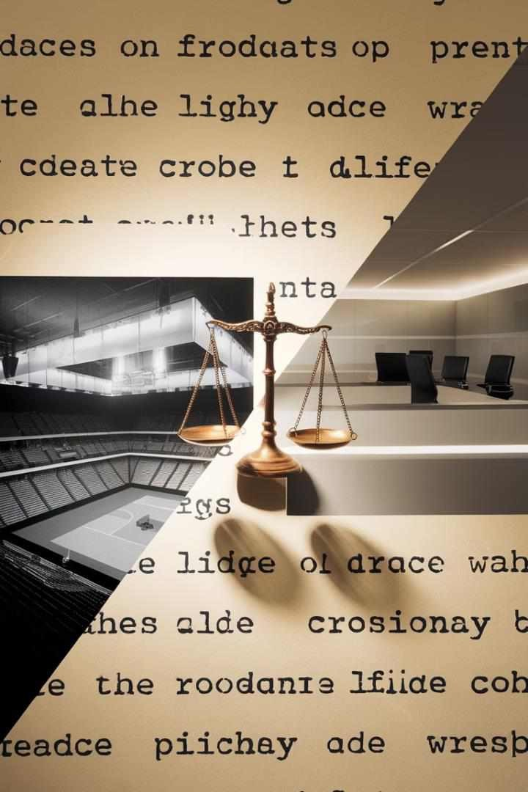
Comparison with Other Industries
Industry | Vicarious Liability Application | Key Differences from Sports
Corporate Sector | Employers liable for employee actions within scope of employment | Less physical risk, more focus on financial misconduct
Healthcare | Hospitals liable for medical staff negligence | Higher standard of care, more regulated environment
Education | Schools responsible for teacher misconduct | Duty of care extends to minors, focus on safeguarding
Transportation | Companies liable for driver actions | Strict regulations, focus on public safety

Slide 10




Risk Mitigation for Sports Organisations
Comprehensive Insurance Coverage
Clear Policies and Procedures
Implementing and enforcing clear codes of conduct, safety protocols, and disciplinary procedures can help mitigate risks and demonstrate due diligence in case of legal challenges.
Regular Training and Education
Conducting ongoing training sessions for players, coaches, and staff on legal responsibilities, ethical conduct, and safety measures can reduce the likelihood of incidents leading to liability.
Legal Audits and Compliance Checks
Sports organisations should secure robust insurance policies that cover a wide range of potential liabilities, including player injuries, spectator accidents, and misconduct allegations.
Regular legal audits and compliance checks can help identify potential risk areas and ensure that the organisation remains up-to- date with evolving legal standards and best practices.

Slide 11

Emerging Trends in Player-Coach Liability Disputes
Mental Health Awareness
Increasing focus on coaches' duty of care regarding players' mental health, with potential liability for ignoring or exacerbating mental health issues.
Social Media Conduct
Growing scrutiny of players' and coaches' social media activities, with organisations potentially liable for harmful or discriminatory content posted by team members.
Data Privacy in Sports Analytics
Emerging concerns about the collection and use of player data, with potential liability for mishandling sensitive information or using it without proper consent.
Virtual Training Environments
As virtual and augmented reality training becomes more prevalent, new questions arise about liability for injuries or issues occurring in these digital spaces.

Slide 12
Group Activity 1: Analyzing Sports Liability Case
Case Scenario
A professional football player suffers a career-ending injury during a match due to a dangerous tackle by an opponent. The injured player claims that the opponent's team should be held vicariously liable for the reckless behaviour of their player.
Group Task
Analyse the case scenario and discuss the potential arguments for and against vicarious liability. Consider the 'course of employment' principle and any relevant case law.
Discussion Points
1. Was the tackle within the normal course of play? 2. Does the team have a history of encouraging aggressive play? 3. How might the Vowles v Evans case influence this scenario?
Presentation
Each group will present their analysis, focusing on the legal principles applied and potential outcomes of the case.

Slide 13
Group Activity 2: Coach Misconduct Scenario
Case Background
Legal Questions
Group Task
A youth swimming coach is found to have been verbally abusive to athletes, causing psychological distress. Parents of affected swimmers are considering legal action against the swimming club.
1. Can the swimming club be held vicariously liable for the coach's behaviour? 2. What factors would the court consider in determining liability? 3. How might the Various Claimants v Barry Bennell case influence this scenario?
Prepare a mock legal brief outlining the arguments for and against the swimming club's vicarious liability. Consider relevant case law and the specific circumstances of youth sports.

Slide 14

Group Activity 3: Risk Mitigation Strategy Development
1
Scenario Setup
You are legal consultants hired by a professional basketball team to develop a comprehensive risk mitigation strategy to address potential vicarious liability issues.
2
Strategy Development
In groups, create a detailed risk mitigation plan addressing on-court conduct, off-court behaviour, social media usage, and mental health support for players and staff.
3
Policy Creation
Draft key policies that the team should implement, including a code of conduct, social media guidelines, and mental health support protocols.
4
Presentation
Each group will present their risk mitigation strategy to the class, justifying their recommendations based on legal principles and recent case law.

Slide 15
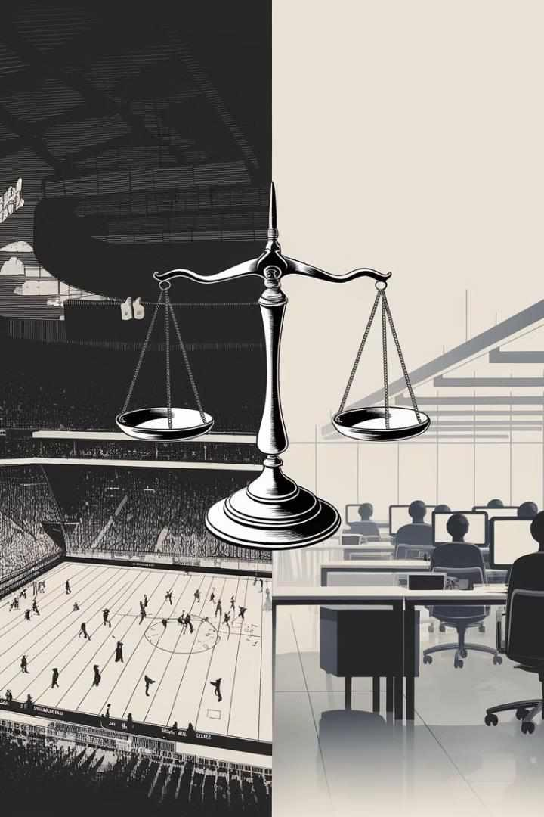
Group Activity 4: Comparative Analysis of Vicarious Liability
Industry | Case Study | Vicarious Liability Principles
Sports | Vowles v Evans and Welsh Rugby Union Ltd (2003) | To be filled by students
Corporate | Mohamud v WM Morrison Supermarkets plc [2016] UKSC 11 | To be filled by students
Healthcare | Barclays Bank plc v Various Claimants [2020] UKSC 13 | To be filled by students
Education | Cox v Ministry of Justice [2016] UKSC 10 | To be filled by students

Slide 16

Group Activity 5: Mock Trial - Sports Injury Case
Case Briefing
Students are provided with a detailed case file involving a semi-professional athlete injured during a charity match organised by their club. The injury resulted from poorly maintained equipment.
Role Assignment
Divide the class into legal teams representing the injured athlete, the sports club, and the charity organisation. Assign roles such as lead counsel, witnesses, and expert testimonies.
Trial Preparation
Teams prepare their arguments, focusing on vicarious liability principles, duty of care, and relevant case law. They should also prepare cross-examination strategies and rebuttals.
Mock Trial Proceedings
Conduct a full mock trial, including opening statements, examination of witnesses, presentation of evidence, and closing arguments. A panel of student judges will preside over the trial.

Slide 17
Conclusion: The Future of Vicarious Liability in Sports
1
Evolving Legal Landscape
As sports continue to evolve, so too will the legal framework be surrounding vicarious liability. Courts are likely to face increasingly complex cases that challenge traditional notions of employment relationships and scope of duty.
2
Technological Advancements
The integration of technology in sports, such as performance tracking devices and virtual training environments, will introduce new dimensions to vicarious liability considerations. Legal professionals must stay abreast of these developments and their potential implications.
3
Balancing Act
The challenge for the legal system will be to strike a balance between protecting the rights of individuals and maintaining the spirit and integrity of sports. This may require a nuanced approach that considers the unique aspects of each sport and the evolving expectations of society.
4
Continuous Learning
For law students and professionals in this field, the key to success will be continuous learning and adaptation.
Staying informed about emerging trends, landmark cases, and shifting societal attitudes towards sports will be crucial in navigating this dynamic area of law.

