Slide 1

Nuisance and Urban Living: Legal Challenges in High-Density Areas
Tutor: Okwudili O. ONWURAH, LL.B. (Nigeria); BL (Abuja, Nigeria); LLM (Exeter,
UK); LLM (Qingdao, PRC); LLM (Shanghai, PRC)
PhD in Law (Hong Kong)
Dr Okwudili O. Onwurah
11/29/2024
1

Slide 2

The purpose of the online lesson is to encourage you
to participate actively in achieving your needs and
simplifying your legal education. I want you to be the
best!
Minor
House
Will make the learning process more interactive
discussions and feel free to ask any question or you
can speak.
Keeping
You have the right to choose whether to turn on
your video or not.
Participation prepares you for your exam and
learning needs with ease.
11/29/2024
2

Slide 3

Introduction
Urban nuisance law addresses conflicts arising from high-density living. This
presentation explores legal challenges, landmark cases, and future trends in
managing urban nuisances.

Slide 4

Insight to Urban
Nuisance
Definition
Importance
Urban nuisance refers to activities
or conditions that interfere with
the enjoyment of property in
densely populated areas.
Understanding urban nuisance
law is crucial for maintaining
quality of life in cities and
resolving conflicts.
Challenges
High-density living creates unique legal and social challenges in addressing
nuisances effectively.

Slide 5
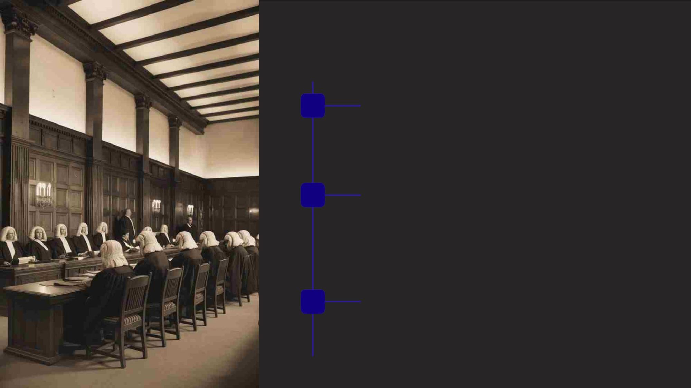
Historical Background
1
Early Common Law
Nuisance law originated in English common law, focusing on
protecting landowners' rights.
2
Industrial Revolution
Urbanization led to increased nuisance cases, prompting
courts to balance individual rights with industrial progress.
3
Modern Era
Contemporary urban nuisance law addresses diverse issues
like noise, light, and odor pollution in cities.

Slide 6

Types of Urban Nuisance
Noise Pollution
Light Pollution
Odor Pollution
Excessive sound from traffic, construction,
or nightlife disrupting residents' peace and
sleep.
Artificial light interfering with natural
darkness, affecting sleep patterns and
wildlife.
Unpleasant smells from industries, waste
management, or food establishments
impacting quality of life.

Slide 7
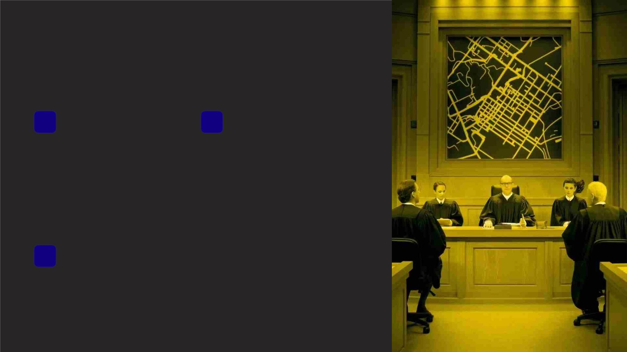
Case Study: Noise Pollution
1
Landmark Case:
Coventry v Lawrence
[2014] UKSC 13
2
Key Issues
Balancing long-standing use of
land for noisy activities with
residents' right to quiet
enjoyment.
Supreme Court case
addressing noise from a
motorsports stadium near
residential properties.
3
Outcome
Court emphasized the importance of planning permission in nuisance
claims, reshaping legal approach.

Slide 8
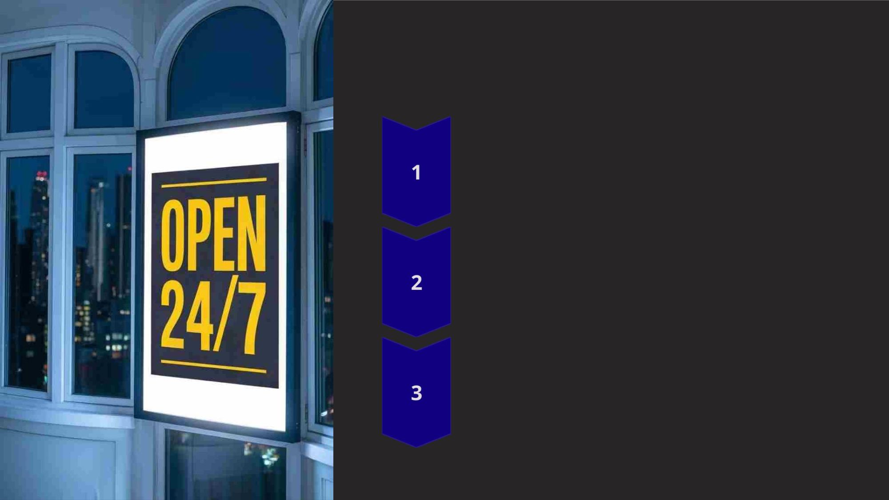
Case Study: Light Pollution
Stone v Bolton [2021] EWCA Civ 1597
Court of Appeal case concerning light nuisance from an
illuminated advertising board.
Legal Arguments
Plaintiffs claimed the bright light interfered with their sleep and
enjoyment of property.
Ruling
Court found in favor of the plaintiffs, ordering adjustments to the
billboard's lighting schedule.

Slide 9

Case Study: Odor Pollution
Case
Barr v Biffa Waste Services Ltd
[2012] EWCA Civ 312
Issue
Odor from waste management
facility affecting nearby residents
Ruling
Impact
Court rejected "reasonable user"
defense, emphasizing statutory
compliance isn't absolute
protection
Strengthened residents' rights in
odor nuisance cases against
industrial operations

Slide 10
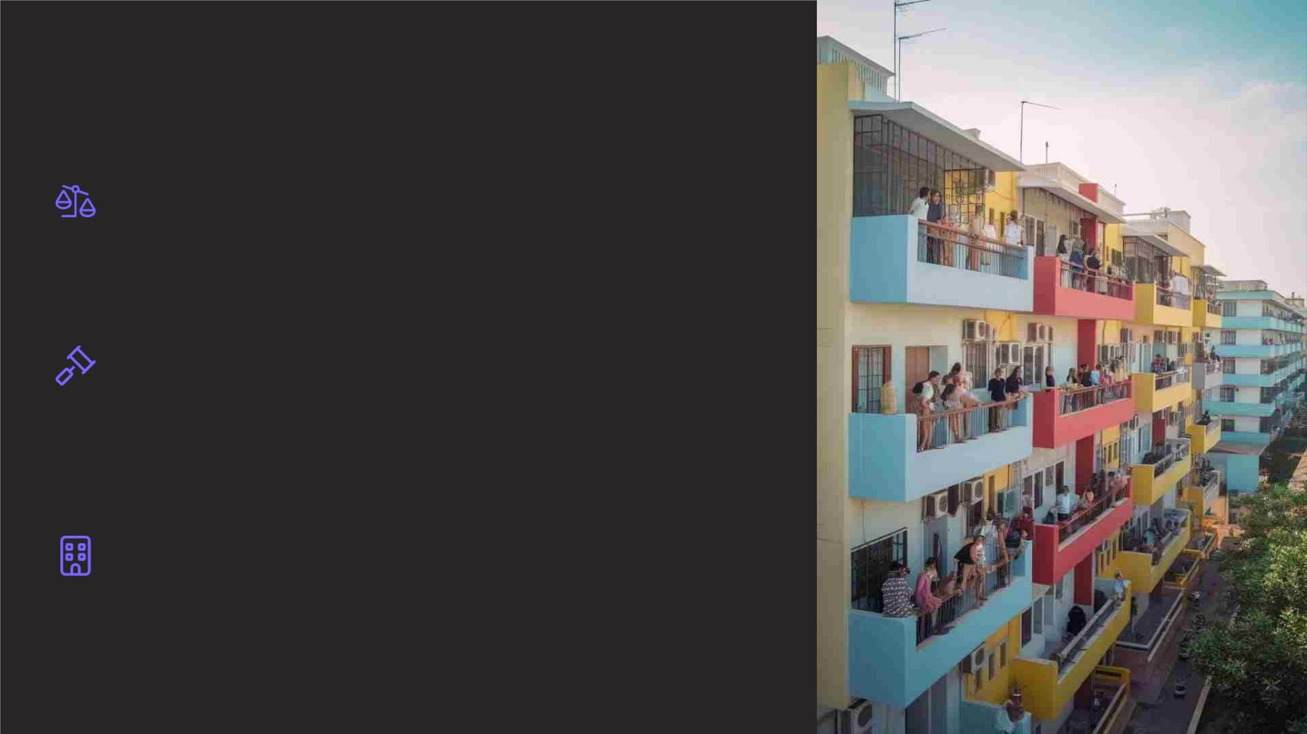
Legal Challenges in High-Density
Areas
Balancing Interests
Courts must weigh individual rights against community needs in densely populated areas.
Enforcement Difficulties
Identifying and prosecuting nuisance sources in complex urban environments can be challenging.
Zoning Conflicts
Mixed-use developments create potential for conflicts between residential and commercial interests.

Slide 11

Role of Local Authorities
Regulatory Powers
Mediation
Local authorities can enact and
enforce bylaws to manage urban
nuisances effectively.
Councils often act as mediators in
neighbor disputes before legal
action is taken.
Planning Decisions
Strategic urban planning can prevent potential nuisances through zoning
and development controls.

Slide 12

Community Involvement
1
2
3
Awareness
Educating residents about their rights and responsibilities
regarding urban nuisances.
Reporting
Establishing efficient channels for community members to
report nuisance issues.
Collaboration
Engaging residents in developing and implementing local
nuisance management strategies.

Slide 13
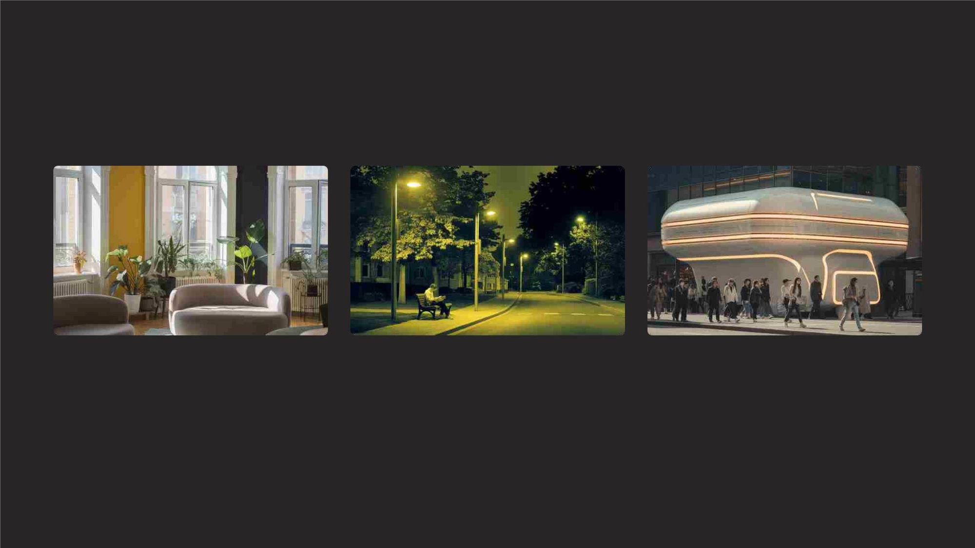
Technological Solutions
Noise Reduction
Smart Lighting
Odor Control
Advanced soundproofing materials and
active noise cancellation systems for urban
buildings.
Adaptive LED streetlights that adjust
brightness based on time and ambient
conditions.
Advanced filtration systems and
biotechnology for managing urban odors at
the source.

Slide 14
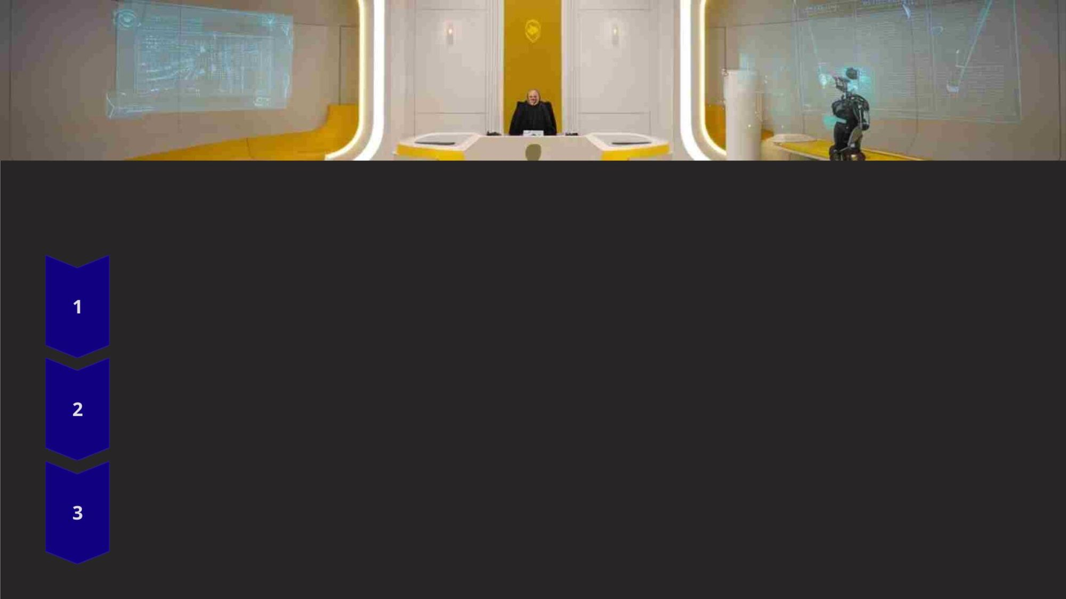
Future Trends in Urban Nuisance Law
AI-Assisted Nuisance Detection
Machine learning algorithms to identify and predict urban nuisance patterns.
Virtual Reality Evidence
Using VR technology in court to simulate nuisance conditions for more accurate judgments.
Blockchain-Based Compliance
Implementing smart contracts for automated enforcement of nuisance regulations.

Slide 15

Practical Tips for Compliance
1
3
Know Your Rights
2
4
Communication First
Familiarize yourself with local
nuisance laws and regulations
applicable to your area.
Attempt to resolve issues
through open dialogue with
neighbors before pursuing
legal action.
Document Everything
Seek Professional
Advice
Keep detailed records of
nuisance incidents, including
dates, times, and any
Consult with legal experts or
local authorities when facing
persistent nuisance issues.
communication attempts.

Slide 16

Q&A Session
Ask Questions
Opportunity for audience to seek clarification on urban nuisance law concepts.
Share Experiences
Attendees can discuss personal encounters with urban nuisances and legal challenges.
Propose Solutions
Brainstorm innovative approaches to addressing urban nuisance issues in your community.

Slide 17
Conclusion
Key Takeaways
Ongoing Challenges
Future Outlook
Urban nuisance law balances individual
rights with community needs in high-
density areas.
Evolving urban landscapes require
continuous adaptation of legal
frameworks and technologies.
Collaborative efforts between residents,
authorities, and innovators will shape
urban living quality.

