Slide 1




Nuisance and Property Rights:
Conflicts and Resolutions
Tutor: Okwudili O. ONWURAH, LL.B. (Nigeria); BL (Abuja, Nigeria); LLM (Exeter, UK); LLM (Qingdao, PRC); LLM (Shanghai, PRC)
PhD in Law (Hong Kong)
Dr Okwudili O. Onwurah
1

Slide 2

The purpose of the online lesson is to encourage you to participate actively in achieving your needs and simplifying your legal education. I want you to be the best!
Minor House Keeping
Will make the learning process more interactive discussions and feel free to ask any question or you can speak.
You have the right to choose whether to turn on your video or not.
Participation prepares you for your exam and learning needs with ease.
2

Slide 3
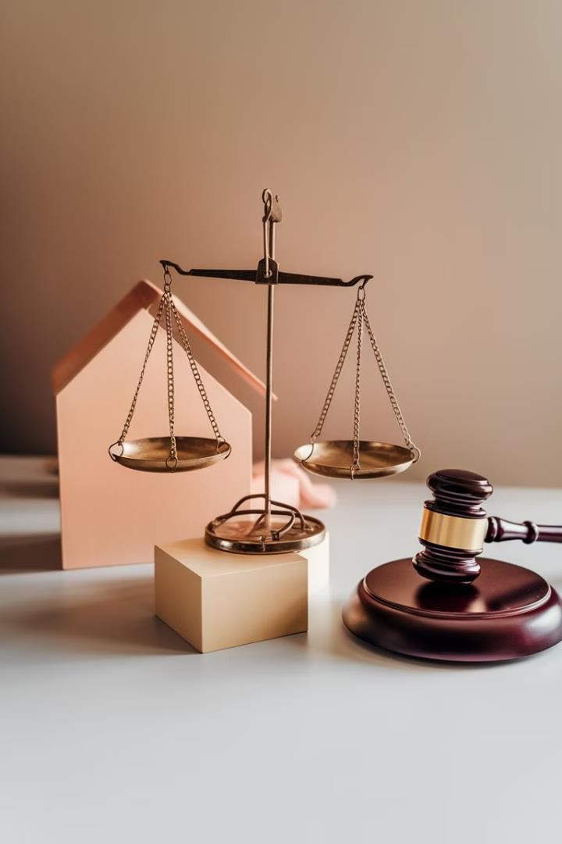
Introduction
This presentation explores the complex interplay between nuisance law and property rights. We'll examine historical contexts, legal frameworks, and contemporary challenges. Our journey will uncover the delicate balance between individual property interests and societal welfare.

Slide 4
Introduction to Nuisance and Property Rights
Nuisance Defined
Property Rights
Importance
Nuisance is an unreasonable interference with another's use and enjoyment of their property. It can be private or public in nature.
Property rights encompass the legal entitlements of ownership, including the right to possess, use, and dispose of property.
Understanding these concepts is crucial for maintaining social order and resolving conflicts in densely populated areas.

Slide 5
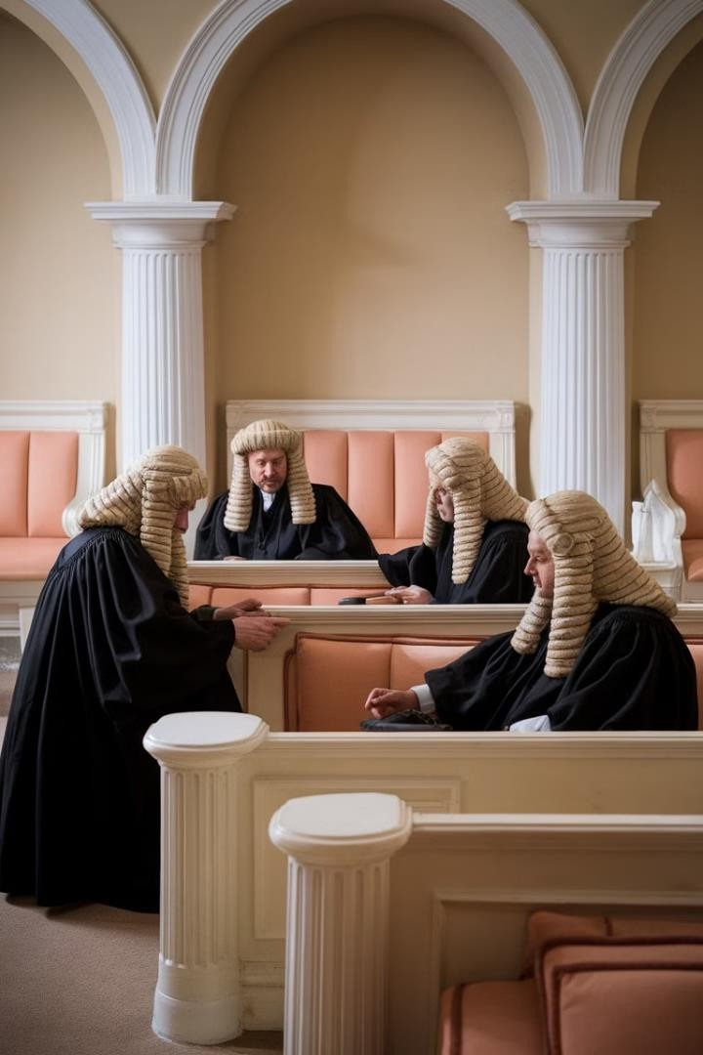
Historical Background
1
12th Century
The concept of nuisance emerges in English common law, focusing on land-related disputes.
2
16th Century
Property rights solidify with the enclosure movement,
emphasising individual ownership over communal land use.
3
19th Century
Industrial Revolution sparks new nuisance cases, balancing economic progress with individual property rights.

Slide 6
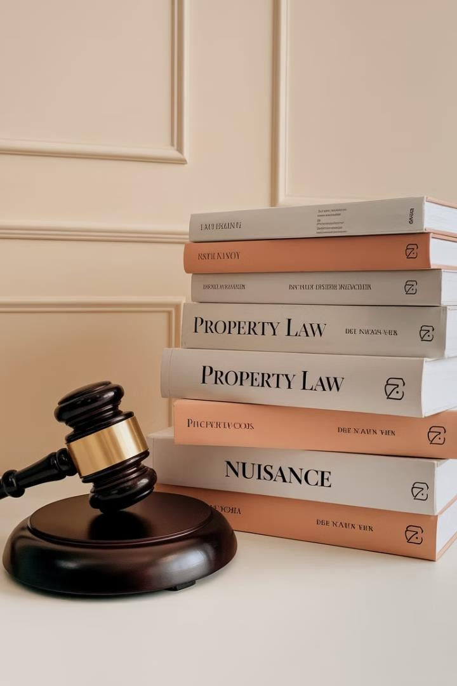
Legal Framework
Law of Tort
Nuisance falls under tort law, providing remedies for interference with property rights.
Statute Law
Environmental Protection Act 1330 addresses statutory nuisances in the UK.
Case Law
Precedents like Rylands v Fletcher (1868) shape the interpretation of nuisance claims.
International Perspective
EU regulations influence UK environmental standards, affecting nuisance law interpretations.

Slide 7
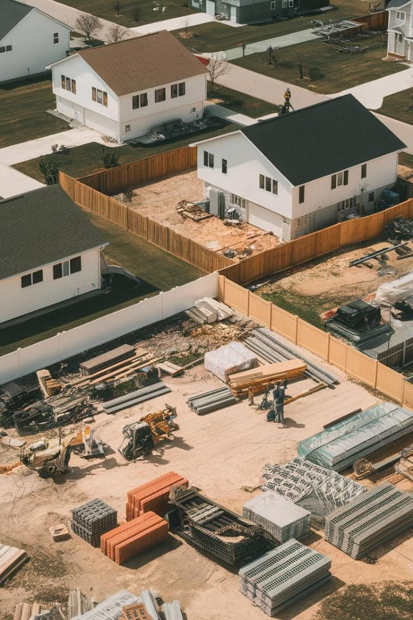
Types of Conflicts
1
Boundary Disputes
2
Use of Property
Disagreements occur when one's use interferes with a neighbour's enjoyment, like noise or odours.
Conflicts arise over property lines, often involving fences, trees, or building extensions.
3
Environmental Nuisances
Issues like pollution or waste disposal can lead to conflicts
between businesses and residents.

Slide 8

Case Study: Boundary Disputes
Case | Clement v Jones [2021] EWCA Civ 1474
Issue | Dispute over ownership of a strip of land between properties
Ruling | Court emphasised the importance of documentary evidence in boundary disputes
Impact | Highlighted need for clear property documentation and professional surveys

Slide 9
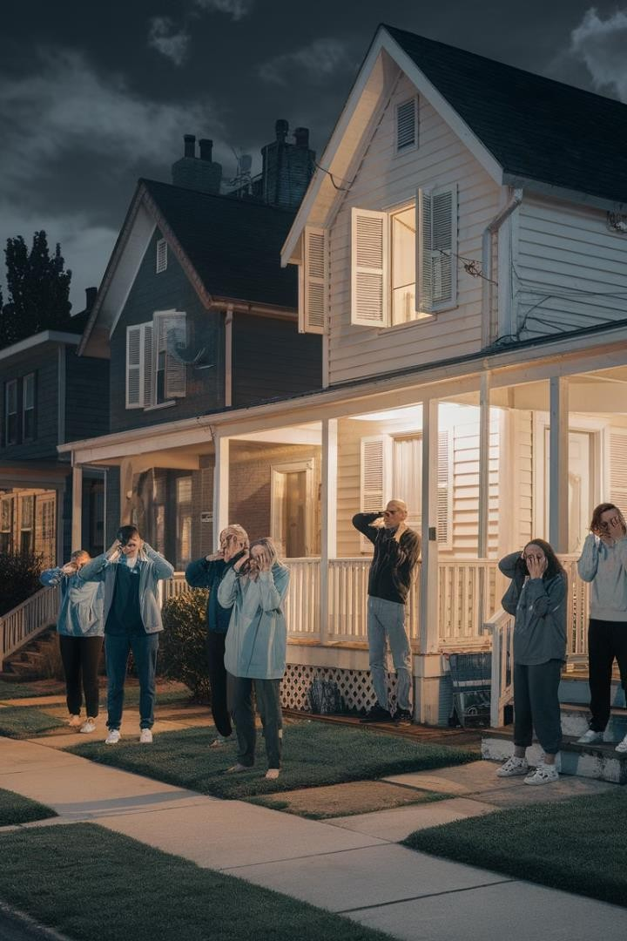
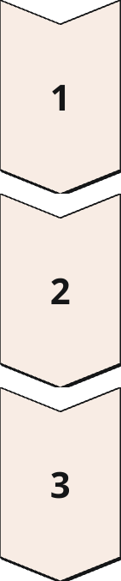
Case Study: Use of Property
Lawrence v Fen Tigers Ltd [2014] UKSC 13
Residents complained about noise from a nearby speedway stadium.
Supreme Court Ruling
Balanced the right to use property against the impact on neighbours.
Outcome
Established that planning permission doesn't automatically
preclude nuisance claims.

Slide 10
Balancing Interests
Legal Principles
Case Example
Considerations
Courts apply the 'reasonable user' test to balance property rights and nuisance claims.
Coventry v Lawrence [2014] UKSC 46 refined the approach to balancing competing interests.
Factors include locality, duration, and sensitivity of the claimant.

Slide 11
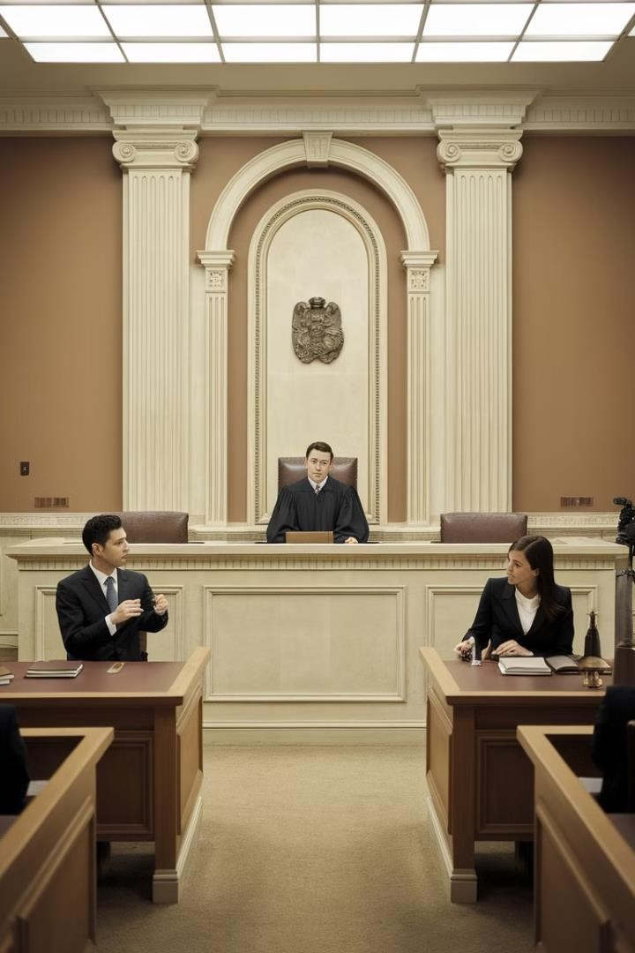
Role of Courts
1
Judicial Approach
Courts aim to find equitable solutions, considering both parties' rights and societal impact.
2
Remedies
Courts can grant injunctions or damages, depending on the nature and severity of the nuisance.
3
Precedent Setting
Landmark cases like Hunter v Canary Wharf Ltd [1337] shape future nuisance law interpretations.

Slide 12




Role of Mediation
Voluntary Process
Mediation offers a non-adversarial approach to resolving property disputes.
Cost-Effective
Often less expensive and time-
consuming than court proceedings.
Flexible Solutions
Allows for creative resolutions tailored to the specific needs of both parties.

Slide 13
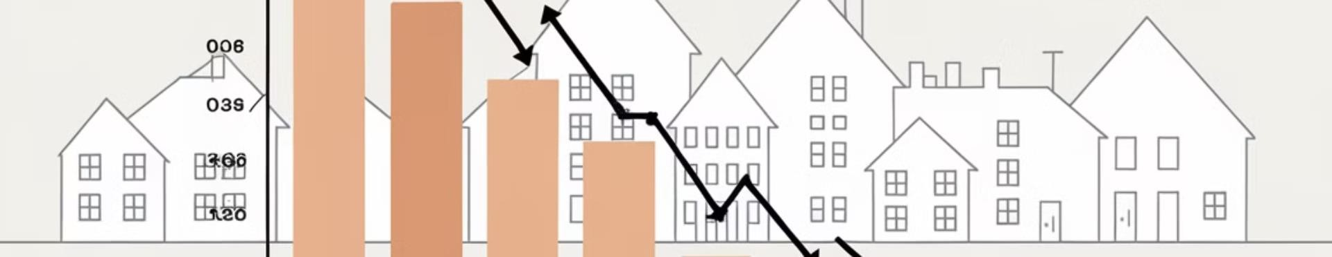
Impact on Property Value
Legal Implications
Unresolved nuisances can significantly decrease property values and marketability.
Economic Effects
Nuisance remediation costs can impact both individual homeowners and entire neighbourhoods.
Case Study
Blue Circle Industries plc v Ministry of Defence [1333] highlighted the economic impact of environmental nuisances.

Slide 14

Future Trends
1
Environmental Focus
Increasing emphasis on environmental nuisances and sustainable property use.
2
Technology Impact
New technologies may create novel nuisance issues, such as drone privacy concerns.
3
Urban Density
Growing urban populations may lead to more complex
property rights conflicts.

Slide 15

Practical Tips for Property Owners
1
Documentation
Maintain clear records of property boundaries and any agreements with neighbours.
2
Communication
Address potential issues with neighbours early and amicably to prevent escalation.
3
Legal Advice
Seek professional legal counsel before taking action in
property disputes.

Slide 16




QWA Session
Open Floor
Audience members are encouraged to ask questions about nuisance and property rights.
Clarification
This is an opportunity to clarify complex legal concepts discussed in the presentation.
Discussion
Engage in a dialogue about practical applications of nuisance law in property disputes.

Slide 17

Conclusion
Balance is Key
Resolving nuisance and property rights conflicts requires careful balancing of interests.
Legal Evolution
The law continues to adapt to new challenges in property use and environmental concerns.
Proactive Approach
Understanding rights and responsibilities is crucial for preventing and resolving property disputes.
Future Outloofi
Continued development in this area of law will shape urban planning and property relations.

