Slide 1




Negligence and Psychiatric Harm:
A Legal Analysis
Tutor: Okwudili O. ONWURAH, LL.B. (Nigeria); BL (Abuja, Nigeria); LLM
(Exeter, UK); LLM (Qingdao, PRC); LLM (Shanghai, PRC)
PhD in Law (Hong Kong)
Dr Okwudili O. Onwurah
11/22/2024
1

Slide 2

The purpose of the online lesson is to encourage you to participate actively in achieving your needs and simplifying your legal education. I want you to be the best!
Minor House Keeping
Will make the learning process more interactive discussions and feel free to ask any question or you can speak.
You have the right to choose whether to turn on your video or not.
Participation prepares you for your exam and learning needs with ease.
11/22/2024
2

Slide 3
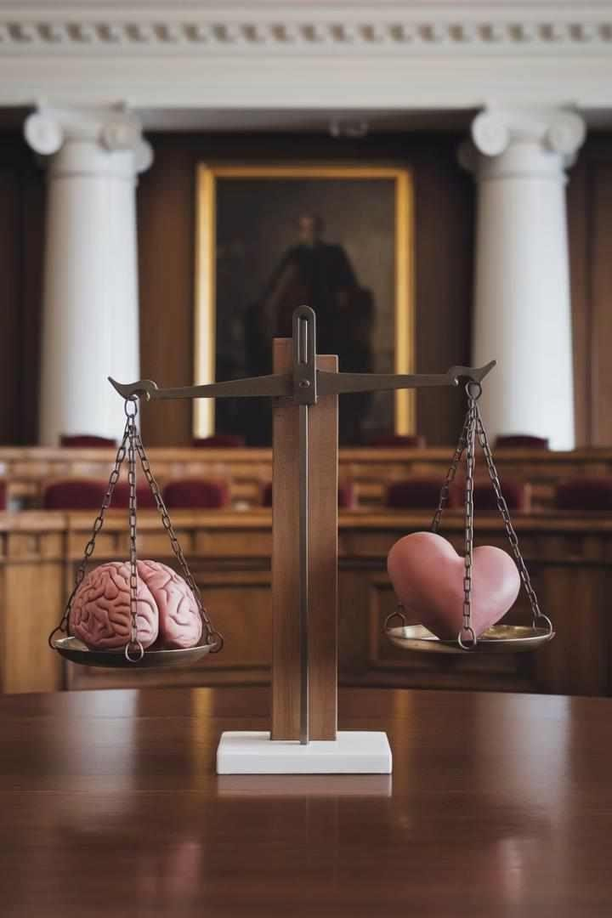
Introduction
This presentation explores the legal concept of psychiatric harm in negligence cases. We'll examine key English and Hong Kong court decisions, analysing the evolution of legal principles and their implications for mental health law.

Slide 4
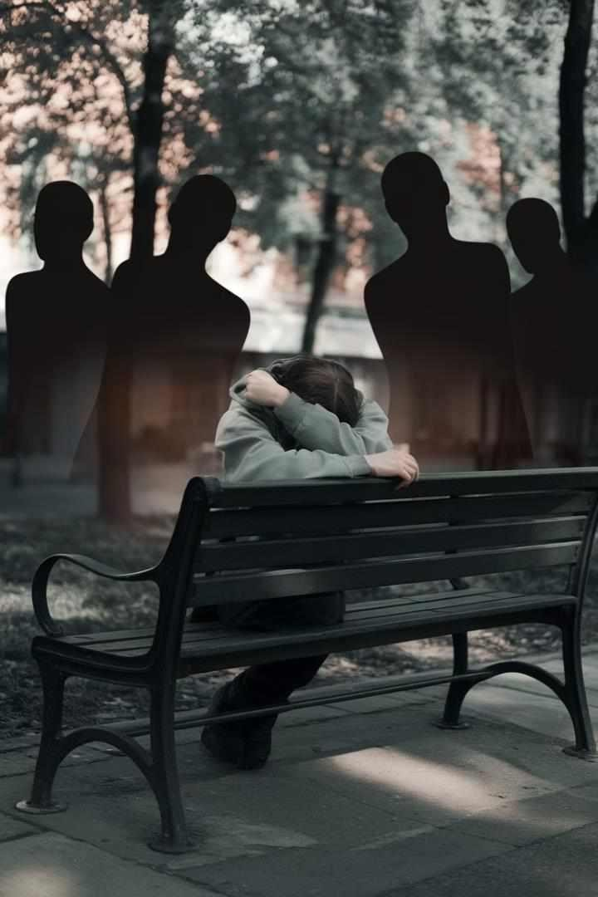
Introduction to Psychiatric Harm
1
Definition
Psychiatric harm refers to recognised mental illnesses caused by another's negligence.
2
Legal Recognition
Courts have gradually expanded the scope of recoverable psychiatric injuries.
3
Challenges
Proving psychiatric harm presents unique difficulties in negligence claims.

Slide 5
Primary and Secondary Victims
Primary Victims
Secondary Victims
Legal Implications
Those directly involved in the incident. They were in the zone of physical danger.
Those who suffer psychiatric harm from witnessing or learning about the incident.
Different tests apply to primary and secondary victims in establishing liability.

Slide 6
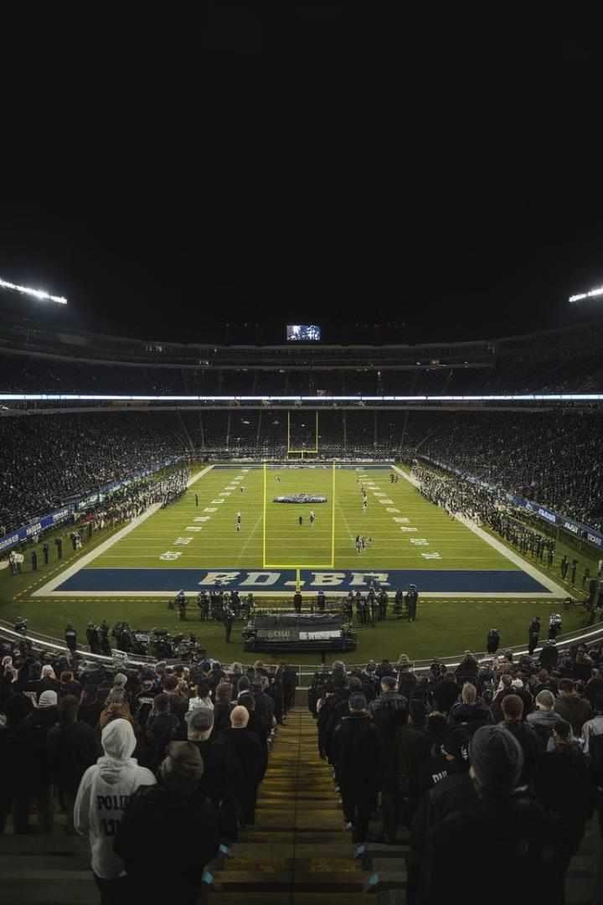
Case Study: Alcock v Chief Constable of South Yorkshire
Police
1
Background
The case arose from the 1989 Hillsborough disaster, where 96 football fans died.
2
Legal Issue
The court considered claims from secondary victims who
witnessed the tragedy on television.
3
Ruling
The House of Lords established strict criteria for secondary victims to claim damages.

Slide 7

Duty of Care in Psychiatric Harm
Caparo Test
Courts apply the three-stage Caparo test to establish a duty of care.
Foreseeability
The harm must be a reasonably foreseeable consequence of the defendant's conduct.
Proximity
There must be a sufficiently close relationship between the parties.
Fair, Just, and
Reasonable
Imposing a duty must be fair, just, and reasonable in the circumstances.

Slide 8
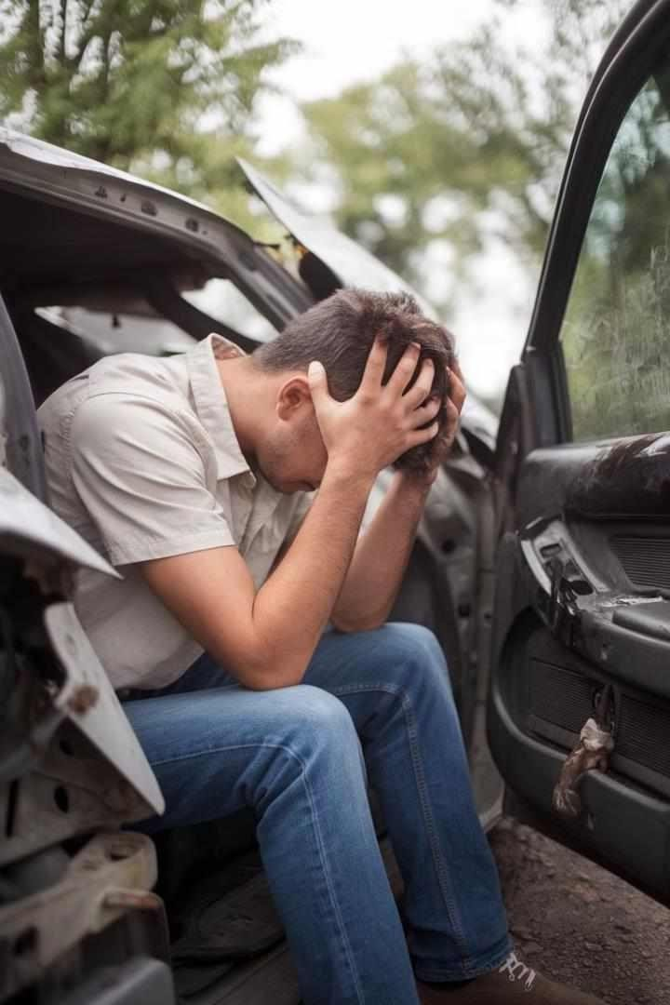

Case Study: Page v Smith
Facts
Mr Page suffered psychiatric harm after a minor car accident.
Legal Issue
The court considered whether foreseeability of physical injury was sufficient for psychiatric harm.
Ruling
The House of Lords held that foreseeability of physical harm suffices for primary victims.

Slide 9




Foreseeability of Psychiatric Harm
Reasonable Person Test
Courts assess foreseeability from the perspective of a reasonable person.
Threshold
The harm must be more than mere grief, distress, or other ordinary emotions.
Eggshell Skull Rule
Defendants must take their victims as they find them, including pre-existing vulnerabilities.

Slide 10
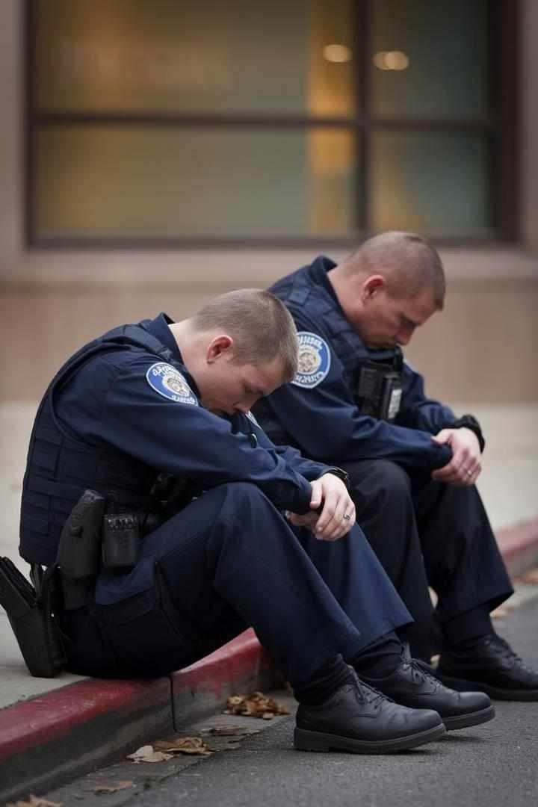
Case Study: White v Chief Constable of South Yorkshire
Police
1
Background
Police officers claimed psychiatric harm after the Hillsborough disaster.
2
Legal Issue
The court considered whether rescuers could claim as primary
victims.
3
Ruling
The House of Lords held that rescuers must meet secondary victim criteria.

Slide 11

Proximity in Psychiatric Harm
1
Temporal Proximity
The psychiatric harm must occur in the immediate aftermath of the incident.
2
Spatial Proximity
Secondary victims must be physically close to the scene of the incident.
3
Relational Proximity
There must be a close tie of love and affection with the primary victim.

Slide 12
Case Study: McLoughlin v O'Brian
Facts
Legal Issue
Ruling
Mrs McLoughlin suffered psychiatric harm after seeing her injured family at the hospital.
The court considered the extent of proximity required for secondary victims.
The House of Lords allowed the claim, establishing the 'immediate aftermath' test.

Slide 13
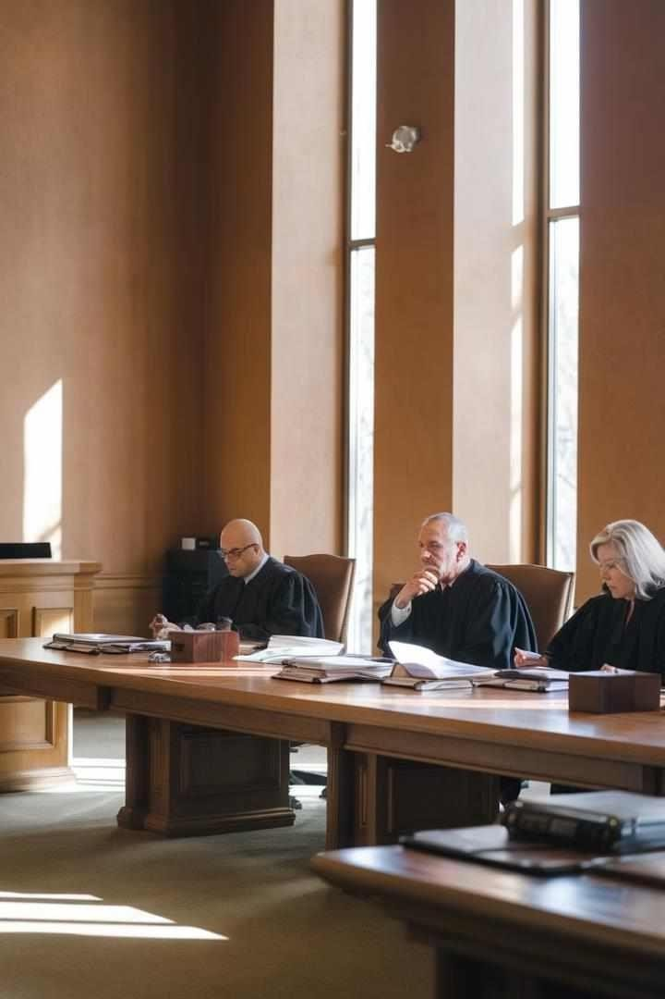
Policy Considerations
Floodgates Argument
Courts aim to prevent a flood of claims by limiting liability.
Fraudulent Claims
There's concern about difficulty in verifying genuine psychiatric harm.
Economic Impact
Courts consider the potential economic burden on defendants and society.
Public Interest
Balancing individual rights with broader societal interests guides policy decisions.

Slide 14
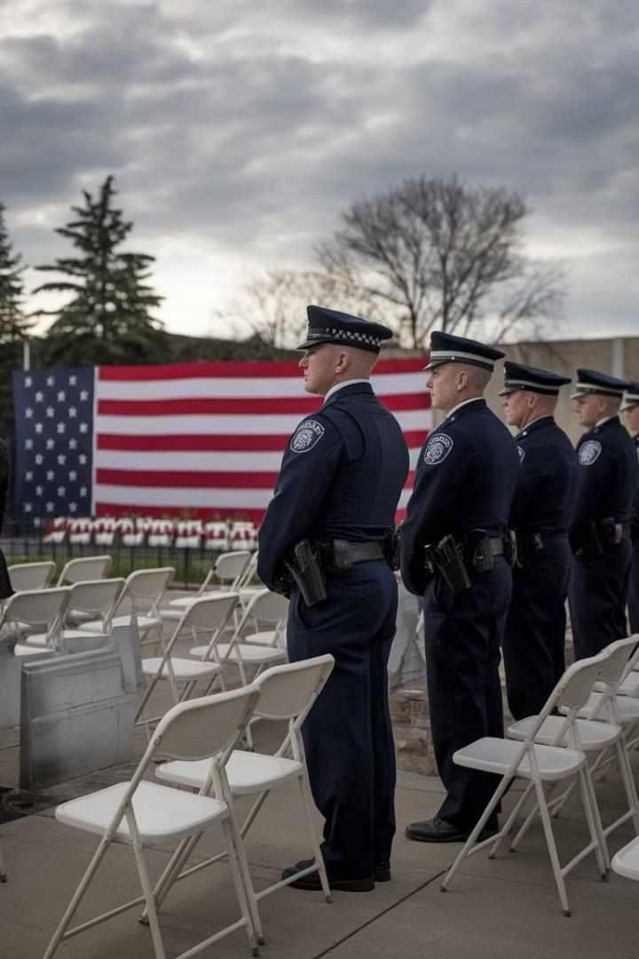
Case Study: Frost v Chief Constable of South Yorkshire
Police
1
Background
Police officers claimed for psychiatric harm after the Hillsborough disaster.
2
Legal Issue
The court reconsidered the position of rescuers in psychiatric
harm claims.
3
Ruling
The House of Lords reaffirmed that rescuers must meet secondary victim criteria.

Slide 15
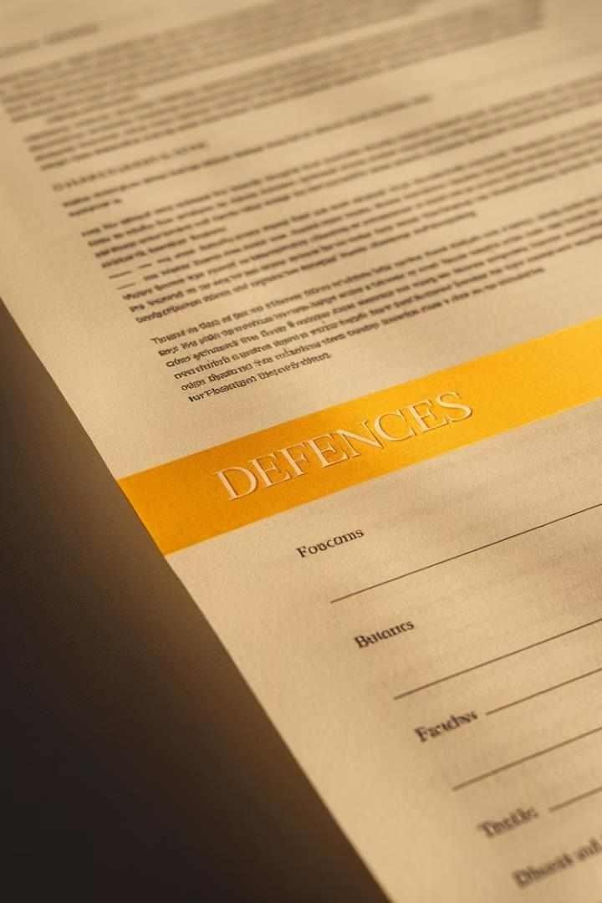



Defences in Psychiatric Harm Claims
Volenti non fit injuria
The defence of voluntary assumption of risk may apply in certain cases.
Limitation
Claims must be brought within the statutory limitation period.
Contributory Negligence
The claimant's own negligence may reduce the damages awarded.

Slide 16
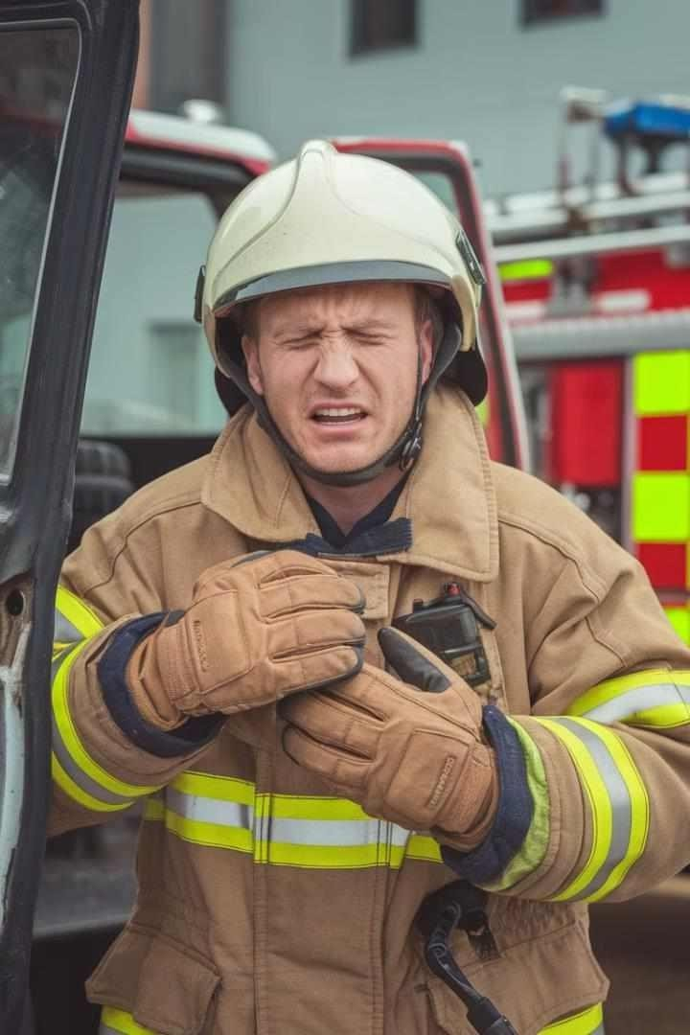

Case Study: Greatorex v Greatorex
Facts
A firefighter suffered psychiatric harm after attending an accident involving his son.
Legal Issue
The court considered whether a primary victim owes a duty to a secondary victim.
Ruling
The court held that policy considerations precluded imposing such a duty.

Slide 17

Conclusion and Future Directions
1
Evolving Law
The law on psychiatric harm continues to develop, balancing competing interests.
2
Mental Health
Awareness
Increased understanding of mental health may influence future legal developments.
3
Technological Challenges
New technologies may present novel scenarios for psychiatric harm claims.

