Slide 1

Remedies for Nuisance:
Injunctions, Damages, and Abatement
Tutor: Okwudili O. ONWURAH, LL.B. (Nigeria); BL (Abuja, Nigeria); LLM (Exeter, UK); LLM (Qingdao, PRC); LLM (Shanghai, PRC)
PhD in Law (Hong Kong)
Dr Okwudili O. Onwurah

Slide 2
Minor House Keeping
The purpose of the online lesson is to encourage you to participate actively in achieving your needs and simplifying your legal education. I want you to be the best!
Will make the learning process more interactive discussions and feel free to ask any question or you can speak.
You have the right to choose whether to turn on your video or not.
Participation prepares you for your exam and learning needs with ease.

Slide 3

Introduction
In nuisance law, remedies play a crucial role in addressing harmful activities. This presentation explores injunctions, damages, and abatement as key remedies. We'll examine landmark cases and discuss their implications for legal practitioners.

Slide 4
Remedies in Nuisance Law
Definition
Importance
Types
Remedies in nuisance law are legal measures to stop, prevent, or compensate for interference with property rights.
They restore balance, deter future nuisances, and provide relief to affected parties.
The three main remedies are injunctions, damages, and abatement, each serving unique purposes.

Slide 5
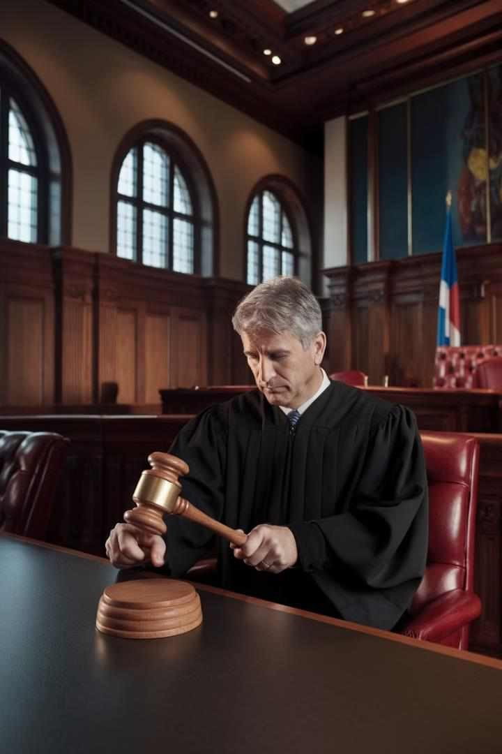
Injunctions: Definition and Types
Prohibitory Injunctions
Court orders that prevent a party from continuing or repeating a nuisance-causing causing activity.
Mandatory Injunctions
Orders requiring a party to take specific actions to remedy the nuisance.
Interim Injunctions
Temporary orders issued before a full trial to prevent immediate harm.
Permanent Injunctions
Long-term orders issued after after a full trial, providing lasting relief.

Slide 6

Legal Standards for Injunctions
1
Irreparable Harm
Courts consider whether the nuisance would cause harm that cannot be adequately compensated by damages.
2
Balance of Convenience
Judges weigh the hardship of granting an injunction against the benefit to the plaintiff.
3
Public Interest
The court considers the broader impact of the injunction on the community.

Slide 7

Damages: Compensatory and Punitive
1
Compensatory
Damages
Aim to restore the plaintiff plaintiff to their position before the nuisance occurred.
Punitive Damages
Awarded in cases of egregious conduct to punish the defendant and and deter future nuisances.
2
Calculation Methods
Courts may use diminution diminution in property value or cost of repair to determine compensation.
3
4
Limitations
Punitive damages are rarely awarded in nuisance nuisance cases and subject to strict criteria.
7

Slide 8


Abatement: Definition and Legal Process
Notice
Local authorities issue a notice to the property owner, detailing the nuisance and
and required actions.
Compliance Period
The owner is given a reasonable time to address the nuisance voluntarily.
Authority Action
If unresolved, authorities may enter the property and abate the nuisance directly.
Cost Recovery
The property owner is typically billed for the cost of abatement actions.

Slide 9

Case Study: Injunctions - Miller v Jackson [1977]
1
Background
Cricket club's balls frequently entered neighboring property, causing damage and distress.
2
Court Decision
Court of Appeal refused to grant an injunction, considering considering the public interest in sport.
3
Implications
Highlighted the court's discretion in balancing interests when when considering injunctive relief.

Slide 10
Case Study: Damages - Halsey v Esso Petroleum [1961]
Issue
Ruling
Significance
Oil refinery caused air pollution and vibrations affecting nearby residents. residents.
Court awarded damages for various nuisances, including acid smuts damaging property.
Established precedent for awarding damages in cases of industrial nuisance.

Slide 11
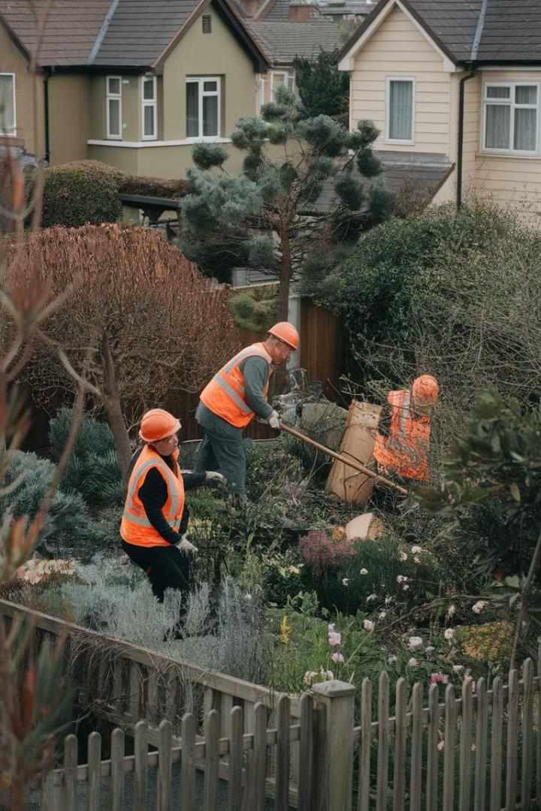
Case Study: Abatement - R v Carrick District Council, ex parte Shelley [1996]
Situation
Local authority served abatement notice for unkempt garden attracting vermin.
Challenge
Property owner contested the notice, claiming it exceeded the the council's powers.
Judgment
Court upheld the notice, affirming the council's authority authority to address such nuisances.
Impact
Reinforced local authorities' powers in nuisance abatement proceedings.

Slide 12
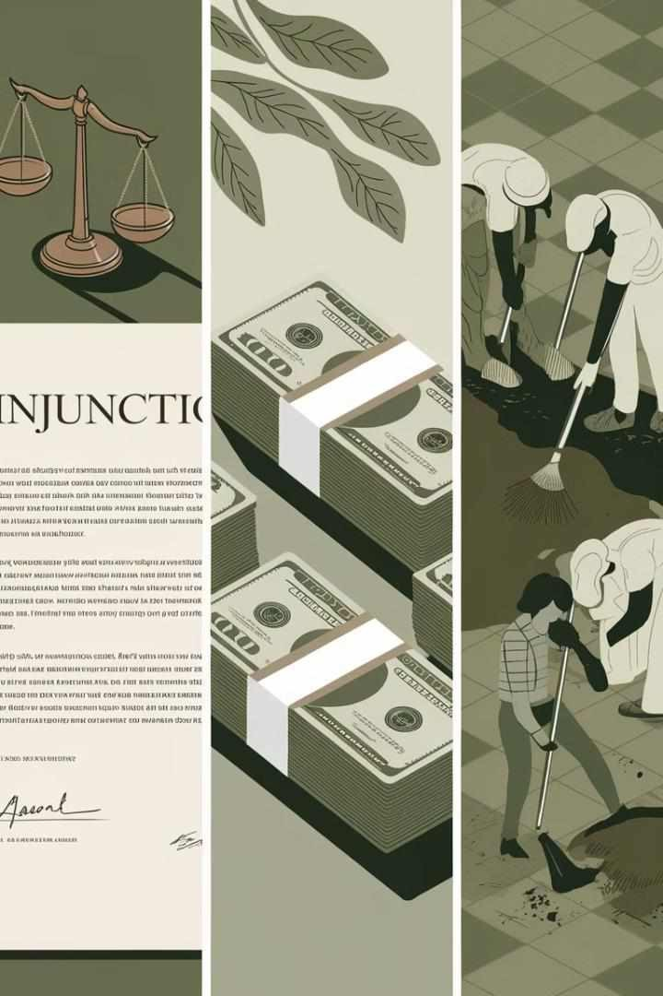
Comparative Analysis of Remedies
Remedy | Pros | Cons
Injunctions | Immediate cessation of nuisance | May be overly restrictive
Damages | Compensates for harm | Doesn't always stop the nuisance
Abatement | Direct action to remove nuisance | Can be costly for authorities

Slide 13

Role of Courts in Nuisance Remedies
1
Discretion
Courts have significant discretion in choosing appropriate remedies for each case.
2
Balancing Interests
Judges must weigh competing interests of parties and the public.
3
Precedent Setting
Court decisions establish guidelines for future nuisance cases and remedies.
4
Enforcement
Courts play a crucial role in in enforcing remedies and and penalizing non- compliance.

Slide 14





Role of Local Authorities in Nuisance Remedies
Investigation
Authorities investigate complaints
and gather evidence of nuisances.
Enforcement
They have the power to issue abatement notices and take direct action.
Mediation
Often act as mediators between parties to resolve nuisance disputes. disputes.
Education
Provide guidance to the public on
preventing and addressing
nuisances.
14

Slide 15


Future Trends in Nuisance Law Remedies
Technology Integration
Increased use of data analytics and AI in assessing nuisances and determining remedies.
Environmental Focus
Greater emphasis on remedies addressing long-term environmental impacts of nuisances.
Alternative Dispute Resolution
Growing preference for mediation and arbitration in resolving nuisance disputes.
Proactive Measures
Shift towards preventative remedies and early intervention in potential nuisance situations.

Slide 16

Practical Tips for Legal Practitioners
Evidence Gathering
Collect comprehensive evidence including photos, expert testimony, and impact impact statements.
Remedy Selection
Carefully consider the most appropriate remedy based on on the specific nuisance and client needs.
Negotiation Skills
Develop strong negotiation skills for out-of-court settlements and alternative dispute resolution.
Stay Informed
Keep up-to-date with evolving evolving case law and local regulations on nuisance remedies.

Slide 17

Conclusion: Key Takeaways
1
Remedy Diversity
Injunctions, damages, and abatement offer varied approaches to addressing nuisances.
2
Case-Specific
Approach
Each nuisance case requires careful consideration of the most appropriate remedy.
Practitioner
Preparedness
Legal professionals must stay informed and adaptable in this dynamic area of law.
3
Evolving Landscape
Nuisance law remedies continue to adapt to changing social and environmental needs.
4

