Slide 1


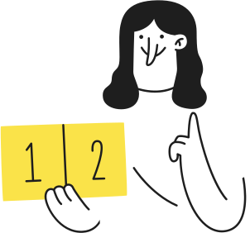

÷
÷
Multiplying and Dividing Decimals

Slide 2
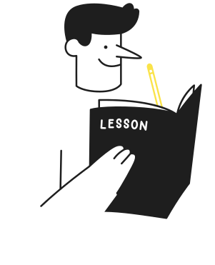

Lesson Outline
  Multiplying decimals by a single digit number
  Multiplying decimals by 2 digit numbers
  Dividing decimals where quotients are decimals
  Dividing decimals by 2 digit numbers

Slide 3
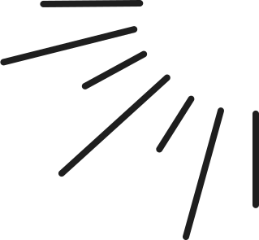


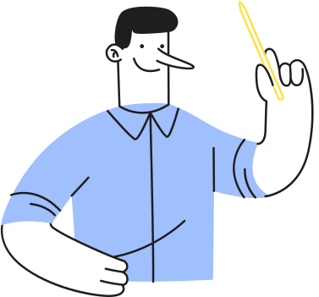

Learning Outcomes
After the lesson, you should be able to...
  multiply decimals by 1-2 digit numbers,
  divide decimals where quotients are decimals and
  divide decimals by 2 digit numbers.

Slide 4
Multiplying decimals
Using visual models, we have 4 groups of 0.8
There are multiple ways we can multiply decimals.
Example:
0.8 × 4

Slide 5
How about for 1.36 × 8?
Use a rectangular area model to multiply the values.
Write the numbers in a place value table. Add the values in each column.
1
2
 | 1 | 0.3 | 0.06
8 | 8 | 2.4 | 0.48
 | Ones | . | Tenths | Hundredths
 | 8 | . | 0 | 0
 | 2 | . | 4 | 0
 | 0 | . | 4 | 8
1 | 0 | . | 8 | 8
+
1.36 × 8 = 8 + 2.4 + 0.48 = 10.88
1.36 × 8 = 10.88

Slide 6

Multiplying decimals by 2 digit numbers
Another method we can use is the standard algorithm when multiplying numbers.
8.15
Example: 8.15 x 12
x
12
1
Write the numbers vertically.
16 30
2
Multiply 8.15 ﻿× 2.
81 50
3
Multiply 8.15 × 1.
97 80
.
4
Add the products.
5
Move the decimal point 2 time﻿s to the left since 8.15 has 2 decimal places.
Answer:
8.15 × 12 = 97.80

Slide 7
YOUR TURN
85.54
25
1
x

Slide 8
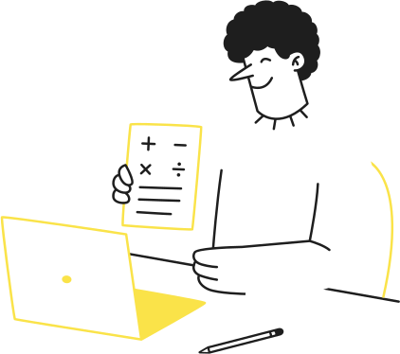

2
92.78
2.8
x

Slide 9
YOUR TURN
39.48
7.98
3
x

Slide 10
YOUR TURN
In a race, Lucas ran at a speed of 6.8 metres per second for 9.5 seconds. How far did he run during the race?
4

Slide 11



Mid-Discussion Break
Let’s Play

Slide 12
Division where answers are decimals
43.75
4
175.00
-
1
Add 0 tenths.
3 will become 30-tenths.
16
15
-
12
2
Divide normally to get 7.
Let’s continue, but instead of having a remainder 3, we will divide further to get the decimal numbers.
30
Add 0 hundredths.
2 will become 20- hundredths.
28
3
-
20
20
-
4
Divide normally to get 5.
0
Adding decimal 0 to a number does not change the number’s value.
NOTE:
Answer:
175 ÷ 4 = 43.75

Slide 13
Dividing decimals by a whole number
The method is very similar to dividing whole numbers.
8.14
Example: 16.28 ÷ 2
2
16.28
-
16
1
Place the decimal point in the quotient directly above the decimal point of the dividend.
02
-
2
08
2
Divide normally, starting from the left, and ignore the decimal for now.
8
-
0
3
Now you’ve got your answer.
Answer:
16.28 ÷ 2 = 8.14

Slide 14
÷
÷
LET’S TRY
746.9 ÷ 9 =
What is 20.4 ÷ 0.4?

Slide 15

LET’S TRY
What is 20.4 ÷ 0.4?

Slide 16
LET’S TRY
What is 20.4 ÷ 0.4?

Slide 17

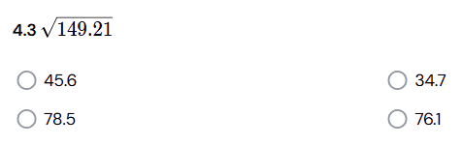
YOUR TURN

Slide 18
YOUR TURN
What is the quotient of 2.73 and 0.03?

Slide 19
÷
÷
YOUR TURN
Ms. Harley bought 5 mangoes for ₱45.50. How much did each mango cost?

Slide 20



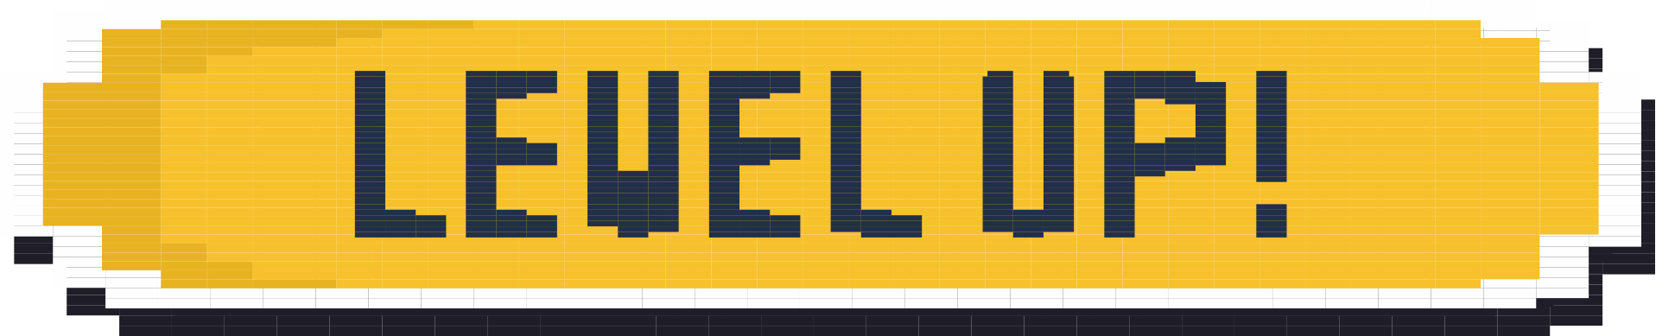


Slide 21



Summary
Multiplying of decimals
Division where answers are decimals
  Multiply decimals by using visual models, area models or standard algorithms.
  Place the decimal point in the product by counting the number of decimal places in both the multiplicand and the multiplier.
  Add zeroes as decimals to the dividend as needed, then place the decimal point directly above the decimal point on the dividend.
Dividing decimals by a whole number
  Place the decimal point in the quotient directly above the decimal point of the dividend, then divide normally.

