Slide 1

Negligence in Sports:
Legal Principles and Case Studies
Tutor: Okwudili O. ONWURAH, LL.B. (Nigeria); BL (Abuja, Nigeria); LLM (Exeter, UK); LLM (Qingdao, PRC); LLM (Shanghai, PRC)
PhD in Law (Hong Kong)
Dr Okwudili O. Onwurah

Slide 2
Minor House Keeping
The purpose of the online lesson is to encourage you to participate actively in achieving your needs and simplifying your legal education. I want you to be the best!
Will make the learning process more interactive discussions and feel free to ask any question or you can speak.
You have the right to choose whether to turn on your video or not.
Participation prepares you for your exam and learning needs with ease.

Slide 3
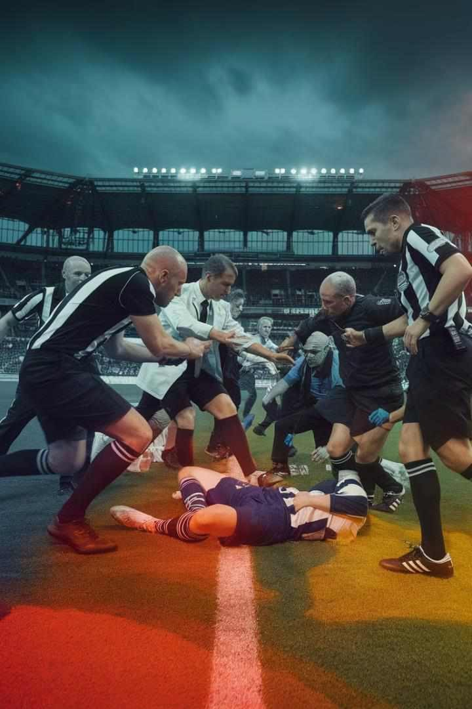
Introduction
This presentation explores the complex legal landscape of negligence in sports, examining key principles and landmark cases from England and Hong Kong. We will delve into the duty of care owed by various parties in sporting contexts, analyze the standard of care expected from participants, coaches, organizers, and governing bodies, and investigate how courts have interpreted liability in different scenarios.
Through a series of case studies, we'll uncover the nuances of sports negligence law, discuss inherent risks, available defenses, and the impact of waivers. Finally, we'll consider recent developments, criticisms, and potential reforms in this evolving area of law.

Slide 4
Introduction to Negligence in Sports
1
Definition of Negligence
Negligence in sports refers to the failure to exercise reasonable care, resulting in harm or injury to another party. It involves breaching a duty of care owed to others in sporting contexts.
2
Elements of Negligence
To establish negligence, four key elements must be proven: duty of care, breach of that duty, causation, and damages. In sports, these elements are applied within the unique context of athletic competition and inherent risks.
3
Importance in Sports Law
Understanding negligence is crucial for athletes, coaches, organizers, and governing bodies to ensure safety, manage risks, and navigate potential legal liabilities arising from sporting activities.
4
Balancing Act
Courts must balance the need to protect participants from unreasonable harm against preserving the essence and excitement of sports, which often involve physical risks and competitive intensity.

Slide 5
Duty of Care in Sports
1
Establishing Duty of Care
In sports, a duty of care arises when there is a sufficiently proximate relationship between parties. This duty extends to various stakeholders, including participants, coaches, officials, and organizers.
2
Scope of Duty
The scope of duty varies depending on the role and circumstances. For example, coaches owe a duty to provide proper training and ensure a safe environment, while participants owe a duty to play within the rules and avoid reckless behavior.
3
Foreseeability
A key factor in determining duty of care is the foreseeability of harm. Courts consider whether a reasonable person in the defendant's position would have foreseen the risk of injury.
4
Evolving Standards
The standard of care in sports continues to evolve with advancements in safety equipment, medical knowledge, and changing societal expectations regarding risk in sports.

Slide 6
Case Study: Condon v Basi
Background
Condon v Basi [1985] 1 WLR 866 is a landmark English case that established the standard of care for participants in contact sports. The case involved an injury sustained during a soccer match when the defendant made a high tackle on the plaintiff, causing a serious leg fracture.
Court's Decision
The Court of Appeal held that players owe a duty of care to each other during a match. The standard of care was defined as that of the ordinary skilled player, taking into account the rules, conventions, and customs of the game. The court found the defendant's tackle to be reckless and far below the standard expected in an ordinary game of soccer.
Impact
This case set a precedent for determining negligence in sports, establishing that participants can be held liable for injuries caused by reckless disregard for others' safety. It balanced the need for vigorous competition with the requirement to play within acceptable bounds of conduct.

Slide 7
Standard of Care for Participants
Reasonable Competitor Test
The standard of care for participants is based on the "reasonable competitor" test. This considers what would be expected of a reasonable participant with the same skill level and experience in similar circumstances.
Rule Compliance
Adherence to the rules of the sport is a crucial factor in determining the standard of care. Deliberate or reckless violations of rules designed for safety can be strong evidence of negligence.
Context-Specific Considerations
Courts take into account the nature of the sport, level of play, and specific circumstances. The standard may vary between professional and amateur levels or between different types of sports.
Momentary Lapses
Courts recognize that sports involve split-second decisions and physical intensity. Mere errors of judgment or momentary lapses in skill are generally not considered negligent unless they are grossly negligent or reckless.

Slide 8
Case Study: Watson v British Boxing Board of Control
1
2
3
Background
Watson v British Boxing Board of Control [2001] QB 1134 involved a professional boxer who suffered severe brain injuries during a match. The case focused on the liability of the sport's governing body for inadequate medical care at ringside.
Court's Decision
The Court of Appeal held that the British Boxing Board of Control owed a duty of care to boxers to ensure proper medical supervision and treatment. The court found the Board negligent for failing to provide adequate ringside medical facilities and post-bout medical care.
Impact
This case expanded the scope of duty owed by sports governing bodies, emphasizing their responsibility to implement and maintain safety standards. It highlighted the importance of proper medical protocols in high-risk sports.

Slide 9




Liability of Coaches and Trainers
Duty to Properly Train
Coaches have a duty to provide proper instruction and training, ensuring athletes are prepared for the physical demands and risks of their sport. This includes teaching correct techniques and safety protocols.
Ensure Safe
Environment
There is a responsibility to maintain a safe training and competition environment, including proper equipment, facilities, and supervision.
Coaches must address hazardous conditions promptly.
Medical Considerations
Balancing Development and Safety
Courts recognize the need to balance athletic development with safety.
Coaches are not expected to eliminate all risks but must take reasonable precautions
to minimize foreseeable dangers.
Coaches must be attentive to athletes' health and well- being, including recognizing signs of injury or fatigue.
They should not push
athletes beyond safe limits or allow them to compete when injured.

Slide 10
Case Study: Vowles v Evans
Background
Vowles v Evans [2003] EWCA Civ 318 involved a rugby player who suffered severe spinal injuries during a collapsed scrum. The case examined the liability of match officials in ensuring player safety during high-risk aspects of the game.
Court's Decision
The Court of Appeal held that the referee owed a duty of care to the players to enforce safety rules. The referee was found negligent for allowing the match to continue with inexperienced players in the front row of the scrum, contrary to the rules designed to prevent just such an injury.
Impact
This case established that match officials can be held liable for negligence in enforcing safety rules. It emphasized the critical role of referees in maintaining player safety, particularly in high-risk aspects of contact sports. The decision has led to increased focus on referee training and strict enforcement of safety protocols in rugby and other contact sports.

Slide 11

Organizers' and Governing Bodies' Liability
Safety Standards
Organizers and governing bodies have a duty to establish and enforce appropriate safety standards for their sports. This includes rules of play, equipment specifications, and venue requirements.
Risk Assessment
There is an obligation to conduct thorough risk assessments for sporting events and implement necessary precautions to mitigate identified risks.
Medical Provisions
Adequate medical facilities and personnel must be provided at sporting events, appropriate to the level of risk involved in the sport.
Regulatory Oversight
Governing bodies are expected to maintain oversight of their sport, updating rules and guidelines as new safety information becomes available or as the sport evolves.

Slide 12
Case Study: Smoldon v Whitworth & Nolan
1
Background
Smoldon v Whitworth & Nolan [1997] ELR 249 involved a young rugby player who suffered severe spinal injuries during a match. The case focused on the referee's duty of care in enforcing safety rules, particularly those related to scrummaging.
2
Court's Decision
The Court of Appeal held that the referee owed a duty of care to the players to enforce the Laws of the Game, especially those designed for safety. The referee was found negligent for failing to control dangerous collapsing scrums, which ultimately led to the plaintiff's injury.
3
Distinguishing Features
The court distinguished between mere errors of judgment and a referee's failure to apply safety rules. It emphasized that the duty of care is particularly high when dealing with young or inexperienced players.
4
Impact
This case reinforced the importance of strict enforcement of safety rules in contact sports, especially at junior levels. It led to increased emphasis on referee training and accountability in ensuring player safety during high-risk aspects of play.

Slide 13
Spectator Safety and Liability
Duty to Spectators
Event organizers and venue operators owe a duty of care to spectators attending sporting events. This includes providing a safe environment, adequate crowd control measures, and protection from foreseeable risks associated with the sport.
Balancing Act
Courts recognize the need to balance spectator safety with maintaining the excitement and atmosphere of live sports. The level of protection required may vary depending on the nature of the sport and the specific risks involved.
Assumption of Risk
While spectators are generally considered to accept certain inherent risks associated with watching live sports (e.g., the possibility of being hit by a stray ball in cricket or baseball), this does not absolve organizers from their duty to take reasonable precautions. The extent of assumed risk may depend on factors such as the spectator's position in the venue and their familiarity with the sport.

Slide 14
Case Study: Wooldridge v Sumner
1
Background
Wooldridge v Sumner [1963] 2 QB 43 involved a spectator injured by a horse during a competition. The case addressed the standard of care owed by participants to spectators in sporting events.
2
Court's Decision
The Court of Appeal held that participants owe a duty to spectators, but this duty is breached only if they show a reckless disregard for spectator safety. Mere errors of judgment or lapses of skill during the heat of competition are not sufficient to establish negligence.
3
Reckless Disregard Standard
The court introduced the concept of "reckless disregard" as the threshold for liability, setting a high bar for spectators to prove negligence against participants.
4
Impact
This case established a principle that has been widely applied in spectator injury cases, balancing the need for participant focus during competition with the safety of spectators. It influenced subsequent cases and continues to shape the approach to spectator safety in sports law.

Slide 15




Inherent Risks in Sports
Voluntary Assumption
of Risk
Participants in sports are generally considered to have voluntarily assumed certain inherent risks associated with their chosen activity.
This principle can limit
liability for injuries resulting from these accepted risks.
Balancing Risk and
Sport Integrity
Courts must balance the need to protect participants from unreasonable harm against preserving the essential character and appeal of sports. Overly restrictive liability could fundamentally alter the nature of many sports.
Sport-Specific
Considerations
The nature and extent of inherent risks vary widely between sports. What might be considered an acceptable risk in boxing could be negligent in a non-contact sport. Courts consider the specific context and norms of each sport.
Limits of Assumption
While participants assume normal risks, they do not assume the risk of negligent behavior that goes beyond the ordinary course of the sport. Reckless or intentional conduct causing injury can still result in liability.

Slide 16
Case Study: Caldwell v Maguire
Background
Caldwell v Maguire [2001] EWCA Civ 1054 involved professional jockeys in a horse race. The plaintiff jockey was injured when the defendants' horses veered across his path, causing a collision. This case examined the standard of care between participants in a high-stakes, professional sporting context.
Court's Decision
The Court of Appeal held that professional sports participants owe a duty of care to fellow competitors, but this duty must be interpreted in the context of the sport's rules and the realities of competitive play. The court found that the defendants had not breached their duty of care, as their actions, while contributing to the accident, were within the realm of acceptable risk in professional horse racing.
Established Principles
The court outlined key principles for determining negligence in sports: the sport's nature, its rules and ethics, the level of risk involved, and the participant's skill level. It emphasized that errors of judgment, oversights, or lapses in skill during the heat of competition do not necessarily constitute negligence.
Impact
This case refined the approach to negligence in professional sports, recognizing the unique pressures and split-second decision-making involved. It has been influential in subsequent cases involving participant-to-participant liability across various sports.

Slide 17
Conclusion: The Future of Negligence in Sports Law
Evolving Standards
As sports continue to evolve and new research emerges on injury prevention and long-term health impacts, the legal standards for negligence in sports are likely to adapt. Courts may need to reassess the balance between maintaining the essence of sports and ensuring participant safety.
Technological Advancements
Emerging technologies in sports equipment, medical care, and real-time monitoring may influence future negligence standards. The availability of advanced safety measures could raise expectations for duty of care across various sporting contexts.
Global Harmonization
As sports become increasingly globalized, there may be a trend towards more uniform international standards for negligence in sports. This could involve harmonizing approaches between different legal jurisdictions to ensure consistency in international competitions.
Balancing Act Continues
The fundamental challenge of balancing risk, excitement, and safety in sports will persist. Future developments in sports law will likely continue to grapple with this delicate equilibrium, striving to protect participants while preserving the spirit of athletic competition.

