Slide 1




Case Study Analysis:
Landmark Trespass Cases
Tutor: Okwudili O. ONWURAH, LL.B. (Nigeria); BL (Abuja, Nigeria); LLM
(Exeter, UK); LLM (Qingdao, PRC); LLM (Shanghai, PRC)
PhD in Law (Hong Kong)
Dr Okwudili O. Onwurah
11/23/2024
1

Slide 2



The purpose of the online lesson is to encourage you to participate actively in achieving your needs and simplifying your legal education. I want you to be the best!
Minor House Keeping
Will make the learning process more interactive discussions and feel free to ask any question or you can speak.
You have the right to choose whether to turn on your video or not.
Participation prepares you for your exam and
learning needs with ease.
11/23/2024
2

Slide 3
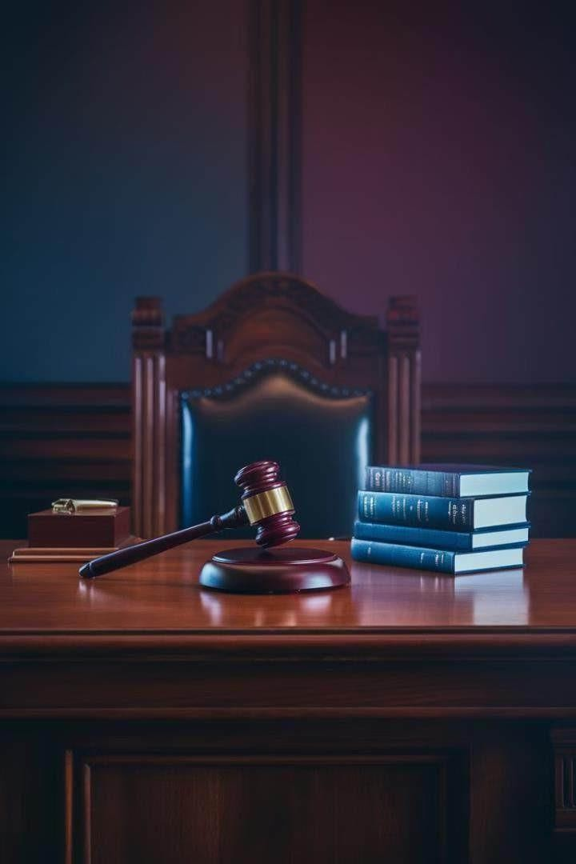
Introduction
Welcometo this comprehensiveanalysisof landmark trespasscasesin Englishlaw. This presentationwill explore pivotalcourt decisionsthat haveshapedour understanding of propertyrightsandpersonal space. Throughexamining thesecases, we'll uncover the evolvingnatureof trespasslawandits implicationsfor modernlegal disputes. Joinus on thisjourneythrough legal historyaswe dissect keyprinciples, challenge assumptions,andconsider the future of trespassinan ever-changing world.

Slide 4
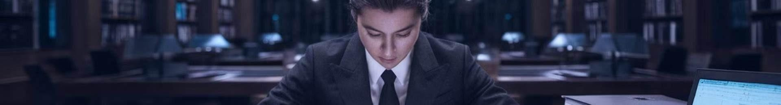
The Case Study Method in Legal Analysis
1
Step 1: Identify Key Facts
Begin by carefully reading the case and identifying the crucial facts that influenced the court's decision. This step forms the foundationfor understandingthe legal issues at hand.
2
Step 2: Analyse Legal Principles
Examine the legal principles appliedby the court in reaching its decision. This involves understandingprecedents, statutes, and the court's interpretationof the law.
3
Step 3: Evaluatethe Court's Reasoning
Critically assess the court's logic and argumentation. Consider alternative viewpoints and potential weaknesses in the reasoning.
4
Step 4: Apply to Contemporary Issues
Reflect on how the case's principles can be applied to modernlegal challenges, considering societal changes and technologicaladvancements.

Slide 5
Landmark Case 1: Entick v Carrington [1765]
Background
Key Legal Issues
Court's Decision
John Entick, a writer critical of the government, had his home searched and and papers seized by agents of the King. The King. The search was conducted without a without a valid warrant, leading to a lawsuit lawsuit against the agents.
The case centred on the legality of general warrants and the limitsof state power in entering private property. It raised fundamental questions about individual rights and the rule of law.
The court ruled in favour of Entick, establishing that the state's intrusion into into private property requires lawful authority. This landmark decision laid the the foundation for the concept of 'every man's home is his castle' in English law.

Slide 6
Landmark Case 2: Bernstein of Leigh v Skyviews & General General Ltd
Case Overview
This 1978 case involved a dispute over over aerial photography of the plaintiff's plaintiff's estate without permission. It
It raised questions about the extent of
of property rights in airspace above land. land.
Legal Principle Established
The court ruled that a landowner's rights rights extend only to the height necessary necessary for ordinary use and enjoyment enjoyment of the land. This decision effectively limited the ancient maxim 'cujus est solum ejus est usque ad coelum coelum et ad inferos' (whoever owns the the soil owns everything up to the sky and sky and down to the depths).
Impact on Modern Law
This case has significant implications for for issues such as drone usage, aerial
surveillance, and air travel rights, balancing
balancing property rights with technological advancements and public public interest.

Slide 7


Landmark Case 3: Collins v Wilcock
Incident
A police officer grabbed a woman's arm to detain her for questioning, leading to a charge of
a charge of assault against the officer.
Legal Question
The case examined the boundaries of lawful physical contact by police and the definition of definition of battery in the context of minor touchings.
Court's Ruling
The court held that not all touchings constitute battery, introducing the concept of
of 'acceptable touching' in social interactions.
Legal Impact
This case refined the understanding of battery and trespass to the person, influencing police
influencing police conduct and personal space rights.

Slide 8
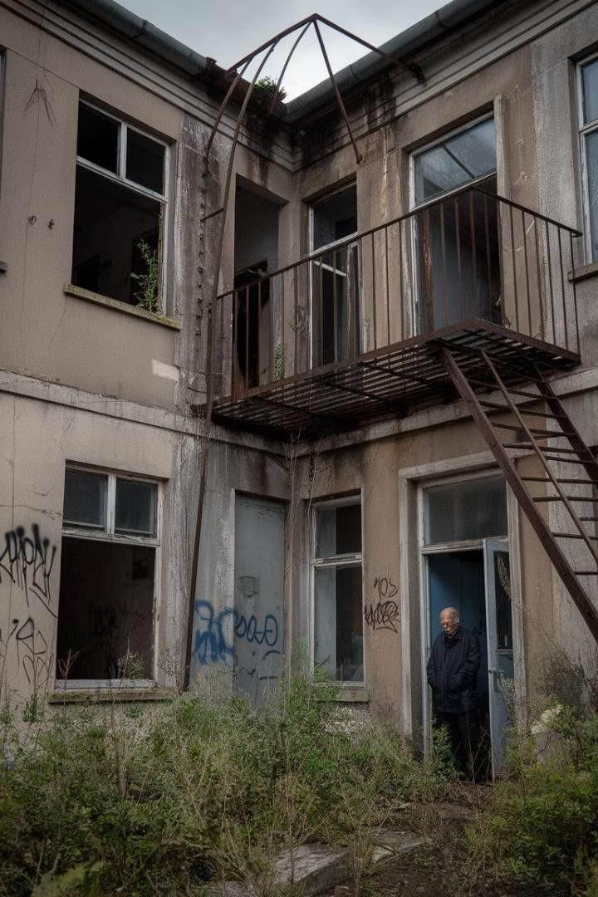
Landmark Case 4: Southwark London Borough Council v Williams
1
Background
Homeless families occupied empty council houses without permission, claiming necessity as a defence against trespass.
2
Legal Arguments
The defendants argued that their actionswere justified by necessity due to their dire circumstances circumstances and the council's failure to provide housing.
3
Court's Decision
The court rejected the necessity defence, ruling that it cannot be used to justify trespass in cases of
in cases of homelessness or housing shortages.
4
Implications
This case set a precedent limiting the use of necessity as a defence in civil trespass cases, particularly cases, particularly in housing disputes.

Slide 9
Legal Principles Derived from These Cases
1
Sanctity of Private Property
Entick v Carrington reinforced the principle that state intrusion intrusion into private property requires lawful authority, establishing a cornerstone of individual rights against government overreach.
2
Limits of Property Rights
Bernstein of Leigh v Skyviews & General Ltd redefined the vertical the vertical extent of property rights, adapting ancient principles principles to modern realities of air travel and technology. technology.
3
Nuanced Understanding of Battery
Collins v Wilcock refined the concept of battery, recognising that recognising that not all physical contact constitutes unlawful unlawful trespass to the person, particularly in social and professional contexts.
4
Limitations of Necessity Defence
Southwark London Borough Council v Williams established clear established clear boundaries on the use of necessity as a defence defence in civil trespass cases, particularly in housing disputes. disputes.

Slide 10
Implications for Modern Trespass Disputes
Technological Challenges
Social Media and Personal Space
Housing Rightsand Necessity
The principles established in these landmark landmark cases are now being tested by new by new technologies. Drones, for instance, instance, raise questions about airspace rights rights similar to those addressed in Bernstein Bernstein v Skyviews. The concept of trespass trespass must evolve to address issues of
In light of ongoing housing crises, the ruling in ruling in Southwark v Williams continues to continues to be debated. Some argue for a for a more flexible approach to necessity in necessity in trespass cases involving homeless homeless individuals, highlighting the tension tension between property rights and social social welfare.
The nuanced understanding of battery from Collins v Wilcock may need reinterpretation in the context of online interactions. As our lives increasingly merge with digital spaces, the boundaries of personal space and acceptable 'touching' become more complex.
of digital intrusion and data privacy.

Slide 11
Interactive Activity: Identifying Principles in New Cases Cases
Case Scenario 1: Drone Surveillance
A homeowner sues a neighbour for flying a drone over their their property to take photos. Participants must apply principles principles from Bernstein v Skyviews to this modern context. context.
Case Scenario 2: VR Trespass
A company creates a virtual reality model of a famous building building without permission. Participants discuss whether this this constitutes trespass, considering principles from Entick v
v Carrington.
Case Scenario 3: Social Media Intrusion
An individual claimsemotional distress from unwanted social media social media contact. Participants apply principles from Collins v Collins v Wilcock to determine if this constitutes a form of battery or battery or trespass.
Case Scenario 4: Squatters' Rights
Activists occupy an abandoned building to provide shelter for for homeless people. Participants debate the application of Southwark v Williams in light of current social issues.

Slide 12





Q&A: Unresolved Controversies in Trespass Law
Digital Trespass
How should the law address trespass trespass in virtual spaces or digital digitalproperty? Does unauthorised unauthorised access to online accounts constitute trespass?
Balancing Rights
How can we balance property rights rights with public interest, especially in especially in cases of environmental environmental protection or historical historical preservation?
International Boundaries
In an increasingly globalised world, world, how do we address trespass trespass issues that cross international international borders, such as data data storage in foreign countries? countries?
AI and Autonomy
As AI becomes more advanced, how how do we handletrespass committed by autonomous systems? systems? Who is liablewhen an AI- AI-controlled drone trespasses?

Slide 13

Evolution of Trespass Law in the Digital Age
1
Traditional Trespass
Historically focused on physical intrusion onto tangible property or unwanted bodily contact.
2
Cyber Trespass
Emergence of cases involving unauthorised access to computer systems and networks, networks, challenging traditional concepts.
3
Data Trespass
Growing concerns about unauthorised collection, use, or manipulation of personal data as a
data as a formof trespass.
4
Virtual Reality Trespass
Potential future cases involving intrusion or unwanted interactions in virtual spaces, blurring blurring lines between physical and digital realms.

Slide 14
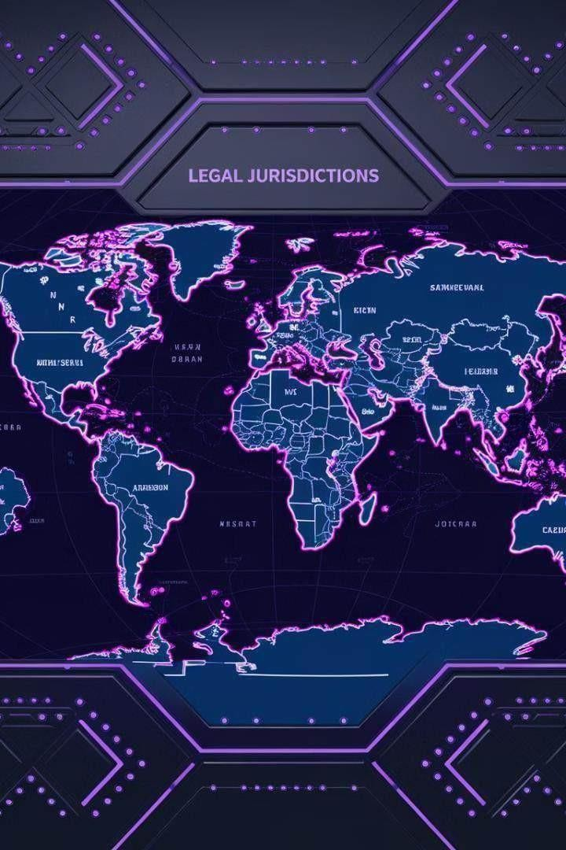
Comparative Analysis: Trespass Law Across Jurisdictions
Jurisdiction | Key Principles | Notable Differences
England and Wales | Strict liability, no damage required | Distinction between trespass trespass to land and trespass trespass to the person
United States | Intentional tort, damage often often required | Varies by state, stronger emphasis on property rights
Hong Kong | Similar to English law, with local adaptations | Influenced by Chinese customary law in some aspects
European Union | Varies by member state, harmonisation efforts ongoing | Greater emphasis on privacy rights in some countries

Slide 15
Case Study: Trespass in Hong Kong - Novel Developments
Trespass and Public Order
Digital Trespass Considerations
Cultural Influences
Recent cases in Hong Kong have explored the intersection of trespass law and publicorder regulations, particularly in the context of political demonstrations. These cases highlight the delicate balance between property rights, freedom of assembly, and state authority.
The unique legal system of Hong Kong, blending English common law with Chinese traditions, has led to nuanced interpretations of trespass. Some cases have considered traditional concepts of land use and community access in applying trespass principles.
Hong Kong's position as a global financial hub has led to pioneering cases addressing digital trespass. Courts have grappled with issues such as unauthorised accessto blockchain assets and the applicability of trespass law to smart contracts.

Slide 16


Future Challenges in Trespass Law
Augmented Reality Disputes
As AR technology becomes moreprevalent, laws will need to address issues of virtual
virtual objects 'placed' on privateproperty withoutpermission.
Autonomous Vehicle Navigation
The increasing use of self-driving cars may lead to new questionsabouttrespass when these when these vehicles make routing decisions that affect private property.
Biometric Data Rights
The collection and use of biometric data may be considered a form of trespass, requiring
requiring new legal frameworks to protect individual rights.
Space Law and Trespass
As private space exploration grows, laws will need to addresstrespass issues in orbital space orbital space and on celestial bodies.

Slide 17
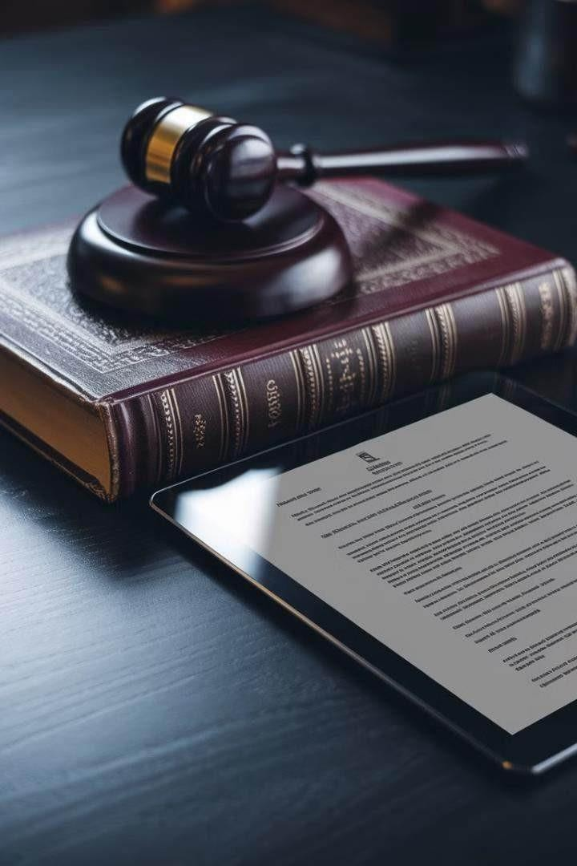
Conclusion: The Enduring Relevance of Trespass Law
1
Adaptability of Common Law
The evolution of trespass law from Entick v Carrington to modern digital cases demonstrates the flexibility and enduring relevance of common law principles in addressing new challenges.
2
Balancing Interests
Trespass law continues to play a crucial role crucial role in balancing individual rights, rights, property interests, and societal needs, adapting to technological and social social changes.
3
Global Perspectives
The comparative analysis of trespass law law across jurisdictions highlights the importance of considering diverse legal legal approaches in an interconnected world.
4
Future Directions
As we face new frontiers in technology and and society, trespass law will undoubtedly undoubtedly continue to evolve, requiring requiring ongoing analysis, debate, and and thoughtful application of established established principles to novel situations. situations.

