Slide 1

Tort Law- Negligence
Duty of Care, Breach, Causation and Damages
Tutor: Okwudili O. ONWURAH, LL.B. (Nigeria); BL (Abuja, Nigeria); LLM (Exeter, UK); LLM (Qingdao, PRC); LLM (Shanghai, PRC)
PhD in Law (Hong Kong)
Dr Okwudili O. Onwurah

Slide 2
Minor House Keeping
The purpose of the online lesson is to encourage you to participate actively in achieving your needs and simplifying your legal education. I want you to be the best!
Will make the learning process more interactive discussions and feel free to ask any question or you can speak.
You have the right to choose whether to turn on your video or not.
Participation prepares you for your exam and learning needs with ease.

Slide 3
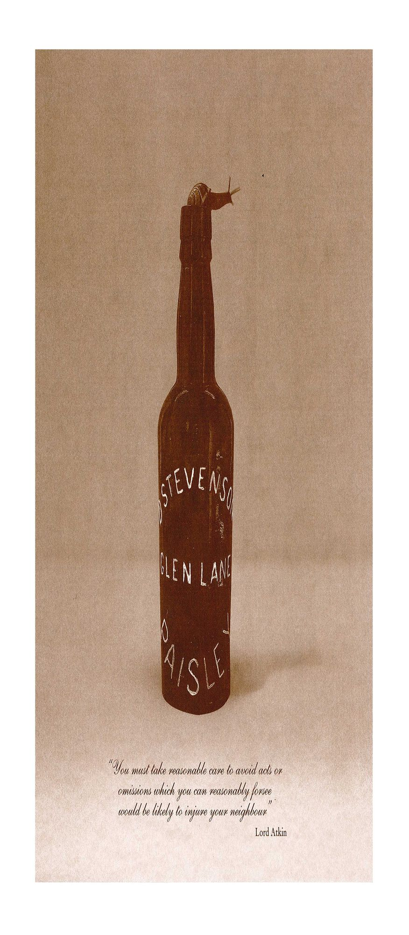
Question One (1)
Explain the meaning of the “neighbour principle” with reference to cases.
Neighbour principle is a principle of English law which says that a person should take reasonable care to avoid acts or omissions that s/he can reasonably foresee as likely to cause injury to the neighbour.
Neighbour includes all persons who are so closely and directly affected by the act that the actor should reasonably think of them when engaging in the act or omission in question.
“You must take reasonable care to avoid acts or omissions which you can reasonably foresee would be likely to injure your neighbour”- Per Lord Atkin
Donoghue v Stevenson (1932) – Plaintiff became ill after drinking a bottled of ginger beer packaged in an opaque bottle by the defendant manufacturer because a decomposed snail was found inside.

Slide 4
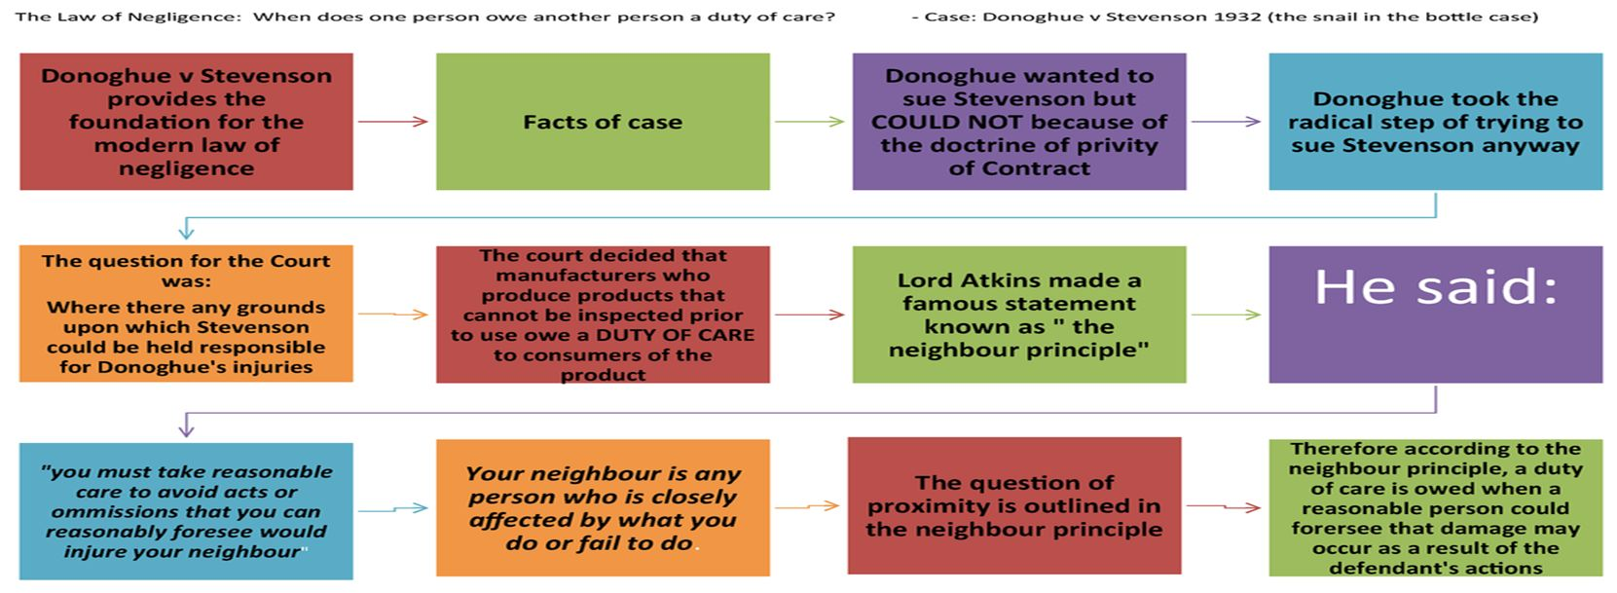
Q.1
Source: https://www.studocu.com/en-au/document/western-sydney-university/introduction-to-crime-and-criminal-justice/summaries/donoghue-v-stevenson-1932-ac-562-the-snail-in-the-bottle-case/2157712/view

Slide 5
Q.1
Donoghue v. Stevenson [1932] AC 562 at p.580 that:
  “…The rule that you are to love your neighbor becomes in law, you must not injure your neighbour; and the lawyer’s question, who is my neighbour? receives a restricted reply. You must take reasonable care to avoid acts or omissions, which you can reasonably foresee, would be likely to injure your neighbour. Who, then, in law is my neighbour? The answer seems to be – persons who are so closely and directly affected by my act that I ought reasonably to have them in contemplation as being so affected when I am directing my mind to the acts or omissions which are called in question.”
Grant v Australian Knitting Mills Ltd (1936) – The defendant manufacturer was held liable for allowing excess bisulphite of soda in the underpants which caused the plaintiff to suffer from dermatitis after using the underpants

Slide 6
Q.1
Distributors: Kubach v Hollands (1937) – A distributor was held liable for failing to notify the plaintiff of manufacturer’s warning that the chemical powder must be “examined and tested by the user before use”
  Cf. Lam Mo Bun v Hong Kong Aerosol Co Ltd [2001] (use of insecticide when using washing machine indoors)
Repairers: Stennett v Hancock & Peters (1939) - A repairer was liable to a pedestrian who was injured when the wheel came off a vehicle repaired by the defendant.
  See Luen Hing Fat Coating & Finishing Factory Ltd v Waan Chuen Ming (2011) (involving independent contractor)
Applies to wholesalers, retailers, assemblers, etc.

Slide 7
Questions Two(2)
What is the difference between causation in fact and causation in law?
Consider the following two cases: Barnett’s Case and The Wagon Mound

Slide 8

Q. 2 :Causation in fact:-
  Implies that there is a causal connection or link between the defendant’s negligence and the plaintiff’s injury. There could be situations multiple causation, consecutive causation, and novus actus interveniens
  The “but-for” test is often used in determining a causal link.
  Applied in Barnett’s Case.

Slide 9

Q. 2 Barnett’s Case
Barnett v Chelsea & Kensington Hospital Management Committee[1969]
Plaintiff’s husband died from arsenic poisoning after taking some tea with two other watchmen. The doctor on duty at the casualty department refused to attend to them and advised them to seek the help of their doctors.
Held-
  The defendant’s casualty officers were negligent
  No actual causal link between the death of the deceased and the defendant’s negligence because if all care had been taken, the deceased would have died anyway.

Slide 10

Q. 2 : Causation in law:-
  Deals with remoteness of damage.
  Remoteness of damage relates to the requirement that the damage must be of a foreseeable type. In negligence claims, once the claimant has established that the defendant owes them a duty of care and is in breach of that duty which has caused damage, they must also demonstrate that the damage was not too remote.
  This implies that for a plaintiff to establish a causal link, the plaintiff must prove that the harm is foreseeable by a reasonable person.
  A test of foreseeability was applied in The Wagon Mound.

Slide 11
Q. 2 The Wagon Mound
Overseas Tankship (UK) Ltd v Morts Dock & Engineering Co Ltd (The Wagon Mound) [1961]
Fact: The Plaintiff, Morts Dock & Engineering Co., Ltd. (Plaintiff), operated a dock in the Port of Sydney. The Defendants were the charterers of the vessel Wagon Mound (Defendants). Wagon Mound was moored 600 feet from the Plaintiff’s wharf when, due the Defendant’s negligence, she discharged furnace oil into the bay causing minor injury to the Plaintiff’s property. However, the oil was ignited when molten metal dropped from the wharf and came into contact with cotton waste floating on the water’s surface. The fire seriously damaged the wharf and two ships docked there.
Morts was successful in obtaining damages at trial, which Overseas Tankship appealed. Appeal was allowed.
Held: The injury to Plaintiff’s property, though a direct result of the defendant’s negligence, was an unforeseeable consequence and liability does not attach.

Slide 12
Question Three (3)
How do you determine whether a person is in breach of duty?
Which tests would you use?
Use case law to illustrate the point.
Objective Standard- Reasonableness test or test of reasonable person.
‘Reasonable man’ refers to a reasonable person of ordinary intelligence. The test is therefore objective - Bolton v. Stone (1951),
Not a standard of personal idiosyncrasies (not subjective standard)
Special standards can be applied to sui generis categories like children, professionals, experts or skilled persons.
  Children- McHale v Watson- (12-year-old boy threw a steel rod at a post and it injured a girl, boy held not negligent)
  Professionals- Bolam v Friern Hospital Management Committee- “…it is sufficient if he exercises the ordinary skill of a competent man exercising that particular art” and not just the standard of an ordinary reasonable person.

Slide 13
Q. 3 – determining factors
Foreseeability of harm- Whether a risk is foreseeable is determined by reference to the current knowledge at the time the harm is caused.
    Roe v Minister of Health [1954)- (injection of anaesthetic stored in ampoule and contaminated with carbonic acid, plaintiff suffered spinal paralysis) no breach of duty of care
    Wong Wai Ming v Hospital Authority [2001]- (throwing of sulphuric acid at the plaintiff/employee in the reception psychiatric centre, previous incidence of violence at the centre) breach of duty
    Bolton v Stone [1951]- (cricket ball hit and injured plaintiff, previous occurrence 6 times in past 30 years and cricket field protected by a 17-foot fence) no breach of duty of care

Slide 14
Q. 3
Seriousness of harm- Inherent dangers call for greater precautions. The risk of greater injury requires greater precaution.
  Paris v Stepney Borough Council [1951]- (A piece of metal totally blinded a one-eyed man while using a hammer to remove a bolt) Being a one-eyed man, the defendant should have taken more precaution, hence in breach of duty of care.
  See also Koehler v Cerebos (Australia) Ltd (2005) where;
    Koehler was given a job merchandising between many stores. She complained many times in writing and orally that the job was too much for her (but never stated it interfered with her health). She saw a doctor and was diagnosed with a psychiatric condition
    Held: It was not reasonably foreseeable for the workplace to think that she would get a psychiatric injury.

Slide 15
Q. 3
Cost of preventing harm- “In every case of a foreseeable risk, it is a matter of balancing the risk against the measure necessary to eliminate it”- Per Denning LJ, in Latimer v AEC Ltd [1952]
  Wayfoong Credit Ltd v Tsui Sui Man [1984]
    Fire from defendant’s factory for manufacturing of plastic dolls damaged plaintiff’s adjoining premises and machines.
    Held: A reasonable person in defendant’s situation would not spent much to build fire-resistant facility for storing 4 tons of plastic, since there is no such practice in Hong Kong. No breach of duty of care
  Where taking precaution is inexpensive and simple, failure to do so amounts to breach of duty of care. See Haley v London Electricity Board [1965]

Slide 16
THE END!
Any Question(s)?

