Slide 1




Case Study Analysis:
Landmark Vicarious Liability Cases
Tutor: Okwudili O. ONWURAH, LL.B. (Nigeria); BL (Abuja, Nigeria); LLM
(Exeter, UK); LLM (Qingdao, PRC); LLM (Shanghai, PRC)
PhD in Law (Hong Kong)
Dr Okwudili O. Onwurah
11/23/2024
1

Slide 2

The purpose of the online lesson is to encourage you to participate actively in achieving your needs and simplifying your legal education. I want you to be the best!
Minor House Keeping
Will make the learning process more interactive discussions and feel free to ask any question or you can speak.
You have the right to choose whether to turn on your video or not.
Participation prepares you for your exam and learning needs with ease.
11/23/2024
2

Slide 3
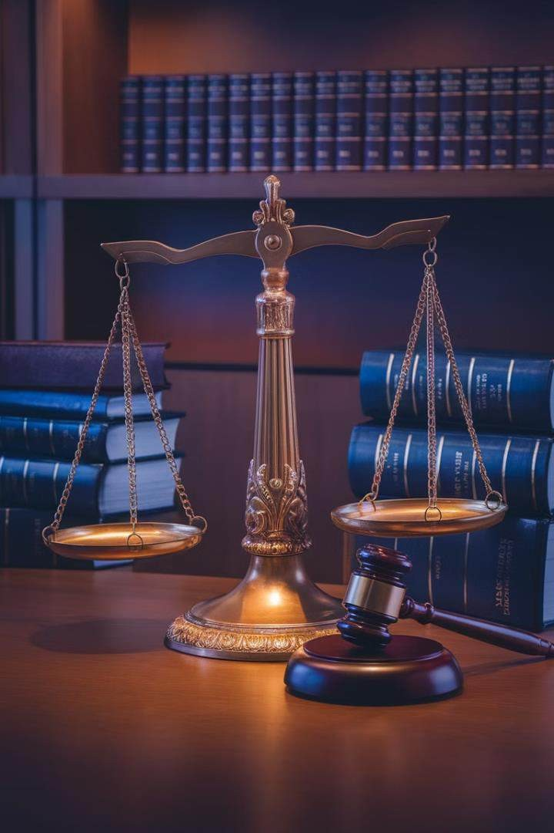
Introduction
Welcome to this comprehensive analysis of landmark vicarious liability cases. This presentation will explore key court decisions that have shaped the doctrine of vicarious liability in English and Hong Kong law. We will examine the facts, reasoning, and implications of these cases, deriving essential principles that continue to guide courts and inform employer practices today. Through this case study approach, we aim to deepen your understanding of vicarious liability and its evolving application in modern legal contexts.

Slide 4
Overview of Case Study Method
Step 1: Identify Key Facts
Step 2: Understand Legal Issues
Carefully read through the case, noting the parties involved, the timeline of events, and the specific circumstances that led to the legal dispute.
Identify the central legal questions the court was asked to address, address, focusing on the elements of vicarious liability in each case. each case.
Step 3: Analyse Court's Reasoning
Step 4: Consider Implications
Examine the court's rationale, paying attention to how they interpreted and applied existing legal principles to reach their their decision.
Reflect on how the case's outcome impacts future legal interpretations and what it means for employers and employees in employees in various industries.
The case study method is a powerful tool for understanding complex legal concepts. By closely examining landmark cases, we can trace the evolution trace the evolution of vicarious liability doctrine and gain insights into its practical application. This approach not only enhances our comprehension of comprehension of legal principles but also develops critical thinking skills essential for legal professionals.

Slide 5
Case 1: Lister v Hesley Hall Ltd
1
Background (1996)
Hesley Hall Ltd operated a boarding annex for children with emotional and behavioural difficulties. The company employed a warden, who was later who was later discovered to have sexually abused several residents.
2
Legal Challenge (1997-2001)
The victims sued Hesley Hall Ltd, arguing that the company should be vicariously liable for the warden's actions. The case made its way through the court
system, reaching the House of Lords.
3
House of Lords Decision (2001)
The House of Lords held that Hesley Hall Ltd was indeed vicariously liable for the warden's abusive acts. They introduced a new test for vicarious liability, for vicarious liability, focusing on the 'close connection' between the employment and the wrongful act.
This landmark case significantly expanded the scope of vicarious liability, moving away from the traditional 'course of employment' test. The court emphasised that employers emphasised that employers could be held responsible for employees' intentional wrongdoing if it was closely connected to their authorised duties.

Slide 6
Case 2: Mohamud v WM Morrison Supermarkets plc plc
Case Facts
Legal Journey
Supreme Court Decision
In 2008, Mr Mohamud entered a Morrisons Morrisons petrol station and asked the attendant, Mr Khan, if he could print some some documents from a USB stick. Mr Khan Khan refused, using racist language, and then and then followed Mr Mohamud to his car, car, physically assaulting him.
Mr Mohamud sued Morrisons for vicarious vicarious liability. The case was initially dismissed in the lower courts but eventually eventually reached the UK Supreme Court in Court in 2016.
The Supreme Court ruled in favour of Mr Mohamud, holding Morrisons vicariously liable for Mr Khan's actions. They applied and refined the 'close connection' test from Lister, emphasising the importance of viewing the employee's field of activities broadly.
This case further expanded the scope of vicarious liability, demonstrating that employers could be held responsible even for seemingly unconnected violent acts by employees. The court's decision highlighted the need to consider the nature of the job and the extent to which the wrongful conduct was related to the employee's role.

Slide 7
Case 3: Barclays Bank v Various Claimants
1 2
3
1968-1984
2017
2020
Dr Gordon Bates conducted medical assessments for Barclays Bank job applicants applicants and employees. Unknown to the to the bank, he sexually assaulted many of many of the individuals he examined during during this period.
126 claimants brought a group action against Barclays Bank, arguing that the bank should be vicariously liable for Dr Bates' actions.
The UK Supreme Court ruled that Barclays Barclays Bank was not vicariously liable for for Dr Bates' assaults, as he was an independent contractor rather than an employee or someone in a relationship 'akin relationship 'akin to employment' with the the bank.
This case marked a significant refinement in the application of vicarious liability principles. The Supreme Court emphasised the importance of the importance of the employment relationship, drawing a clearer line between employees (or those in similar relationships) and independent contractors. This independent contractors. This decision provided some relief to businesses concerned about the expanding scope of vicarious liability following earlier cases. following earlier cases.

Slide 8
Key Principles Derived from These Cases
1
Close Connection Test
2
Broad Interpretation of Employee's Field of Activities
Established in Lister v Hesley Hall Ltd, this principle looks at whether there is a sufficiently close connection between the wrongful act and the nature of the employment. It replaced the narrower 'course of employment' test.
Mohamud v WM Morrison Supermarkets plc emphasised that courts should take a wide view of the employee's job responsibilities when considering vicarious liability.
3
Importance of Employment Relationship
4
Intentional Wrongdoing Inclusion
Barclays Bank v Various Claimants highlighted that vicarious liability liability typically applies only to employees or those in relationships relationships 'akin to employment', not to independent contractors. contractors.
These cases collectively establish that employers can be held liable for liable for intentional wrongdoing by employees, not just negligence, if negligence, if other criteria are met.
These principles have significantly shaped the modern doctrine of vicarious liability in English law. They provide a framework for courts to assess complex cases assess complex cases involving employer responsibility for employee actions, balancing the interests of victims, businesses, and public policy considerations. considerations.

Slide 9




Implications for Employers in Similar Industries
Enhanced Screening
Clear Policies
Training Programmes
Legal Review
Employers must implement rigorous background checks and and ongoing monitoring of employees, especially those in
in positions of trust or with access access to vulnerable individuals. individuals.
Organisations should develop and and enforce comprehensive policies outlining expected employee behaviour and consequences for misconduct. misconduct.
Regular training on ethical conduct, legal obligations, and appropriate workplace behaviour is crucial to minimise risks of employee misconduct.
Employers should regularly review review their relationships with workers to ensure proper classification of employees versus versus independent contractors. contractors.
These landmark cases have significant implications for employers across various industries. Organisations must now be more vigilant in their hiring vigilant in their hiring practices, employee management, and overall risk assessment. The expanded scope of vicarious liability means that employers means that employers could potentially be held responsible for a wider range of employee actions, even those that seem unrelated to their primary to their primary job duties.

Slide 10
Interactive Scenario: Applying Principles to New Cases
Scenario Presentation
Principle Application
Discussion
Decision
A delivery driver for an online retailer gets into a heated argument with a customer over a late delivery. The argument escalates, and the driver physically assaults the customer.
Apply the 'close connection' test and consider the broad interpretation of the employee's field of activities as established in Mohamud v WM Morrison Supermarkets plc.
Debate whether the assault was closely connected to the driver's employment duties and if the online retailer should be held vicariously liable.
Reach a conclusion based on the application of legal principles and and comparison with precedent cases.
This interactive scenario encourages participants to apply the principles derived from landmark cases to a new situation. By engaging in this exercise, law students and
law students and professionals can develop their analytical skills and gain a deeper understanding of how courts might approach similar cases in the future. It also highlights
future. It also highlights the complexities involved in determining vicarious liability in real-world situations.

Slide 11
Q&A: Unresolved Issues in Vicarious Liability
Question | Unresolved Issue
How far does the 'close connection' test extend? | Boundaries of employer liability for extremely unexpected employee actions
What constitutes a relationship 'akin to employment'? | Clarity on types of working relationships covered by vicarious liability
How does vicarious liability apply in the gig economy? | Liability for actions of workers in non-traditional employment structures structures
Can technology companies be vicariously liable for AI actions? | Application of vicarious liability principles to artificial intelligence
Despite the clarifications provided by landmark cases, several unresolved issues remain in the realm of vicarious liability. These questions highlight the ongoing challenges faced by courts in adapting traditional legal principles to modern working arrangements and technological advancements. As the nature of work continues to evolve, it is likely that courts will need to further refine and possibly expand the doctrine of vicarious liability to address these complex scenarios.

Slide 12
Comparative Jurisdictional Analysis: England
Historical Context
Recent Developments
Current Approach
England has a long-standing common law tradition that has significantly influenced the development of vicarious liability doctrine.
The principle of 'respondeat superior' (let the master answer) has been a cornerstone of English tort law for centuries.
English courts have shown a trend towards expanding the scope of vicarious liability, as evidenced by cases like Lister and Mohamud. However, Barclays Bank v Various Claimants suggests a potential pullback, emphasising the importance of the employment relationship.
English courts now apply a two-stage test: first, assessing the relationship between the wrongdoer and the defendant, and second, examining the connection between that relationship and the wrongdoer's act or omission.
The English approach to vicarious liability has been characterised by a gradual expansion of employer responsibility, balanced by occasional retrenchment to prevent overreach. This nuanced evolution reflects the courts' attempts to balance fairness to victims with the need to avoid imposing unreasonable burdens on businesses.

Slide 13
Comparative Jurisdictional Analysis: Hong Kong
Legal System
Key Cases
Hong Kong operates under a common law system, largely influenced by English law due to its colonial history. This foundation has shaped its approach to vicarious liability.
Hong Kong courts have generally followed English precedents, with cases like Ming An Insurance Co (HK) Ltd v Ritz-Carlton Ltd (2002) applying principles similar to those in Lister v Hesley Hall Ltd.
Unique Considerations
Future Directions
Hong Kong's dense urban environment and unique business landscape have led to some jurisdiction-specific applications of vicarious liability principles, particularly in cases involving domestic helpers and property management companies.
As Hong Kong continues to develop its own body of case law, it may may diverge slightly from English precedents to address local concerns concerns and business practices.
While Hong Kong's approach to vicarious liability closely mirrors that of England, there are subtle differences emerging due to the territory's unique social and unique social and economic context. The Hong Kong courts have shown a willingness to adapt English principles to local circumstances, creating a slightly distinct creating a slightly distinct body of jurisprudence on vicarious liability.

Slide 14
Comparative Jurisdictional Analysis: Australia
Pre-2000s
1
Australian vicarious liability law closely followed English precedents, with a
precedents, with a relatively narrow interpretation of employer liability.
liability.
2
2003: New South Wales v Lepore
The High Court of Australia grappled with the application of vicarious liability in cases of intentional wrongdoing, showing some divergence from the English approach.
2015: Prince Alfred College Inc v ADC
3
The High Court refined the test for vicarious liability, introducing the the concept of 'occasion' to determine when an employer should be held should be held liable for an employee's criminal acts.
4
Present Day
Australian courts continue to develop a distinct approach to vicarious vicarious liability, balancing policy considerations with legal principles. principles.
Australia's approach to vicarious liability has evolved to be more nuanced than its English counterpart. While still influenced by English precedents, Australian courts have Australian courts have developed their own tests and principles, particularly in cases involving intentional wrongdoing. This unique approach reflects Australia's efforts to tailor Australia's efforts to tailor vicarious liability doctrine to its specific social and legal context.

Slide 15




Comparative Jurisdictional Analysis: Canada
Bazley v Curry (1999)
Jacobi v Griffiths (1999)
671122 Ontario Ltd v Sagaz Industries Canada Inc (2001)
EB v Order of the Oblates of of Mary Immaculate (2005) (2005)
This landmark case established the the 'enterprise risk' test, focusing on focusing on whether the employer's employer's enterprise created or
or materially enhanced the risk of the
of the employee's wrongdoing.
Decided alongside Bazley, this case case helped refine the application of application of the enterprise risk test test in different contexts.
The Supreme Court of Canada clarified the distinction between employees and independent contractors for vicarious liability purposes.
This case further developed the enterprise risk test, emphasising the the need for a strong connection connection between the enterprise- enterprise-created risk and the wrongful act.
Canada has developed a distinct approach to vicarious liability, particularly through the 'enterprise risk' test established in Bazley v Curry. This test focuses on This test focuses on whether the employer's enterprise created or enhanced the risk that led to the harm, rather than solely on the closeness of the connection of the connection between the employee's duties and the wrongful act. This approach has allowed Canadian courts to take a more policy-oriented view of oriented view of vicarious liability, often leading to broader application than in some other jurisdictions.

Slide 16
Comparative Analysis: Key Differences and Similarities
Jurisdiction | Key Principle | Unique Feature
England | 'Close connection' test | Recent reaffirmation of employment relationship importance
Hong Kong | Follows English precedents closely | Adaptations for local business practices
Australia | 'Occasion' test | Focus on employer's role in providing occasion for wrongdoing
Canada | 'Enterprise risk' test | Emphasis on policy considerations and risk creation
While all four jurisdictions share a common law heritage and broadly similar approaches to vicarious liability, each has developed distinct nuances in their legal tests and application. England's 'close connection' test has been influential but interpreted differently across jurisdictions. Hong Kong closely follows English precedents but with local adaptations. Australia's 'occasion' test and Canada's 'enterprise risk' test represent more significant departures, reflecting these jurisdictions' efforts to develop approaches that better suit their specific legal and social contexts.

Slide 17

Conclusion: The Future of Vicarious Liability
Evolving Work Relationships
As gig economy and remote work arrangements become more prevalent, courts will need to adapt vicarious liability principles to these new forms of employment.
Technological Advancements
The rise of AI and autonomous systems will challenge traditional notions of employer-employee relationships and liability.
Global Harmonisation
Increasing cross-border business activities may drive efforts to harmonise vicarious liability principles across jurisdictions.
Balancing Act
Courts will continue to grapple with balancing victim protection, fair risk allocation, and avoiding undue burdens on businesses.
The doctrine of vicarious liability continues to evolve, shaped by changing societal norms, technological advancements, and emerging forms of work. While the core principles established in landmark cases remain landmark cases remain influential, courts across jurisdictions are likely to face new challenges in applying these principles to novel situations. The future of vicarious liability law will require a delicate balance between delicate balance between maintaining consistency with established precedents and adapting to the realities of a rapidly changing world. Legal professionals must stay attuned to these developments to effectively developments to effectively navigate this complex area of tort law.

