Slide 1

Trespass in the Digital Realm: Unauthorized Access to Computer Systems
Tutor: Okwudili O. ONWURAH, LL.B. (Nigeria); BL (Abuja, Nigeria); LLM (Exeter, UK); LLM (Qingdao, PRC); LLM (Shanghai, PRC)
PhD in Law (Hong Kong)
Dr Okwudili O. Onwurah

Slide 2
Minor House Keeping
The purpose of the online lesson is to encourage you to participate actively in achieving your needs and simplifying your legal education. I want you to be the best!
Will make the learning process more interactive discussions and feel free to ask any question or you can speak.
You have the right to choose whether to turn on your video or not.
Participation prepares you for your exam and learning needs with ease.

Slide 3
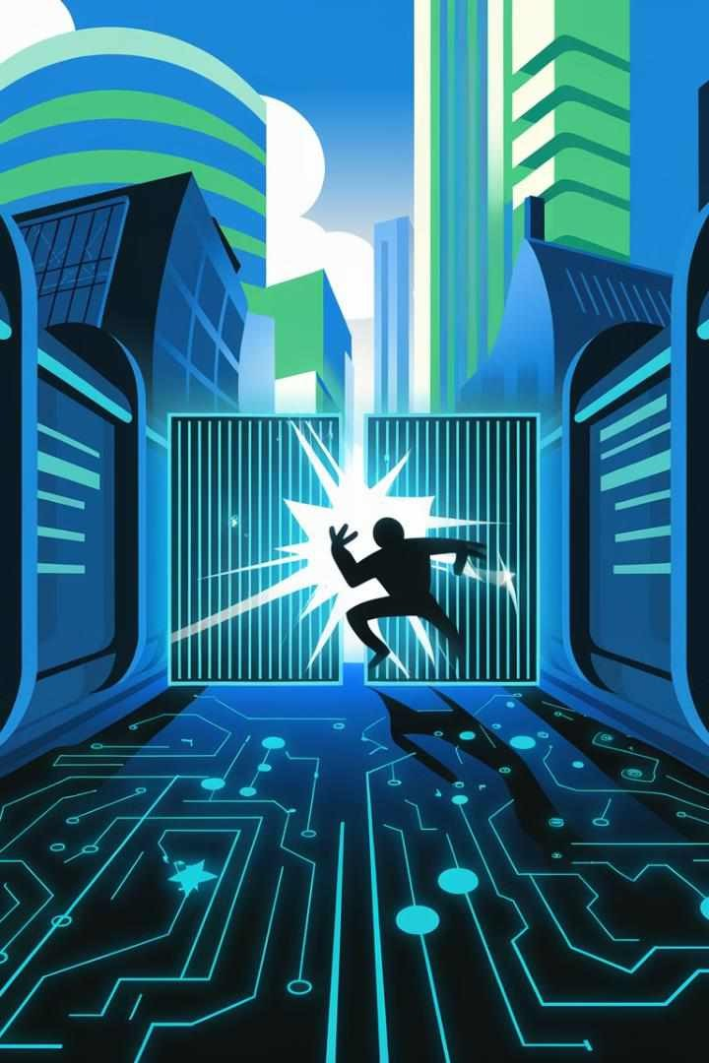
Introduction
In the ever-evolving landscape of technology, the concept of trespass has expanded beyond physical boundaries into the digital realm. This presentation explores the legal implications of unauthorized access to computer systems, examining how traditional principles of trespass have been adapted to address cybercrime. We will delve into relevant case law from the United Kingdom and Hong Kong, analyse key legislation, and discuss the practical challenges of identifying and proving digital trespass. Join us as we navigate the complex intersection of property law and cybersecurity in the 21st century.

Slide 4

Expanding the Scope of Trespass to the Digital Space
1
Traditional Trespass
Historically, trespass was defined as the unlawful entry onto another's land. This concept was firmly rooted in physical property rights and tangible boundaries.
2
Digital Revolution
With the advent of computers and networks, the notion of 'property' expanded to include digital assets and systems. This shift necessitated a re-evaluation of trespass laws.
3
Legal Adaptation
Courts and legislators began to recognize that unauthorized access to computer systems could constitute a form of trespass, leading to the development of new laws and legal interpretations.
4
Current Landscape
Today, digital trespass is a recognized legal concept, encompassing various forms of unauthorized access, data breaches, and cyber intrusions.

Slide 5
Hong Kong Computer Crimes Ordinance Provisions
Section 161: Access to Computer with Criminal or Dishonest Intent
This provision criminalizes unauthorized access to a computer with intent to commit an offence or with a dishonest intent to deceive. It carries a maximum penalty of five years' imprisonment.
Section 27A: Unauthorized Access to Computer by Telecommunications
This section specifically addresses unauthorized access to computer systems through telecommunications networks, reflecting the interconnected nature of modern cybercrime.
Section 60: Making False Entries in Bank Books by Computer
This provision targets financial cybercrime, addressing the use of computers to make false entries in bank records with intent to defraud.
Section 85: Obtaining Unauthorized Access to Computer by Telecommunications
Similar to Section 27A, this provision focuses on unauthorized access through telecommunications, but is specifically located within the Telecommunications Ordinance.

Slide 6
Key Principles: Unauthorized Access and Interference
Unauthorized Access
Interference
Intent and Knowledge
This principle forms the cornerstone of digital trespass. It occurs when an individual gains entry to a computer system without permission or exceeds their authorized level of access. This can include actions such as password cracking, exploiting security vulnerabilities, or using someone else's credentials.
Beyond mere access, interference involves actions that disrupt or impair the functioning of a computer system. This can include introducing malware, altering or deleting data, or causing system crashes. Interference is often considered a more severe form of digital trespass due to its potentially destructive nature.
Many jurisdictions require proof of intent or knowledge for a digital trespass offence. This means that accidental access may not be criminalized, but reckless or deliberate actions are. The level of intent required can vary depending on the specific legislation and jurisdiction.

Slide 7

Case Law: R v Gold and Schifreen (1988)
The Incident
In 1984, Robert Schifreen and Stephen Gold gained unauthorized access to British Telecom's Prestel service, including the personal message box of Prince Philip.
Appeal and Acquittal
The convictions were overturned by the House of Lords in 1988, ruling that the Forgery and Counterfeiting Act was not designed to cover computer hacking.
1
2
3
4
Initial Conviction
The defendants were convicted under the Forgery and Counterfeiting Act 1981 for defrauding the computer system by using a false instrument (the stolen passwords).
Legal Impact
This case highlighted the need for specific legislation to address computer crimes, leading to the creation of the Computer Misuse Act 1990 in the UK.

Slide 8
US Influence: eBay Inc v Bidder's Edge Inc (1999)
1
Case Background
eBay sued Bidder's Edge for repeatedly accessing its website to collect pricing information. This case marked a significant attempt to apply the doctrine of trespass to chattels to the digital realm.
2
Court's Ruling
The US District Court granted a preliminary injunction against Bidder's Edge, finding that their repeated queries could constitute trespass to chattels by potentially harming eBay's computer systems.
3
Legal Implications
This case set a precedent for treating unauthorized access to websites as a form of digital trespass, influencing subsequent cases and legislation worldwide.
4
Global Impact
While a US case, eBay v Bidder's Edge has been widely discussed in international legal circles, including in the UK and Hong Kong, shaping the global discourse on digital trespass.

Slide 9

Practical Challenges: Identifying and Proving Digital Trespass
Detection
Identifying digital trespass often requires sophisticated monitoring systems and expert analysis. Unlike physical trespass, digital intrusions can be subtle and may go unnoticed for extended periods.
Attribution
Tracing the origin of a digital trespass can be extremely challenging due to techniques like IP spoofing, VPNs, and the use of compromised systems as intermediaries.
Evidence Gathering
Collecting and preserving digital evidence in a forensically sound manner is crucial. This often requires specialized tools and expertise to ensure the admissibility of evidence in court.
Jurisdictional Issues
Digital trespass often crosses international borders, raising complex jurisdictional questions and making prosecution challenging.
Proving Intent
Demonstrating that unauthorized access was intentional rather than accidental can be difficult, especially in cases involving complex systems or technical vulnerabilities.

Slide 10
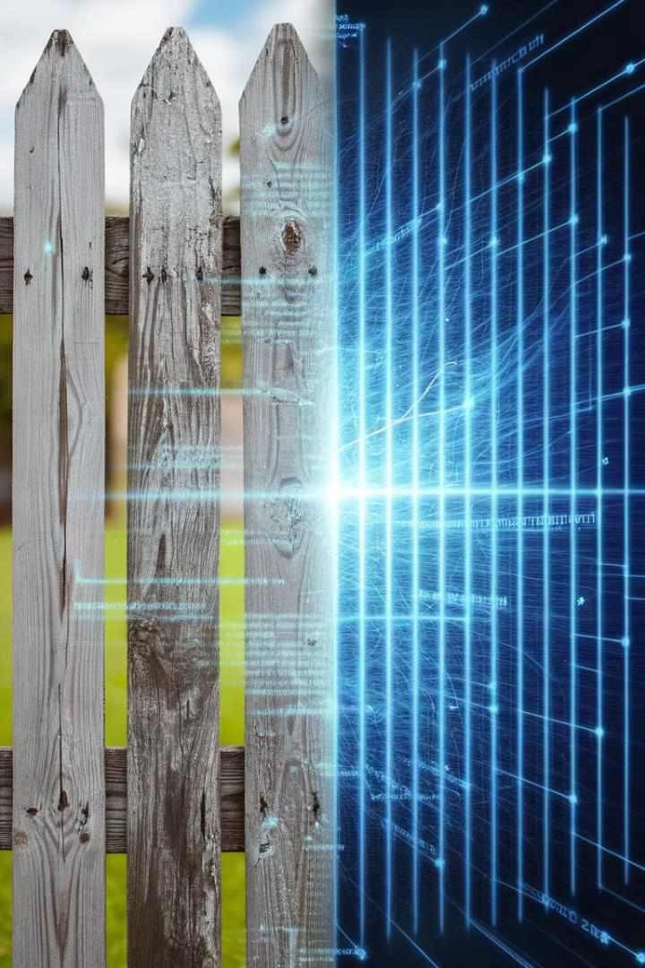
Comparison with Traditional Trespass Principles
Aspect | Traditional Trespass | Digital Trespass
Boundaries | Physical, visible | Virtual, often unclear
Evidence | Physical traces, witnesses | Digital logs, forensic analysis
Intent | Often easier to infer | Can be more ambiguous
Damage | Usually tangible | May be intangible or delayed
Jurisdiction | Typically local | Often cross-border

Slide 11




Recommendations for Cybersecurity Compliance
Implement Robust Access Controls
Utilize strong authentication methods, including multi- factor authentication, to prevent unauthorized access. Regularly review and update access permissions to ensure they align with current roles and responsibilities.
Develop Clear Policies
Create and communicate comprehensive cybersecurity policies that outline acceptable use of systems, data handling procedures, and consequences for policy violations. Regularly update these policies to address emerging threats and technologies.
Conduct Regular Training
Provide ongoing cybersecurity awareness training to all employees, covering topics such as recognizing phishing attempts, proper data handling, and the importance of maintaining strong passwords.
Implement Monitoring Systems
Deploy advanced intrusion detection and prevention systems to identify potential security breaches quickly.
Regularly review system logs and conduct security audits to detect any unauthorized access attempts.

Slide 12

Digital Trespass Scenario: Social Media Account Hijacking
Scenario
An individual gains unauthorized access to a celebrity's social media account by exploiting a weak password. They post inflammatory content, causing reputational damage.
Legal Implications
This action could constitute digital trespass under various cybercrime laws. It involves unauthorized access to a computer system (the social media platform) and interference with data.
Challenges
Proving the identity of the perpetrator may be difficult if they used sophisticated methods to hide their digital footprint. The cross-border nature of social media platforms may also complicate jurisdiction.
Prevention
This scenario highlights the importance of strong password policies, two-factor authentication, and regular security audits for high-profile accounts.

Slide 13
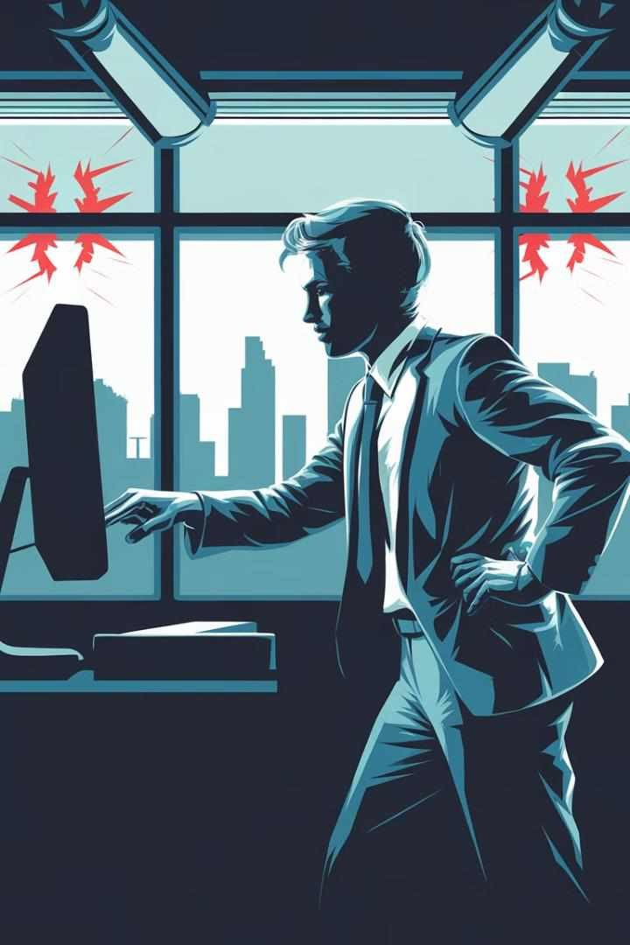
Digital Trespass Scenario: Corporate Espionage
1
Infiltration
An employee of Company A uses their credentials to access confidential research and development files of Company B, their employer's main competitor.
2
Data Exfiltration
The employee copies and transfers the confidential data to an external storage device, intending to sell it to Company A.
3
Detection
Company B's IT security team notices unusual access patterns and file transfers
during a routine security audit.
4
Legal Action
Company B pursues legal action against both the employee and Company A for digital trespass and theft of trade secrets.

Slide 14
Digital Trespass Scenario: IoT Device Exploitation
The Incident
Legal Considerations
Challenges and Implications
A hacker gains unauthorized access to a network of smart home devices, including security cameras and smart locks. They exploit weak default passwords and unpatched vulnerabilities in the devices' firmware.
This scenario raises questions about the application of digital trespass laws to Internet of Things (IoT) devices. It also highlights the potential for physical harm resulting from digital trespass, as compromised smart locks could allow physical break-ins.
Prosecuting this type of digital trespass may be complicated by the distributed nature of IoT networks and the potential for multiple affected parties across different jurisdictions. It also underscores the need for robust security measures in IoT devices and clear legal frameworks to address emerging technologies.

Slide 15

Audience Q&A: Emerging Threats in Digital Trespass
1
AI-Powered Attacks
How does the law address digital trespass facilitated by artificial intelligence, such as automated hacking tools or deepfake- based social engineering?
2
Cloud Computing Challenges
In multi-tenant cloud environments, how do we define and enforce boundaries to prevent digital trespass between different users or organizations sharing the same infrastructure?
3
Quantum Computing Implications
As quantum computing advances, how might this impact our current understanding of digital trespass, particularly in relation to encryption and secure access controls?
4
Virtual and Augmented Reality
How do digital trespass laws apply to virtual spaces in VR/AR environments, especially when these spaces represent or interact with real-world locations or data?

Slide 16

Audience Q&A: International Cooperation in Cybercrime Prosecution
Current Frameworks
Discussion of existing international agreements and treaties related to cybercrime, such as the Budapest Convention on Cybercrime.
Challenges
Exploration of difficulties in cross-border investigations, including differences in legal systems, data privacy laws, and extradition agreements.
Best Practices
Highlighting successful examples of international cooperation in prosecuting digital trespass cases and lessons learned.
Future Directions
Discussion of emerging initiatives and proposals for improving global collaboration in addressing digital trespass and other cybercrimes.

Slide 17




Audience Q&A: The Future of Digital Trespass Law
Evolving Legal
Frameworks
How might digital trespass laws need to evolve to keep pace with rapidly advancing technology? Discussion of potential new legal concepts and principles to address emerging forms of cyber intrusion.
Global
Harmonization
Exploration of efforts towards creating a more unified global approach to digital trespass laws.
Consideration of challenges and benefits of harmonizing legislation across different legal systems and cultures.
Balancing Security
and Privacy
Discussion on striking the right balance between robust cybersecurity measures and protecting individual privacy rights.
How can future laws address this tension effectively?
AI and Autonomous
Systems
Consideration of how digital trespass laws might apply to AI systems that can autonomously access and process data. What new legal and ethical questions does this raise?

