Slide 1


Let’s learn words beginning

Slide 2
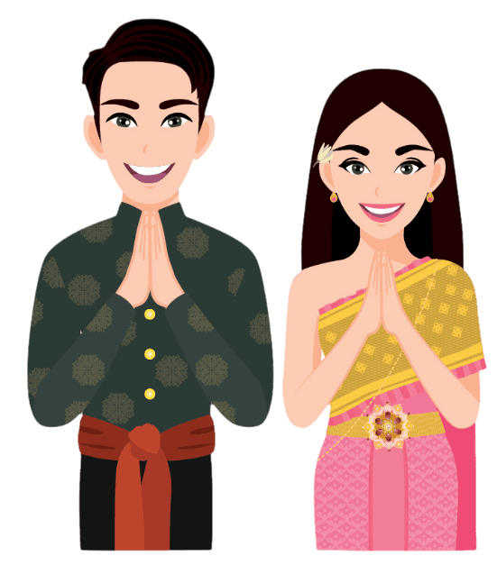
Definition
Interjection
hello; hi; good morning; good afternoon
Goodbye
สวัสดี
sà-wàt-dee

Slide 3

Definition
Particle
!! No direct translation
It’s particle used by female speakers at the end of sentences to make them more polite.
ค่ะ
kâ

Slide 4

Definition
Particle
!! No direct translation
It’s particle used by male speakers at the end of sentences to make them more polite.
ครับ
kráp

Slide 5

Definition
Verb
Thank you
ขอบคุณ
kòp kun

Slide 6

Definition
Interjection
1. Sorry
2. Excuse me
ขอโทษ
kǒr tôht

Slide 7

Definition
Verb
1. It’s Okay.
2. It’s all right
3. It’s doesn’t matter
ไม่เป็นไร
mâi bpen rai

