Slide 1
Physics Paper 1
Combined & Separate
High Demand Questions & Answers

Slide 2
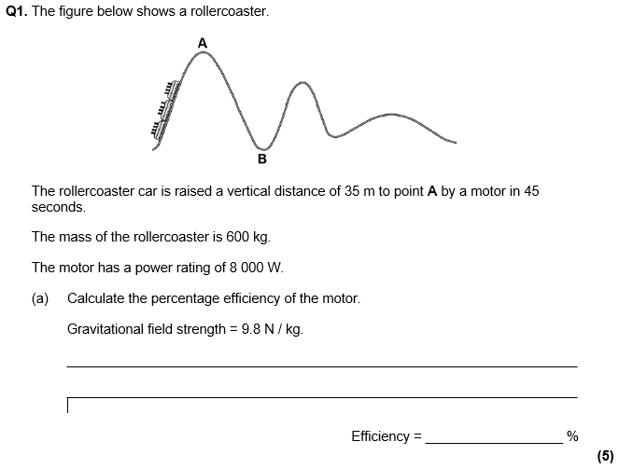
Weight of 600 kg mass = m x g = 600 x 9.8 = 5,880 N
Power = (5,880 x 35) / 45
Power = 4,573 W
Efficiency = (4,573 / 8,000) = 0.572
% Efficiency = 0.572 x 100 = 57.2%

Slide 3
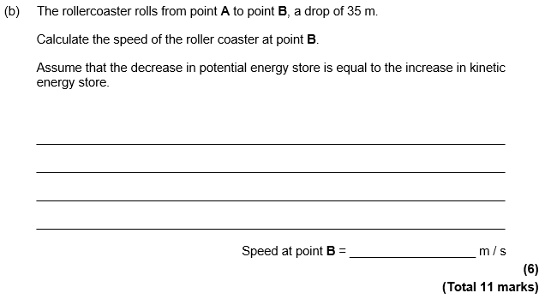
GPE = m x g x h = 600 x 9.8 x 35
GPE = 205,800 J
GPE = KE = 0.5 x m x v²
v = √(KE / (0.5 x m))
v = √(205800 / (0.5 x 600))
v = 26.2 m/s
We assume that all of the GPE gained is transformed into KE.

Slide 4
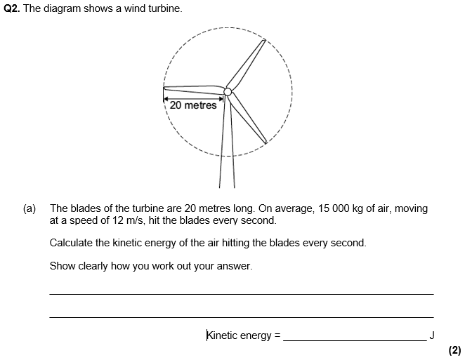
KE = 0.5 x m x v²
KE = 0.5 x 15,000 x 12²
KE = 1,080,000 J

Slide 5
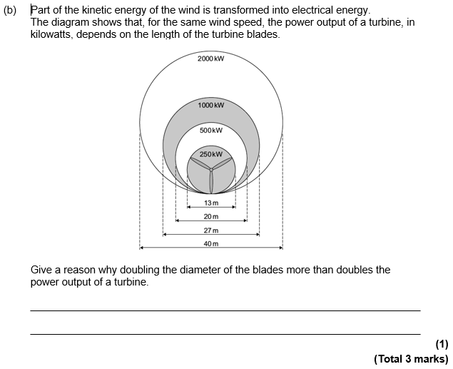
Any one of the following:
Area of circle is 4x larger.
Mass of air hitting blades 4x larger.
KE of wind is 4x larger.

Slide 6
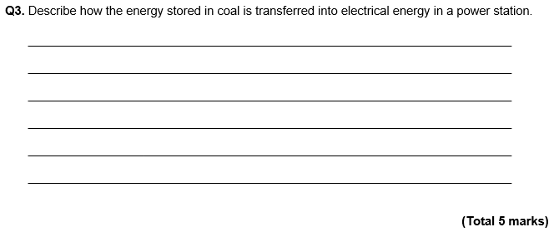
Coal has a store of chemical energy.
This is converted into heat when burnt.
The heat is used to boil water.
Steam turns turbine so it has kinetic energy.
Turbine drives generator which converts kinetic energy into electrical energy.

Slide 7
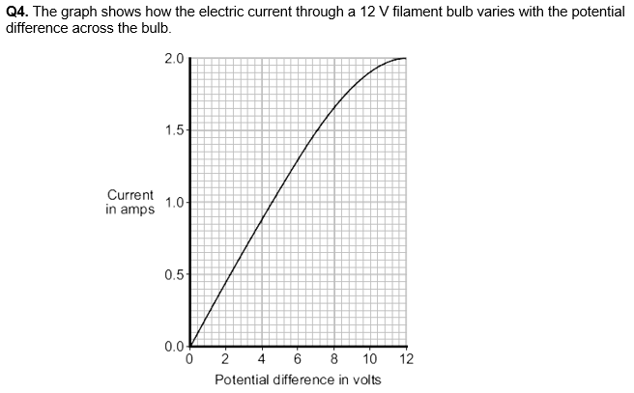

Slide 8
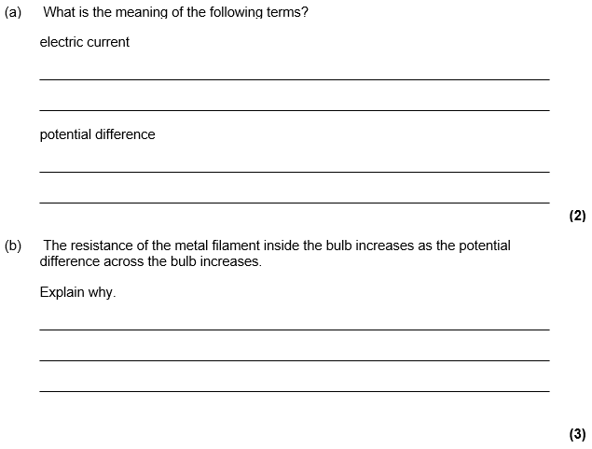
Rate of flow of charge. I = Q/t
Work done per coulomb of charge. V = W/Q
Remember, ions are fixed in position and so can only vibrate.
Metal filament contains ions and free electrons.
As temperature increases, ions vibrate faster.
Free electrons collide more frequently with ions.

Slide 9
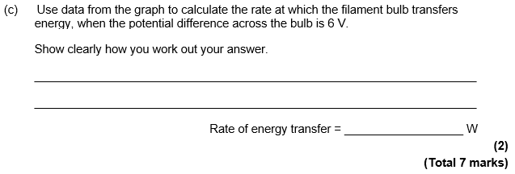
Adding construction lines to the graph is a good way to show how you work out your answer.
When p.d. is 6V, the current is 1.3 A.
P = V x I = 7.8 W

Slide 10
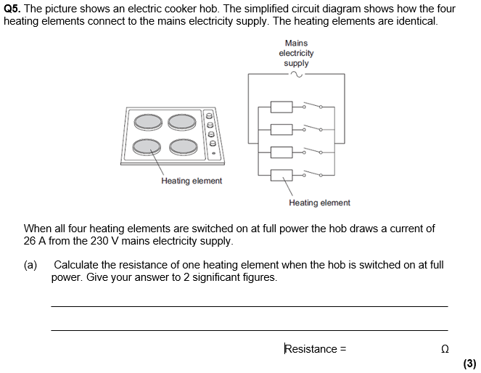
Current through one element = 26/4 = 6.5 A
R = V / I = 230 / 6.5
R = 35.38 Ω = 35 Ω to 2 sig. fig.
Current divides equally between the heating elements because they are identical and have the same resistance.

Slide 11
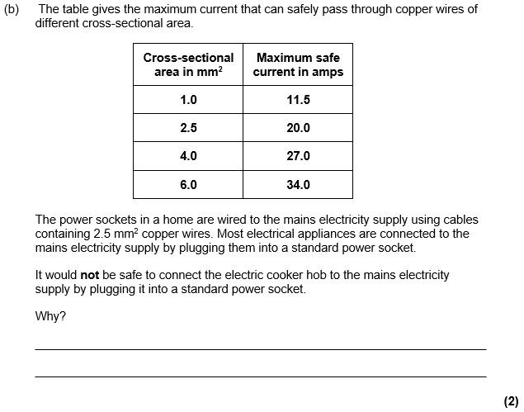
Maximum current of 26 A exceed maximum safe current for 2.5 mm² cable.
Cable would overheat.

Slide 12
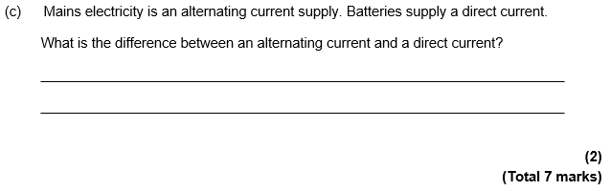
a.c. constantly changes direction.
d.c. flows in one direction only.

Slide 13
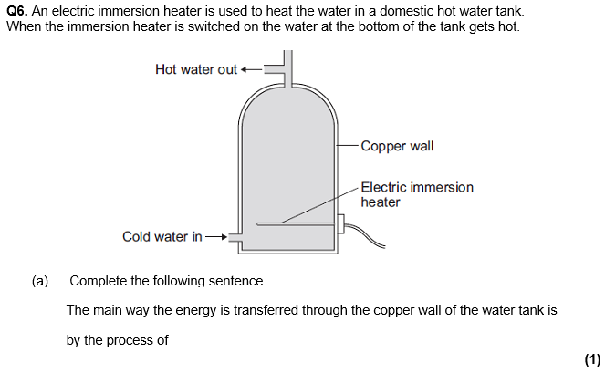
Conduction

Slide 14
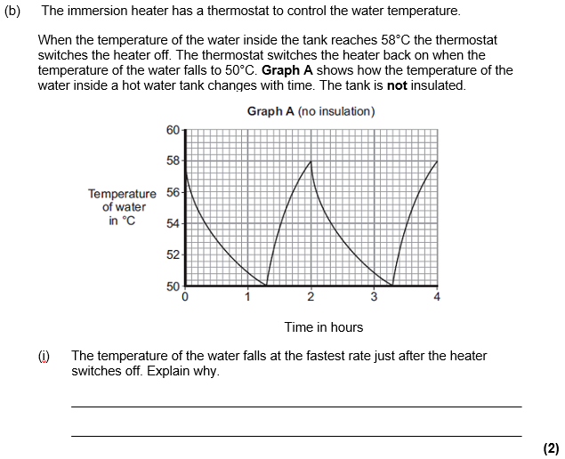
There is a large difference between the temperature of the water and the surroundings.
Therefore energy is transferred more quickly.

Slide 15
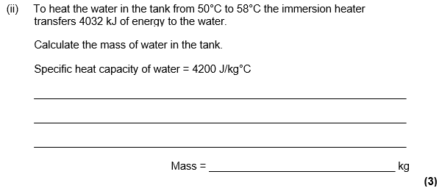
1 kJ = 1,000 J
4,032 kJ = 4,032,000 J or change in temperature = 8 °C
4,032,000 = m x 4,200 x 8
m = 4,032,000 / (4,200 x 8) = 120 kg

Slide 16
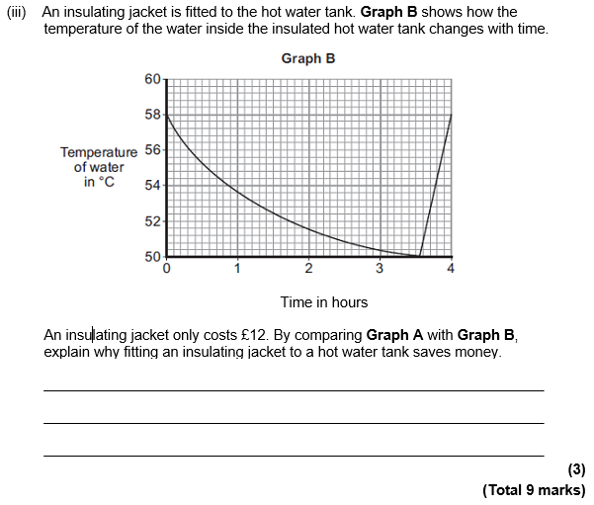
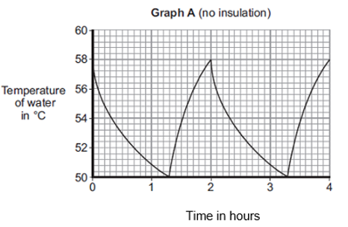
Water stays hot for longer.
Heater not kept on so long.
Cost of jacket is soon recovered.

Slide 17
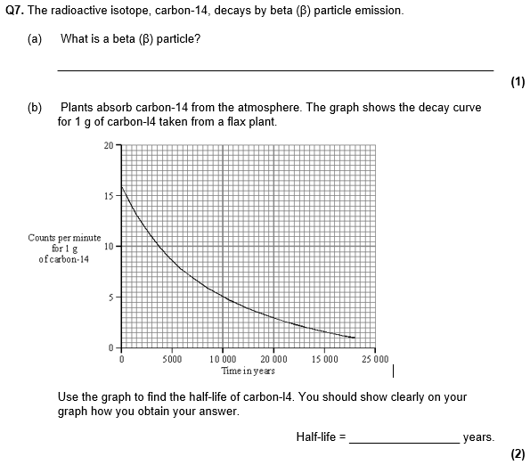
Electron
Counts per minute falls from 16 to 8.
5,500 years.
Adding construction lines to the graph is a good way to show how you work out your answer.

Slide 18
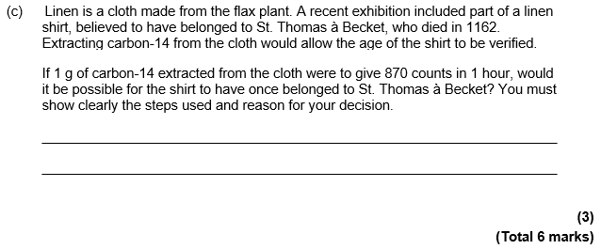
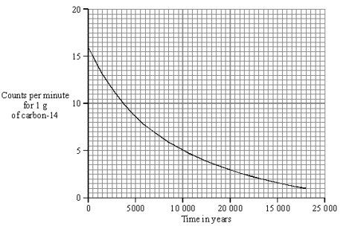
Again, adding construction lines to the graph is a good way to show how you work out your answer.
870 counts per hour = 14.5 counts per minute.
750 years.
No, shirt made after he died.

Slide 19
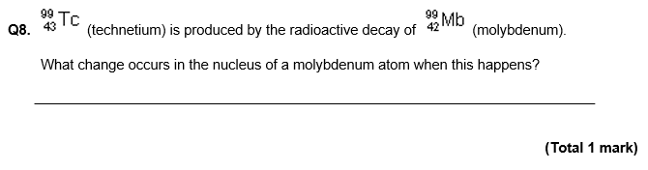
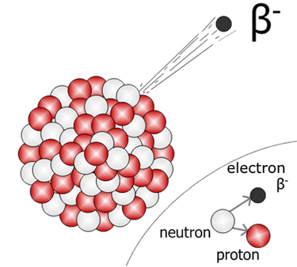
A neutron decays into a proton.
When the neutron decays into a proton, and electron is also produced. This electron is ejected from the nucleus.
Because a neutron turns into a proton, the total number of protons and neutrons does not change, so the mass number does not change.
Because there is now one more proton in the nucleus, the atomic number increases by one.

