Slide 1
Volume
Prepared by Teacher Jennel

Slide 2
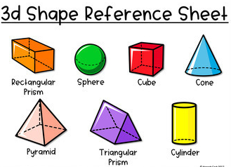
What is Volume?
Answer: It is the amount of space in a certain 3D (three-dimensional) object. Examples of 3D shapes are cube, cone, cylinder, prism, pyramid and sphere.
How is volume measured?
Answer: in cubic units or units³

Slide 3
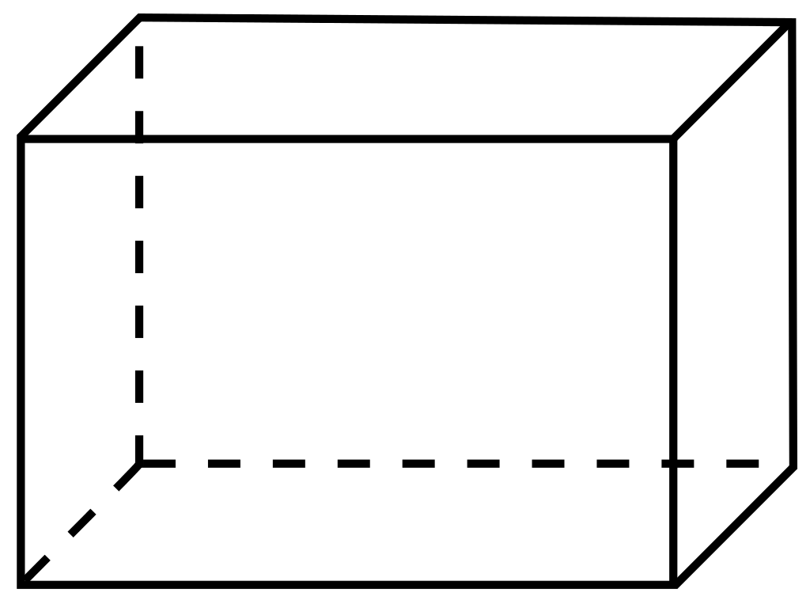
prism
Formula
V = 𝝅r²h
Formula
V = length x width x height
cylinder

Slide 4
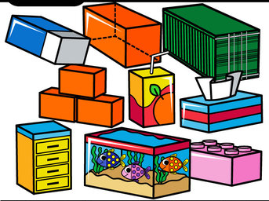
Examples of rectangular prisms in daily life

Slide 5
Example Problems
A carton of juice is 16 cm long, 5 cm wide and 20 cm tall. What is the volume of the carton?
First, list the given information:
long = 16 cm
wide = 5 cm
tall = 20 cm
What is being asked?
Volume of the carton of juice.
V = length x with x height
= 16 cm x 5 cm x 20 cm
= 1,600 cubic cm or cm³
The volume of the carton of juice is 1,600 cm³

Slide 6
Example Problems
2. A fish tank in a rectangular shape is 20 cm wide and 36 cm long and 30 cm high. What is the capacity of the fish tank in liters?
First, list the given information:
wide = 20 cm
long = 36 cm
high = 30 cm
What is being asked?
Volume of fish tank in liters.
V = length x with x height
= 36 cm x 20 cm x 30 cm
= 21,600 cubic cm or cm³
1 liter = 1,000 cm³
So, 21,600 ÷ 1,000 = 21.6 liters
The capacity of fish tank is 21.6 liters

