Slide 1




Private vs. Public Nuisance:
Key Differences and Case Studies
Tutor: Okwudili O. ONWURAH, LL.B. (Nigeria); BL (Abuja, Nigeria); LLM
(Exeter, UK); LLM (Qingdao, PRC); LLM (Shanghai, PRC)
PhD in Law (Hong Kong)
Dr Okwudili O. Onwurah
11/22/2024
1

Slide 2

The purpose of the online lesson is to encourage you to participate actively in achieving your needs and simplifying your legal education. I want you to be the best!
Minor House Keeping
Will make the learning process more interactive discussions and feel free to ask any question or you can speak.
You have the right to choose whether to turn on your video or not.
Participation prepares you for your exam and learning needs with ease.
11/22/2024
2

Slide 3
Introduction
Welcome to an in-depth exploration of private and public nuisance in the realm of tort law. This presentation delves into the critical distinctions between these two legal concepts, examining their historical roots, key characteristics, and modern applications. Through a series of landmark cases from England, the United States, and Hong Kong, we'll uncover the nuances that shape how courts interpret and apply nuisance law.
As we navigate through this complex legal landscape, we'll analyze the evolving definitions, the role of local authorities, and the remedies available to those affected by nuisances. Whether you're a law student, legal professional, or simply curious about how the law balances individual rights with community interests, this presentation will provide valuable insights into the fascinating world of nuisance law.

Slide 4
Tort of Nuisance
Private Nuisance
Private nuisance is a civil wrong that involves the unreasonable interference with an individual's use or enjoyment of their property. It typically arises from activities on neighboring land that cause substantial and unreasonable annoyance or discomfort to the property owner or occupier.
Public Nuisance
Public nuisance, on the other hand, is an act or omission that obstructs, damages, or inconveniences the rights of the community. It affects the public or a significant portion thereof, rather than just an individual or a limited group of people.
Importance of Distinction
Understanding the differences between private and public nuisance is crucial for determining legal standing, applicable remedies, and the scope of liability. This knowledge is essential for legal practitioners, policymakers, and citizens seeking to protect their rights or defend against nuisance claims.

Slide 5
Historical Background of Nuisance Law
1
12th Century Origins
The concept of nuisance law originated in 12th century England with the assize of nuisance, which allowed landowners to complain about neighboring activities that interfered with their property rights. This early form primarily addressed what we now consider private nuisance.
2
16th Century Evolution
By the 16th century, the distinction between private and public nuisance began to emerge. The Court of Star Chamber started to prosecute public nuisances as criminal offenses, recognizing their impact on the broader community.
3
19th Century Refinement
The industrial revolution brought new challenges, leading to significant refinements in nuisance law. Key cases like Rylands v Fletcher (1868) helped establish the modern principles of liability for dangerous substances escaping from land, influencing both private and public nuisance doctrines.

Slide 6
Legal Definitions and Criteria
Private Nuisance Definition
A private nuisance is defined as a substantial and unreasonable interference with an individual's use or enjoyment of their land.
The interference must be both substantial and unreasonable,
taking into account factors such as the nature and extent of the harm, the social value of the activity causing the nuisance, and the burden of avoiding the harm.
Public Nuisance Definition
A public nuisance is an unreasonable interference with a right common to the general public. It must affect a considerable number of people or an entire community. The interference must be substantial and unreasonable, considering factors such as the extent and duration of the interference, the nature of the harm, and the social utility of the conduct.
Legal Criteria
Courts consider several factors when determining if a nuisance exists: the nature and extent of the harm, the social value of the activity, the suitability of the locality for the use, and the burden on the person harmed to avoid the consequences. For public nuisance, there must also be a common injury to the public or a significant portion thereof.

Slide 7
Key Characteristics of Private Nuisance
1
Interference with Property Rights
Private nuisance primarily concerns the interference with an individual's use or enjoyment of their property. This can include physical damage to the property, interference with comfort or convenience, or reduction in the property's value.
2
Reasonableness Standard
Courts apply a reasonableness standard, balancing the right of the property owner to use their land as they see fit against the right of neighbors to enjoy their own property without unreasonable interference. The case of Miller v Jackson [1977] QB 966 illustrates this balance, where the court considered the social utility of a cricket club against the nuisance caused to neighboring properties.
3
Continuing Nature
Private nuisances are typically ongoing or recurring issues rather than one-time events. In Sturges v Bridgman (1879) 11 Ch D 852, the court emphasized the importance of the continuing nature of the interference in establishing a private nuisance.

Slide 8




Key Characteristics of Public Nuisance
Affects the Public at Large
Public nuisance impacts a significant portion of the community or interferes with rights common to all members of the public. The case of Attorney General v PYA Quarries Ltd [1957] 2 QB 169 established that the number of people affected must be sufficient to constitute a class of the public.
Criminal and Civil Liability
Public nuisance can give rise to both criminal and civil liability. In R v Rimmington [2005] UKHL 63, the House of Lords clarified the elements of criminal public nuisance, emphasizing the need for widespread effects on the community.
Government Enforcement
Public nuisances are often enforced by government authorities acting on behalf of the public. The case of Manchester Corporation v Farnworth [1930] AC 171 demonstrates how local authorities can take action to abate public nuisances affecting the community.
Balancing Public Interest
Courts must balance the public interest against individual rights when determining public nuisance. In Tate & Lyle Industries Ltd v Greater London Council [1983] 2 AC 509, the court considered the broader public benefit of river management against the harm caused to individual businesses.

Slide 9
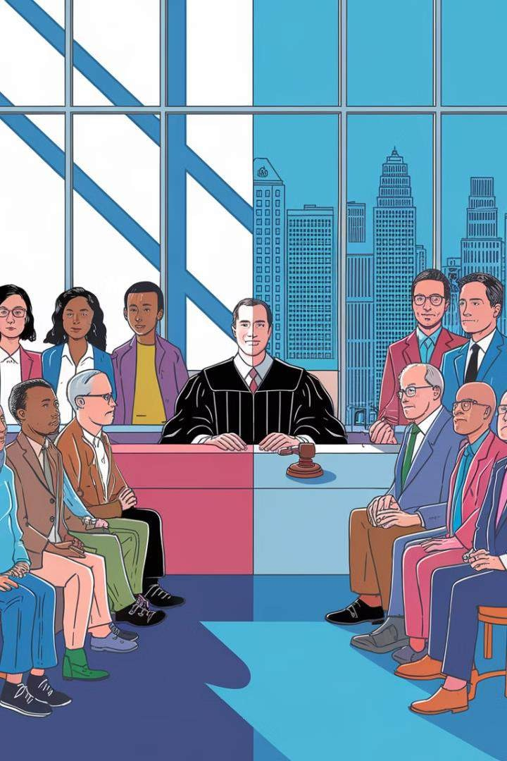
Comparative Analysis: Private vs. Public Nuisance
Aspect | Private Nuisance | Public Nuisance
Parties Affected | Individual or limited group | General public or significant portion
Legal Standing | Affected individual can sue | Typically requires government action
Nature of Harm | Interference with property rights | Interference with public rights
Remedies | Injunction, damages | Abatement, criminal penalties, damages
Burden of Proof | Balance of probabilities | Beyond reasonable doubt (criminal)

Slide 10
Case Study: Private Nuisance
Ruling
The House of Lords held that while some discomfort might be expected in an industrial area, visible damage to property was not acceptable regardless of the location. This established the principle that physical damage is actionable per se in private nuisance cases.
Background
In the landmark case of St Helen's Smelting Co v Tipping (1865) 11 HL Cas 642, William Tipping, a landowner, sued St Helen's Smelting Company for damage caused to his trees and shrubs by noxious vapors from their copper smelting operations.
1
2
3
4
Legal Issue
The court had to determine whether the smelting company's activities constituted a private nuisance, considering both the physical damage to property and the interference with comfort in an industrial area.
Impact
This case set a precedent for distinguishing between nuisances causing physical damage and those causing sensible personal discomfort, influencing future private nuisance cases and environmental regulations.

Slide 11

Case Study: Public Nuisance
Case Background
In City of London v Bovis Construction Ltd & Ors [1992] 3 All ER 697, the construction of a building in the City of London caused severe traffic congestion, affecting a large number of people and businesses in the area.
Legal Arguments
The City of London Corporation sued the construction company for public nuisance, arguing that the extensive traffic disruption interfered with the public's right to use the highways and caused significant economic loss to local businesses.
Court's Decision
The court held that the construction activities, despite being lawful and licensed, constituted a public nuisance due to the substantial
interference with public rights and the economic impact on the community.
Legal Implications
This case expanded the scope of public nuisance to include economic loss and demonstrated that even lawful activities can be considered a public nuisance if they unreasonably interfere with public rights. It also highlighted the role of local authorities in protecting public interests.

Slide 12
Overlap and Conflicts in Nuisance Law
Dual Nature of Nuisances
Some situations can simultaneously constitute both a private and public nuisance. For example, a factory emitting toxic fumes might affect neighboring properties (private nuisance) while also polluting the air breathed by the general public (public nuisance). The case of Halsey v Esso Petroleum Co Ltd [1961] 1 WLR 683 illustrates this overlap, where oil depot operations caused both private nuisance to neighbors and public nuisance on the highway.
Legal Challenges
When a nuisance has both private and public aspects, courts must navigate complex legal terrain. The primary challenge lies in determining the appropriate plaintiffs, remedies, and extent of liability. In some cases, individual plaintiffs may need to show special damage beyond that suffered by the general public to maintain a private action for what is essentially a public nuisance.
Resolving Conflicts
Courts often resolve these conflicts by focusing on the predominant nature of the harm and the most effective means of addressing it. In some jurisdictions, legislation has been enacted to clarify the relationship between private and public nuisance actions. The Hong Kong case of Ngan Chor Ying v Year Trend Development Ltd [2001] 3 HKLRD 83 provides guidance on how courts balance private and public interests in nuisance cases.

Slide 13
Role of Local Authorities in Managing Public Nuisance
Statutory Powers
Local authorities are often granted statutory powers to prevent, abate, and prosecute public nuisances. These powers may include issuing abatement notices, conducting inspections, and initiating legal proceedings. The Environmental Protection Act 1990 in the UK exemplifies legislation empowering local authorities to address various forms of public nuisance.
Proactive Measures
Authorities can implement proactive measures to prevent public nuisances, such as zoning regulations, noise control ordinances, and public health initiatives. The case of R (on the application of Sainsbury's Supermarkets Ltd) v Wolverhampton City Council [2010] UKSC 20 demonstrates how local authorities balance development needs with potential public nuisances.
Enforcement Challenges
Local authorities face challenges in enforcing public nuisance laws, including resource constraints and balancing competing interests. The Hong Kong case of Incorporated Owners of Westlands Garden v Oey Chiou Ling [2011] 2 HKLRD 421 highlights the complexities authorities face in addressing long-standing public nuisances in densely populated urban areas.
Collaboration with Communities
Effective management of public nuisances often requires collaboration between local authorities and community members. Public consultations, community policing initiatives, and citizen reporting systems can enhance the identification and resolution of public nuisances.

Slide 14




Remedies for Private Nuisance
Injunctions
Courts may grant injunctions to prevent or stop ongoing nuisances. In Shelfer v City of London Electric Lighting Co [1895] 1 Ch 287, the court established guidelines for when damages might be awarded in lieu of an injunction, known as the "Shelfer test."
Damages
Compensation may be awarded for loss of amenity, property damage, or diminution in property value. The case of Hunter v Canary Wharf Ltd [1997] AC 655 clarified the principles for awarding damages in private nuisance cases, particularly regarding loss of amenity.
Abatement
In some cases, individuals may have the right to abate (remove or stop) a nuisance themselves. However, this remedy is risky and should be exercised with caution, as demonstrated in Burton v Winters [1993] 1 WLR
1077.
Regulatory Compliance
While not a direct remedy, demonstrating compliance with relevant regulations can be a defense against nuisance claims. The case of Coventry v Lawrence [2014] UKSC 13 considered the impact of regulatory compliance on private nuisance claims.

Slide 15
Remedies for Public Nuisance
Criminal Penalties
Public nuisance can be prosecuted as a criminal offense, resulting in fines or imprisonment. The case of R v Goldstein [2003] EWCA Crim 3450 illustrates the application of criminal penalties in public nuisance cases involving false bomb threats.
Civil Injunctions
Government authorities or, in some cases, private individuals with special damage, can seek injunctions to stop public nuisances. The case of Attorney General v PYA Quarries Ltd [1957] 2 QB 169 demonstrates the use of civil injunctions in addressing widespread public nuisances.
Abatement Orders
Courts may issue abatement orders requiring the responsible party to remove or stop the nuisance. In Hong Kong, the Noise Control Authority v The Incorporated Owners of Tsim Sha Tsui Mansion [2007] 2 HKLRD 217
case shows how abatement orders are used to address noise pollution.
Damages
While less common in public nuisance cases, damages may be awarded to individuals who suffer special damage beyond that experienced by the general public. The landmark case of Tate & Lyle Industries Ltd v Greater London Council [1983] 2 AC 509 illustrates the circumstances under which damages might be awarded in public nuisance cases.

Slide 16
Future Trends in Nuisance Law
1
Environmental Focus
Nuisance law is likely to play an increasingly important role in addressing environmental concerns. Climate change litigation, such as the landmark Dutch case of Urgenda Foundation v State of the Netherlands [2015] HAZA C/09/00456689, may influence the development of public nuisance doctrines globally.
2
Technological Nuisances
As technology evolves, new forms of nuisance may emerge, such as issues related to drones, augmented reality, or smart city infrastructure. Courts will need to adapt traditional nuisance principles to these novel contexts, potentially drawing inspiration from cases like Google Spain SL v Agencia Española de Protección de Datos (AEPD) [2014] EUECJ C-131/12 on the "right to be forgotten."
3
Balancing Economic Development
Future nuisance cases may increasingly grapple with balancing economic development against environmental and community interests. The approach taken in cases like Coventry v Lawrence [2014] UKSC 13, which considered the impact of planning permissions on nuisance claims, may evolve to address these complex trade-offs.
4
Cross-Border Nuisances
Globalization and environmental challenges may lead to more cross-border nuisance cases, requiring courts to navigate complex jurisdictional and international law issues. The Trail Smelter case (United States v Canada, 1941) provides a historical precedent that may inform future transboundary nuisance disputes.

Slide 17
Conclusion: The Evolving Landscape of Nuisance Law
Key Distinctions
Throughout this presentation, we've explored the crucial differences between private and public nuisance, from their historical origins to their modern applications. Private nuisance focuses on protecting individual property rights, while public nuisance addresses broader harms to community interests. Understanding these distinctions is essential for legal practitioners, policymakers, and citizens alike.
Adaptability of Nuisance Law
Nuisance law has demonstrated remarkable adaptability over the centuries, evolving to address new challenges posed by industrialization, urbanization, and technological advancements. As we look to the future, this flexibility will be crucial in addressing emerging issues such as environmental degradation, digital privacy concerns, and complex urban development conflicts.
Balancing Interests
The enduring relevance of nuisance law lies in its fundamental role of balancing competing interests. Whether adjudicating between neighbors' property rights or weighing community welfare against economic development, nuisance law provides a flexible framework for courts to achieve equitable outcomes. As society continues to evolve, so too will the application of nuisance principles, ensuring their continued importance in shaping our legal and social landscape.

