Slide 1

Product Liability:
Legal Principles and Case Studies
Tutor: Okwudili O. ONWURAH, LL.B. (Nigeria); BL (Abuja, Nigeria); LLM (Exeter, UK); LLM (Qingdao, PRC); LLM (Shanghai, PRC)
PhD in Law (Hong Kong)
Dr Okwudili O. Onwurah

Slide 2
Minor House Keeping
The purpose of the online lesson is to encourage you to participate actively in achieving your needs and simplifying your legal education. I want you to be the best!
Will make the learning process more interactive discussions and feel free to ask any question or you can speak.
You have the right to choose whether to turn on your video or not.
Participation prepares you for your exam and learning needs with ease.

Slide 3
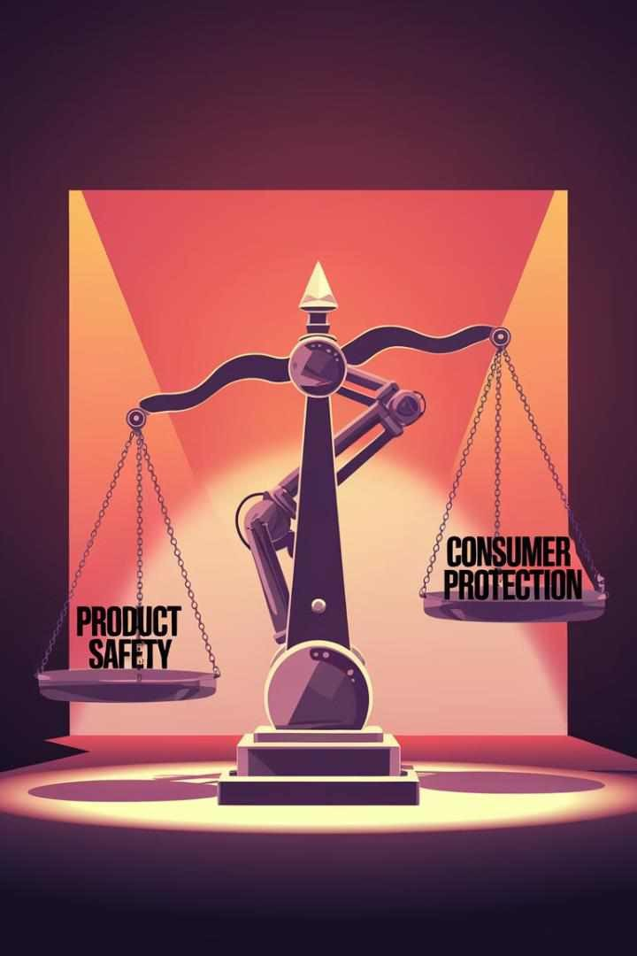
Introduction
Product liability is a critical area of law that addresses the responsibility of manufacturers, distributors, and sellers for injuries caused by defective products. This presentation explores the fundamental principles of product liability, examining key English and Hong Kong court cases that have shaped this field. We will delve into the duty of care, consumer protection legislation, defective products, causation, and defences available to manufacturers. Through an analysis of landmark cases and recent developments, we aim to provide a comprehensive understanding of product liability law and its impact on consumer rights and business practices.

Slide 4
Meaning to Product Liability
Product liability is a legal concept that holds manufacturers, distributors, and sellers responsible for injuries or damages caused by defective products. This area of law has evolved significantly over the years, primarily through case law and statutory developments. The core principle underlying product liability is that consumers have the right to expect that products they purchase and use are safe when used as intended.
In the UK and Hong Kong, product liability claims can arise under three main legal theories: negligence, breach of warranty, and strict liability. Each of these theories places different burdens of proof on the plaintiff and offers varying levels of protection for consumers. Understanding these fundamental concepts is crucial for both legal professionals and manufacturers in navigating the complex landscape of product liability law.
1
Negligence
Requires proof that the defendant failed to exercise reasonable care in the production or sale of the product.
2
Breach of Warranty
Based on the failure of a product to live up to express or implied promises about its performance or safety.
3
Strict Liability
Holds manufacturers liable for defective products regardless of fault, focusing on the product's condition rather than the manufacturer's conduct.

Slide 5
Duty of Care in Product Liability
The concept of duty of care is fundamental to product liability cases, particularly those based on negligence. It establishes that manufacturers, distributors, and sellers have a legal obligation to ensure their products are safe for consumers when used as intended. This duty extends throughout the supply chain, from design and production to marketing and post-sale support.
In English law, the duty of care in product liability cases has been significantly influenced by the landmark case of Donoghue v Stevenson [1932] AC 562. This case established the 'neighbour principle', which forms the basis of the modern concept of negligence and has been widely applied in product liability cases.
Elements of Duty of Care Scope of Duty Limitations
Foreseeability of harm
Proximity between parties
Fairness and reasonableness
The duty of care extends to: Duty of care does not extend to:
Product design
Manufacturing process
Warning labels and instructions
Unforeseeable misuse
Obvious risks
Informed consumers

Slide 6
Case Study: Donoghue v Stevenson
Donoghue v Stevenson [1932] AC 562 is a seminal case in the development of product liability law. The case involved Mrs Donoghue, who consumed a bottle of ginger beer containing a decomposed snail, leading to illness. Unable to sue under contract law, she pursued a claim in negligence against the manufacturer, Mr Stevenson.
The House of Lords ruled in favour of Mrs Donoghue, establishing the principle that manufacturers owe a duty of care to the ultimate consumers of their products. This decision, delivered by Lord Atkin, introduced the 'neighbour principle', which states that individuals must take reasonable care to avoid acts or omissions that could foreseeably harm their 'neighbours'.
Facts of the Case
Mrs Donoghue drank ginger beer containing a decomposed snail, causing illness.
Legal Issue
Whether the manufacturer owed a duty of care to the ultimate consumer in the absence of a contract.
Ruling
The House of Lords held that the manufacturer owed a duty of care to Mrs Donoghue.
Impact
Established the modern law of negligence and laid the foundation for product liability claims.

Slide 7
Consumer Protection Act 1Y87
The Consumer Protection Act 1987 (CPA) is a pivotal piece of legislation in UK product liability law. It was enacted to implement the European Product Liability Directive (85/374/EEC) and introduced strict liability for defective products. This Act significantly enhanced consumer rights by removing the need to prove negligence in product liability claims.
Under the CPA, producers are liable for damage caused by defective products, regardless of fault. This includes manufacturers, importers, and those who put their name or mark on products. The Act covers a wide range of products and applies to both goods and electricity. It provides a statutory right of action for consumers who suffer personal injury or property damage due to defective products.
1
Key Provisions
The Act imposes strict liability on producers for damage caused by defective products, regardless of fault or contractual relationships.
2
Definition of Defect
A product is considered defective if its safety is not such as persons generally are entitled to expect, taking all circumstances into account.
3
Liable Parties
The Act extends liability to producers, importers, and those who put their name or mark on products, broadening the scope of potential defendants.
4
Defences
The Act provides specific defences, including compliance with mandatory regulations and the state of scientific knowledge (development risks defence).

Slide 8
Defective Products
In product liability law, a defective product is one that fails to meet the safety standards that consumers are generally entitled to expect. The concept of defectiveness is central to liability claims and encompasses three main types of defects: design defects, manufacturing defects, and marketing defects (also known as failure to warn).
Under the Consumer Protection Act 1987, the test for defectiveness is objective, focusing on what persons generally are entitled to expect in terms of safety. This expectation takes into account various factors, including the product's presentation, reasonably expected use, and the time it was put into circulation. Courts have interpreted this test in numerous cases, refining the understanding of what constitutes a defective product.
Type of Defect | Description | Example
Design Defect | Inherent flaw in the product's design | Unstable furniture prone to tipping
Manufacturing Defect | Error in production process | Contaminated food products
Marketing Defect | Inadequate warnings or instructions | Medication without proper side effect warnings

Slide 9
Case Study: A v National Blood Authority
A v National Blood Authority [2001] 3 All ER 289 is a landmark case in UK product liability law, particularly in the interpretation of the Consumer Protection Act 1987. The case involved multiple claimants who had contracted Hepatitis C from contaminated blood transfusions. They sued the National Blood Authority under the CPA 1987, arguing that the blood products were defective.
The High Court ruled in favour of the claimants, holding that the infected blood was indeed defective under the Act. This decision was significant for several reasons:
Interpretation of 'Defect'
The court adopted a consumer expectations test, focusing on what the public at large was entitled to expect in terms of product safety.
Unavoidable Risks
The court held that the unavoidability of the risk did not preclude the product from being considered defective.
Avoidability vs Unavoidability
The court distinguished between avoidable and unavoidable risks, with different considerations for each category.
Impact on Strict Liability
The decision reinforced the strict liability nature of the CPA 1987, emphasising consumer protection over producer interests.

Slide 10




Standard of Care for Manufacturers
The standard of care for manufacturers in product liability cases is a critical concept that defines the level of care expected from producers to ensure their products are safe for consumers. This standard is particularly relevant in negligence-based claims, where the plaintiff must prove that the manufacturer failed to meet the required standard of care.
In English law, the standard of care for manufacturers is generally determined by what a reasonable manufacturer in the same circumstances would have done. This includes considerations such as industry standards, technological capabilities, and the state of scientific knowledge at the time of production. The landmark case of Donoghue v Stevenson established the foundational principle, but subsequent cases have refined and expanded upon this concept.
Research and Development
Ǫuality Control
Implementing robust quality control measures throughout the production process is essential to meet the standard of care.
Warnings and Instructions
Post-Sale Monitoring
Manufacturers are expected to monitor their products post-sale and take appropriate action if safety issues arise.
Manufacturers must conduct thorough research and testing to identify potential risks associated with their products.
Providing clear and adequate warnings and instructions for safe use is a crucial aspect of meeting the required standard of care.

Slide 11
Case Study: Grant v Australian Knitting Mills Ltd
Grant v Australian Knitting Mills Ltd [1936] AC 85 is a significant case in product liability law that further developed the principles established in Donoghue v Stevenson. The case involved Dr Grant, who contracted dermatitis after wearing undergarments manufactured by Australian Knitting Mills Ltd. The underwear contained excess sulphites due to a manufacturing defect.
The Privy Council ruled in favour of Dr Grant, finding that the manufacturer had breached its duty of care. This case is notable for several key points:
1 2 3 4
Expansion of Duty of Care
Manufacturing Process
The court emphasised the manufacturer's responsibility to ensure that their production process does not introduce harmful elements into the product.
Reasonable Foreseeability
Burden of Proof
The case clarified that while the burden of proving negligence rests with the plaintiff, the manufacturer must explain its production process if a defect is established.
The case confirmed that the duty of care established in Donoghue v Stevenson extends beyond food and drink to other consumer products.
The decision highlighted that manufacturers must consider reasonably foreseeable risks associated with their products.

Slide 12
Causation in Product Liability
Causation is a crucial element in product liability cases, requiring the plaintiff to establish a causal link between the defective product and the harm suffered. In English law, causation typically involves two tests: factual causation and legal causation.
Factual causation is often determined using the 'but for' test, asking whether the harm would have occurred but for the defendant's actions. Legal causation considers whether the harm was a reasonably foreseeable consequence of the defect.
In product liability cases, proving causation can be particularly challenging, especially in complex scenarios involving multiple potential causes or long-term effects. Courts have developed various approaches to address these challenges, including:
Material Contribution Loss of Chance Evidential Burden Shifting
Where a defective product materially contributes to the harm, even if it's not the sole cause, liability may be established.
In some cases, courts may consider the loss of a chance of a better outcome as a form of damage.
In certain circumstances, the burden of disproving causation may shift to the defendant once the plaintiff establishes a prima facie case.

Slide 13
Case Study: Stennett v Hancock & Peters
Stennett v Hancock & Peters [1939] 2 All ER 578 is an important case in product liability law that addresses issues of causation and the extent of a manufacturer's duty of care. The case involved a lorry wheel that had been negligently repaired by the first defendant, Hancock. During transit, a piece of metal became detached from the wheel and struck the plaintiff, causing injury.
The court's decision in this case highlighted several key principles:
1
Extended Duty of Care
The court held that the repairer's duty of care extended not only to the owner of the lorry but also to other road users who might be affected by the defective repair.
2
Foreseeability of Harm
The judgment emphasised that it was reasonably foreseeable that a negligent repair could lead to parts becoming detached and causing injury to others.
3
Causation Chain
The court found a clear causal link between the negligent repair and the plaintiff's injury, despite the involvement of multiple parties in the chain of events.
4
Liability of Repairers
The case established that repairers could be held liable under principles similar to those applying to manufacturers in product liability cases.

Slide 14
Defences in Product Liability
Defendants in product liability cases have several potential defenses available to them, both under common law and statutory provisions. These defenses can significantly impact the outcome of a case and may absolve the defendant of liability or reduce damages. Understanding these defenses is crucial for both plaintiffs and defendants in product liability litigation.
Key defenses in product liability cases include:
Defense | Description | Applicable Law
State of the Art | Product conformed to highest known standards at time of manufacture | Common Law / CPA 1987
Contributory Negligence | Plaintiff's own negligence contributed to the harm | Common Law
Volenti non fit injuria | Plaintiff voluntarily assumed the risk | Common Law
Regulatory Compliance | Product complied with mandatory regulations | CPA 1987
Development Risks | Defect was undiscoverable given scientific knowledge at the time | CPA 1987

Slide 15

Case Study: Kubach v Hollands
Kubach v Hollands [1937] 3 All ER 907 is a significant case in product liability law that addresses the defense of volenti non fit injuria (voluntary assumption of risk) and the duty of care
owed by manufacturers. The case involved a child who was injured while playing on a see-saw in a public playground. The see-saw had been manufactured by the defendant, Hollands.
The court's decision in this case highlighted several important principles:
Manufacturer's Duty
The court confirmed that manufacturers owe a duty of care to the end-users of their products, even in public spaces.
Foreseeability of Use
The judgment emphasised that manufacturers must consider foreseeable misuse of their products, especially when designed for children.
Volenti Defense
The court rejected the volenti defense, stating that children could not be expected to fully understand and voluntarily assume the risks associated with playground
equipment.
Standard of Care
The case established that the standard of care for manufacturers of children's equipment is particularly high, given the vulnerability of the end-users.

Slide 16




Recent Developments and Future Trends
Product liability law continues to evolve in response to technological advancements, changing consumer expectations, and global market dynamics. Recent developments and emerging trends in this field include:
AI and Autonomous Systems
The rise of artificial intelligence and autonomous systems poses new challenges in determining liability for actions or decisions made by these technologies.
Cross-Border Litigation
Sustainability and Circular Economy
Growing focus on sustainability is influencing product design and lifecycle management, potentially impacting liability considerations.
Emerging Technologies
Increasing globalisation of supply chains has led to more complex cross-border product liability cases, raising issues of jurisdiction and applicable law.
Nanotechnology, 3D printing, and other emerging technologies are creating new product liability challenges and potential risks.

Slide 17
Conclusion: The Future of Product Liability Law
As we look to the future of product liability law, it is clear that this field will continue to evolve in response to technological advancements, changing consumer expectations, and global market dynamics. The principles established in landmark cases like Donoghue v Stevenson and legislation such as the Consumer Protection Act 1987 will remain foundational, but their application will need to adapt to new contexts.
Key challenges and considerations for the future of product liability law include:
1
Emerging Technologies
The legal framework will need to address liability issues arising from AI, autonomous systems, and other emerging technologies that blur the lines of traditional manufacturer responsibility.
2
Global Supply Chains
Increasingly complex and globalised supply chains will necessitate more sophisticated approaches to determining liability and jurisdiction in cross-border cases.
3
Consumer Expectations
As consumer awareness and expectations regarding product safety continue to evolve, the legal standard for what constitutes a 'defective' product may shift.
4
Balancing Innovation and Safety
The law will need to strike a balance between encouraging innovation and ensuring consumer safety, particularly in rapidly advancing fields like biotechnology and nanotechnology.

