Slide 1

Trespass and Public Spaces:
Legal Challenges and Solutions
Tutor: Okwudili O. ONWURAH, LL.B. (Nigeria); BL (Abuja, Nigeria); LLM (Exeter,
UK); LLM (Qingdao, PRC); LLM (Shanghai, PRC)
PhD in Law (Hong Kong)
Dr Okwudili O. Onwurah
11/29/2024
1

Slide 2

The purpose of the online lesson is to encourage you
to participate actively in achieving your needs and
simplifying your legal education. I want you to be the
best!
Minor
House
Will make the learning process more interactive
discussions and feel free to ask any question or you
can speak.
Keeping
You have the right to choose whether to turn on
your video or not.
Participation prepares you for your exam and
learning needs with ease.
11/29/2024
2

Slide 3

Introduction
Welcome to this comprehensive exploration of the intricate relationship between trespass laws and public spaces. As we navigate through
the legal landscape, we'll examine the challenges faced by both authorities and citizens in balancing the right to public assembly with
property rights. This presentation will delve into landmark cases, analyse current legislation, and propose innovative solutions to address
the complexities of managing public spaces in an era of increasing social activism and urban development.
From the bustling streets of London to the vibrant public squares of Hong Kong, we'll uncover how different jurisdictions approach these
issues, providing valuable insights for law students and professionals alike. Join us as we unravel the legal intricacies and explore practical
approaches to harmonising public rights and private interests in our shared urban environments.

Slide 4
Defining Public Spaces and Trespass Implications
Public Spaces
Trespass in Context
Legal Implications
Public spaces are areas within a city or
town that are freely accessible to all
members of the community. These
typically include parks, streets, squares,
and civic buildings. The concept of public
space is rooted in the idea of the
commons, dating back to medieval
England, where certain lands were
reserved for communal use.
Trespass, in legal terms, refers to the
unauthorized entry onto someone else's
property. However, when it comes to
public spaces, the concept becomes
more nuanced. The key question often
revolves around whether an individual's
presence or actions in a public space
exceed the implied permission granted by
the space's public nature.
The intersection of public space and
trespass law creates complex legal
scenarios. For instance, while a person
may have the right to be in a public park,
they may be considered trespassing if
they refuse to leave when the park closes
or if they engage in prohibited activities.
Understanding these nuances is crucial
for both law enforcement and citizens.

Slide 5

Legal Issues in Protests and Public Gatherings
1
Right to Assembly
The fundamental right to peaceful assembly is protected in many democracies, including the UK and Hong Kong. This right allows citizens to gather in public
spaces for demonstrations, rallies, and other forms of protest. However, this right is not absolute and must be balanced against other public interests.
2
Permit Requirements
Many jurisdictions require organizers to obtain permits for large gatherings or demonstrations. This allows authorities to manage public safety and minimize
disruption. The legality of these requirements has been challenged in courts, raising questions about the balance between regulation and free expression.
3
4
Obstruction and Disruption
A key legal issue arises when protests obstruct public thoroughfares or disrupt normal activities. Courts have grappled with determining the point at which a
peaceful assembly becomes an unlawful obstruction, considering factors such as duration, location, and impact on others.
Police Powers
The extent of police powers in managing public gatherings is another contentious issue. This includes the authority to disperse crowds, make arrests, and use
force. Recent cases have scrutinized the proportionality of police actions in protest scenarios.

Slide 6

Case Law: DPP v Jones (Margaret) [1999]
Background
Legal Issue
DPP v Jones (Margaret) [1999] is a landmark case in English
law concerning the right to protest on public highways. The
case involved demonstrators who gathered on a roadside
verge near Stonehenge to protest its closure during the
summer solstice.
The central question was whether peaceful assembly on a
public highway, which did not obstruct passage, could
constitute trespass. This case challenged the traditional view
that highways were solely for passage and repose.
Ruling
Impact
The House of Lords ruled that the public's right to use
highways extends beyond mere passage and repose to
include reasonable and non-obstructive activities, including
peaceful protest. This decision significantly expanded the
interpretation of public rights on highways.
This ruling has had far-reaching implications for protest rights
in the UK. It established that peaceful demonstrations on public
highways are not automatically trespassory, provided they do
not unreasonably impede the right of passage.

Slide 7

Hong Kong Laws on Trespass in Public Spaces
1
Public Order Ordinance
2
Unlawful Assembly
Hong Kong's approach to public gatherings is primarily
governed by the Public Order Ordinance. This law requires
organizers of public assemblies to notify the police in
advance and obtain a "letter of no objection". The ordinance
has been a subject of controversy, particularly in light of
recent pro-democracy protests.
Under Hong Kong law, an assembly of three or more people
can be deemed unlawful if it is likely to cause a breach of
the peace. This broad definition has been criticized for
potentially limiting the right to peaceful assembly.
3
Private Property Rights
4
Recent Developments
Hong Kong's legal system, based on English common law,
recognizes trespass as a tort. However, the concept of
trespass in public spaces is less clearly defined, often
intersecting with regulations on public order and assembly.
The implementation of the National Security Law in 2020
has added another layer of complexity to the legal
landscape surrounding public gatherings and protests in
Hong Kong, potentially affecting how trespass in public
spaces is interpreted and enforced.

Slide 8
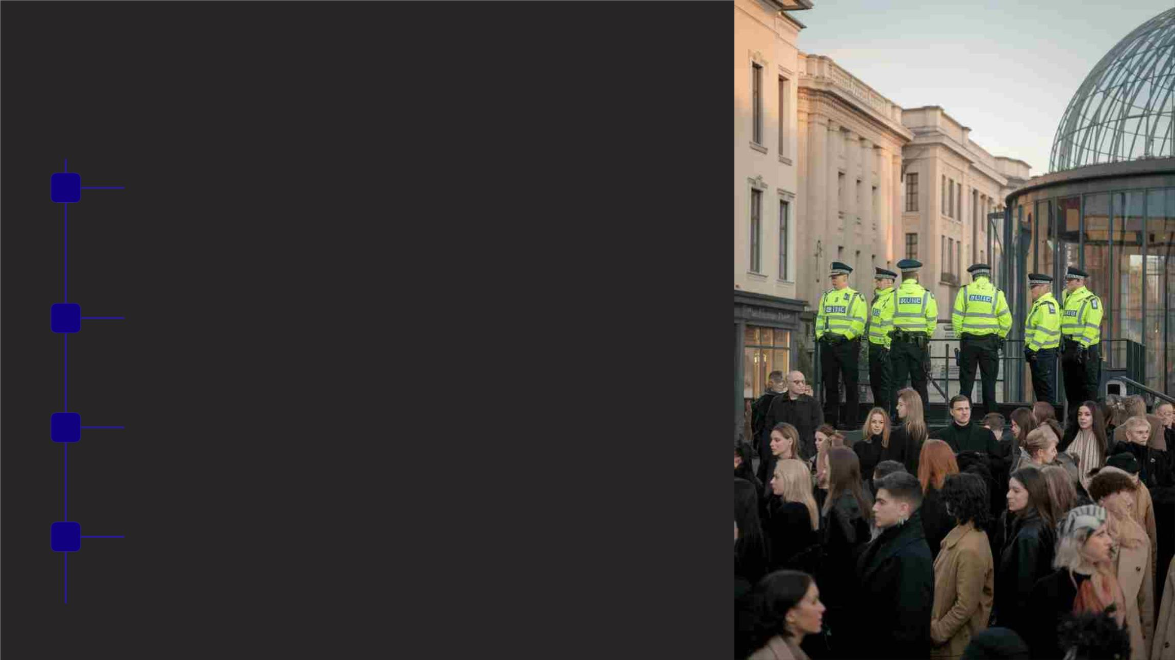
Practical Examples: Managing Public
Protests
1
Pre-event Planning
Authorities engage with protest organizers to agree on routes, timings, and crowd management
strategies. This collaborative approach aims to balance the right to protest with public safety concerns.
2
3
4
During the Protest
Police employ various tactics such as crowd containment ('kettling'), strategic placement of barriers,
and the use of liaison officers to maintain open communication with protesters.
Escalation Management
If a protest becomes disruptive or violent, authorities may issue dispersal orders. The legality and
proportionality of these actions are often scrutinized in subsequent legal proceedings.
Post-event Analysis
Authorities conduct reviews to assess the effectiveness of their management strategies and identify
areas for improvement in balancing public order with the right to protest.

Slide 9
Balancing Public Rights and Private Property
Public Rights
Private Property Interests
Legal Balancing Act
The right to access and enjoy public
spaces is fundamental in democratic
societies. This includes the freedom of
movement, assembly, and expression in
areas designated for public use. Courts
have consistently upheld these rights,
recognizing their importance in fostering
civic engagement and social cohesion.
Private property owners have the right to
control access to and use of their property.
This includes the ability to exclude others
and determine how the property is used.
However, these rights can be limited by
various factors, including easements,
public rights of way, and regulations
aimed at serving the public interest.
Courts and legislators face the challenge
of striking a balance between these
competing interests. This often involves
considering factors such as the nature
and purpose of the space, the extent of
the public's reliance on it, and the impact
of public access on private property rights.
Recent cases have explored this balance
in the context of privately owned public
spaces (POPS) in urban areas.

Slide 10

Innovative Solutions: Mediation and Crowd
Management
Mediation Services
Digital Crowd
Management
Conflict De-escalation Designated Protest
Training
Zones
Implementing professional
mediation services to resolve
disputes between protesters
and authorities before they
escalate. This approach can
help find mutually acceptable
solutions and reduce the
Utilizing mobile apps and social
Providing specialized training
Creating pre-approved areas
for demonstrations that balance
visibility for protesters with
minimal disruption to daily city
functions, while ensuring clear
guidelines for both protesters
and law enforcement.
media platforms to provide real- for law enforcement in de-
time information to protesters
and the public about safe
assembly areas, potential
congestion points, and
escalation techniques and non-
violent communication to
manage potentially volatile
situations more effectively.
likelihood of confrontations.
emergency procedures.

Slide 11

Comparative Analysis: Global
Approaches to Public Space Disputes
Country
Key Legislation
Protest Management
Approach
Notable Features
United Kingdom
Public Order Act 1986
Notification-based
system
Police liaison officers,
emphasis on facilitation
United States
First Amendment
Permit system for large
gatherings
Strong protection for
free speech,
time/place/manner
restrictions
France
Code de la Sécurité
Intérieure
Declaration system
Strict regulations on
face coverings during
protests
Germany
Assembly Act
Notification required for
outdoor assemblies
Constitutional
(Versammlungsgesetz)
protection for freedom
of assembly

Slide 12

The Role of Technology in Public Space Management
Data Collection
Predictive Analytics
Communication Systems Public Engagement
Advanced sensors and cameras
are deployed to gather real-time
data on crowd sizes, movement
patterns, and potential safety
hazards in public spaces. This
information helps authorities
make informed decisions about
resource allocation and crowd
management strategies.
Machine learning algorithms
analyse historical data and
current trends to predict potential
flashpoints or areas of
Mobile applications and social
Integrated communication
platforms enable seamless
information sharing between
different agencies involved in
managing public spaces. This
improves coordination and
response times during large-
scale events or emergencies.
media platforms are utilized to
provide real-time updates to the
public about space availability,
safety alerts, and event
congestion during public
gatherings. This allows for
proactive measures to be
implemented, reducing the
likelihood of conflicts or safety
issues.
information. This empowers
individuals to make informed
decisions about their use of
public spaces.

Slide 13

Environmental Design and Public Space Management
Crime Prevention Through Environmental Design
(CPTED)
Flexible Spaces
Modern public spaces are designed with flexibility in mind, allowing
for easy reconfiguration to accommodate different types of
gatherings and activities. This adaptability helps manage diverse
uses of public spaces more effectively.
CPTED principles are increasingly integrated into public space
design to reduce opportunities for criminal behaviour and enhance
safety. This includes strategies such as natural surveillance, access
control, and territorial reinforcement.
Green Infrastructure
Lighting and Visibility
Incorporating green elements like urban forests and rain gardens
not only improves environmental quality but also contributes to
crowd management by creating natural barriers and flow patterns.
Strategic lighting design enhances safety and usability of public
spaces after dark, while also contributing to the aesthetic appeal.
This can influence crowd behaviour and improve overall space
management.

Slide 14

Legal Challenges in the Digital Age
Online Coordination of Protests
1
2
The use of social media and messaging apps to organize "flash
mob" style protests presents new challenges for authorities in
managing public spaces. Legal frameworks are still adapting to
address the rapid mobilization capabilities enabled by technology.
Digital Privacy in Public Spaces
The increasing use of surveillance technologies in public spaces
raises concerns about privacy rights. Courts are grappling with
defining the boundaries of reasonable expectations of privacy in
public areas in the age of ubiquitous cameras and facial
recognition systems.
Cybersecurity of Public Infrastructure
3
4
As public spaces become more technologically integrated, the risk
of cyber attacks on these systems increases. Legal frameworks
are evolving to address liability and security standards for smart
city infrastructure.
Regulating Augmented Reality
The rise of augmented reality applications that overlay digital
content on public spaces presents novel legal questions about
property rights, public safety, and the regulation of virtual content
in physical spaces.

Slide 15
Case Study: Occupy Central with Love and Peace
(Hong Kong)
Background
Legal Challenges
Court Rulings
The Occupy Central movement in Hong
Kong, which began in 2014, provides a
compelling case study of the complexities
surrounding public space use for large-
scale protests. The movement saw
thousands of protesters occupying major
thoroughfares in the city's central
The Hong Kong government faced
significant challenges in balancing the
right to protest with maintaining public
order. The prolonged occupation tested
the limits of existing laws on public
assembly and raised questions about the
interpretation of 'temporary' use of public
spaces for demonstrations.
Subsequent court cases, such as
Secretary for Justice v Cheng Lai King
and Others (2019), addressed the legality
of the occupation. The Court of Final
Appeal upheld convictions for public
nuisance, emphasizing the need to
balance freedom of expression with the
rights of others to use public spaces.
business district for 79 days.

Slide 16

Future Trends in Public Space Management
AI-Driven Crowd
Management
Dynamic Regulation
Virtual Public Spaces
Eco-Centric Design
Future legal frameworks may
incorporate more flexible,
As virtual and augmented
reality technologies advance,
legal systems will need to
address the concept of 'virtual
Future public space design is
likely to prioritize environmental
sustainability, potentially
Artificial intelligence is set to
play a larger role in predicting
crowd behaviour and
situation-specific regulations for
public space use. This could
influencing how these spaces
are used and regulated. This
may include laws promoting
green infrastructure and limiting
activities that harm urban
ecosystems.
automating responses to
potential issues in public
spaces. This may include AI-
powered surveillance systems
and chatbots for public
involve real-time adjustments to public spaces' and how
permitted activities based on
current conditions and AI-
assisted decision-making
processes.
traditional public space laws
apply in these new digital
realms.
information dissemination.

Slide 17

Conclusion: Navigating the Future of Public Spaces
1
Evolving Legal Landscape
2
Balancing Act
As we've explored throughout this presentation, the legal
framework surrounding public spaces and trespass is
continuously evolving. Future legislation and court decisions will
need to adapt to new technologies, changing social norms, and
emerging forms of public engagement.
The challenge for lawmakers and jurists will be to maintain a
delicate balance between protecting individual rights, ensuring
public safety, and fostering vibrant, inclusive public spaces. This
may require innovative legal approaches and a willingness to
revisit traditional concepts of property and public use.
3
Collaborative Solutions
4
Continuous Learning
Moving forward, effective management of public spaces will likely
require increased collaboration between legal experts, urban
planners, technologists, and community stakeholders.
Interdisciplinary approaches will be key to addressing the
complex challenges of modern urban environments.
For legal professionals and students, staying informed about
developments in this area of law will be crucial. The intersection
of trespass law, public space management, and emerging
technologies promises to be a rich field for legal scholarship and
practice in the coming years.

