Slide 1




Handling Employee Grievances:
Legal Procedures and Practical Tips
Tutor: Okwudili O. ONWURAH, LL.B. (Nigeria); BL (Abuja, Nigeria); LLM (Exeter, UK); LLM (Qingdao, PRC); LLM (Shanghai, PRC)
PhD in Law (Hong Kong)
Dr Okwudili O. Onwurah
11/28/2024
1

Slide 2

The purpose of the online lesson is to encourage you to participate actively in achieving your needs and simplifying your legal education. I want you to be the best!
Minor House Keeping
Will make the learning process more interactive discussions and feel free to ask any question or you can speak.
You have the right to choose whether to turn on your video or not.
Participation prepares you for your exam and learning needs with ease.
11/28/2024
2

Slide 3

Handling Employee Grievances: Legal
Procedures and
Practical Tips
Welcome to this comprehensive presentation on handling employee grievances. As we navigate the complex landscape of workplace disputes, we'll explore legal procedures, practical tips, and real-world cases that will equip HR professionals, managers, and legal experts with the knowledge to effectively manage and resolve employee grievances. From understanding the scope of grievances to fostering workplace harmony, this presentation will provide valuable insights and strategies to create a fair and productive work environment.

Slide 4
Definition and Scope of Employee Grievances
Formal Complaints
Employee grievances are formal complaints raised by workers regarding their employment conditions, workplace relationships, or violation of rights. These can range from issues with pay and benefits to allegations of discrimination or harassment.
Informal Concerns
Grievances may also encompass informal concerns that, if left unaddressed, could escalate into more serious issues. These might include communication breakdowns, workload disputes, or perceived unfair treatment.
Legal Implications
Understanding the scope of grievances is crucial, as they often have legal implications. Employers must be aware of their obligations under employment law and take appropriate action to address and resolve grievances promptly.
Impact on Workplace
Grievances can significantly impact workplace morale, productivity, and employee retention. Effective handling of grievances is essential for maintaining a positive work environment and preventing costly legal disputes.

Slide 5
EO Procedures for Grievance Resolution
1
Step 1: Informal Resolution
Encourage employees to discuss concerns with their immediate supervisor or HR representative. Many issues can be resolved through open dialogue without formal procedures.
2
Step 2: Formal Complaint
If informal resolution is unsuccessful, the employee should submit a written grievance detailing the nature of the complaint and desired outcome.
3
Step 3: Investigation
The employer must conduct a thorough and impartial investigation, gathering evidence and interviewing relevant parties. This process should be
documented carefully.
4
Step 4: Grievance Meeting
Arrange a formal meeting to discuss the grievance. The employee has the right to be accompanied by a colleague or union representative.
5
Step 5: Decision and Appeal
Provide a written decision on the grievance. If the employee is dissatisfied, they should have the opportunity to appeal the decision to a higher level of management.

Slide 6
Case Law: Ng Chi Wa v Guardforce Ltd
Case Background
Key Issues
Ruling and Implications
In the case of Ng Chi Wa v Guardforce Ltd, heard in the Hong Kong Labour Tribunal, the employee (Ng) filed a grievance against his employer (Guardforce) for unfair dismissal and unpaid wages. This case highlights the importance of proper grievance procedures and documentation in employment disputes.
The tribunal examined whether Guardforce had followed proper procedures in addressing Ng's initial grievances before the dismissal. It also considered the company's documentation of performance issues and communication with the employee.
The tribunal ruled in favour of Ng, finding that Guardforce had not adequately addressed his grievances or provided sufficient evidence of poor performance. This case underscores the need for employers to maintain clear grievance procedures, thorough documentation, and open communication with employees to avoid costly legal battles.

Slide 7
Effective Grievance Policies
1
Clear Communication
Effective grievance policies start with clear communication. Ensure that all employees are aware of the grievance procedure and how to access it. This information should be included in employee handbooks and easily accessible on company intranets.
2
Timely Response
Establish and adhere to specific timelines for each stage of the grievance process. This demonstrates the company's commitment to resolving issues promptly and prevents frustration due to prolonged waiting periods.
3
Confidentiality and Impartiality
Maintain strict confidentiality throughout the grievance process to protect all parties involved. Ensure that investigations are conducted by impartial individuals who have no personal stake in the outcome.
4
Documentation and Follow-up
Keep detailed records of all grievances, investigations, and outcomes. Implement a system for following up on resolved grievances to ensure that agreed-upon actions are implemented and that the resolution remains effective.

Slide 8
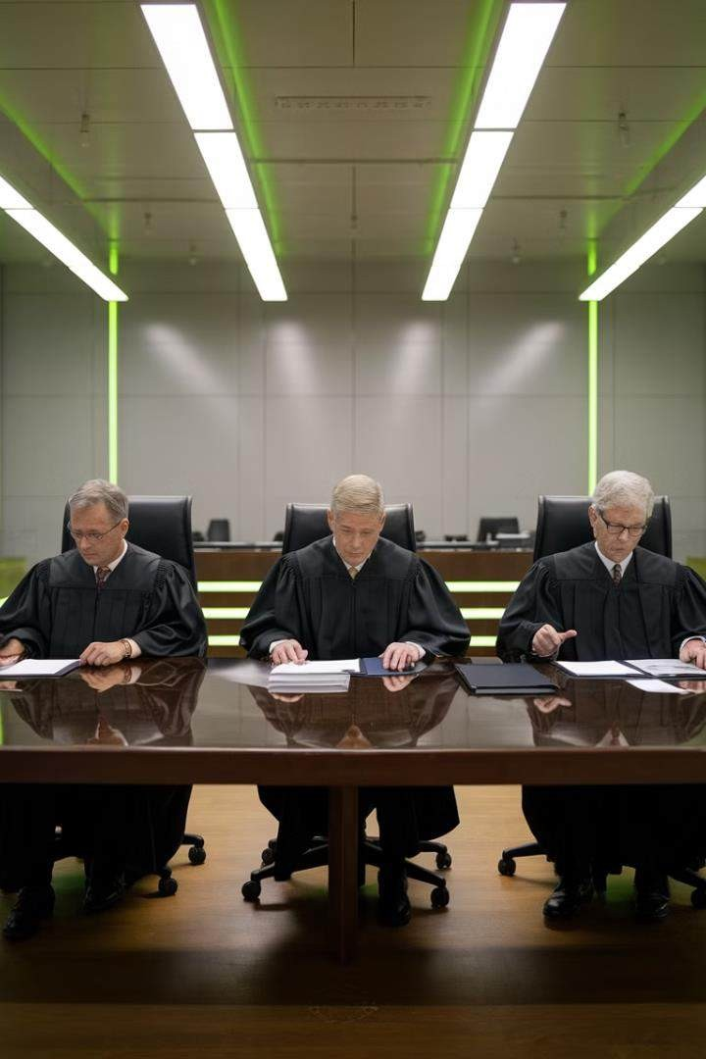
How Tribunals Assess Grievance- Related Claims
Criteria | Tribunal Considerations
Procedure Adherence | Was the company's grievance procedure followed correctly?
Timeliness | Were grievances addressed within reasonable timeframes?
Fairness | Was the investigation conducted impartially and thoroughly?
Communication | Were parties kept informed throughout the process?
Documentation | Is there sufficient documentation of the grievance and resolution attempts?
Reasonableness | Were the employer's actions and decisions reasonable in the circumstances?

Slide 9





Common Employer Mistakes
Delayed Response
Failing to address grievances promptly can lead to escalation and potential legal issues. Employers should have systems in place to ensure timely responses to all complaints.
Poor Documentation
Inadequate record-keeping of grievances, investigations, and outcomes can weaken an employer's position in potential disputes. Maintain detailed and accurate documentation throughout the process.
Bias in Investigations
Allowing personal relationships or preconceptions to influence the grievance process can lead to unfair outcomes.
Ensure all investigations are conducted impartially and objectively.
Lack of Communication
Failing to keep employees informed about the progress of their grievances can lead to frustration and mistrust. Maintain open lines of communication throughout the resolution process.

Slide 10
Mediation vs. Litigation in Grievance Handling
Mediation
Litigation
Choosing the Right Approach
Mediation is a voluntary, confidential process where a neutral third party facilitates discussion between the parties to reach a mutually acceptable resolution. It is often quicker, less costly, and less adversarial than litigation. Mediation can help preserve working relationships and allow for more creative solutions.
Litigation involves taking the dispute to a court or tribunal for a legally binding decision. While it can provide a definitive resolution, it is often
time-consuming, expensive, and can
damage workplace relationships. However, it may be necessary for complex cases or when other resolution methods have failed.
The choice between mediation and litigation depends on factors such as the nature of the grievance, the relationship between the parties, and the desired outcome. In many cases, attempting mediation before resorting to litigation can be beneficial for all parties involved.

Slide 11

Tools for Fostering Workplace Harmony
Open Door Policy
Encourage managers to maintain an open door policy, allowing employees to discuss concerns informally before they escalate into formal grievances.
Regular Feedback Sessions
Implement structured feedback sessions between employees and managers to address potential issues proactively and maintain open communication channels.
Conflict Resolution Training
Provide training for managers and employees on effective conflict resolution techniques to equip them with the skills to handle disagreements constructively.
Employee Surveys
Conduct regular anonymous surveys to gauge employee satisfaction and identify potential areas of concern before they develop into formal grievances.

Slide 12


Scenario 1: The Overlooked Promotion
Situation
An employee, Sarah, files a grievance after being passed over for a promotion in favour of a less experienced colleague. She believes the decision was influenced by gender bias.
Initial Response
HR acknowledges the grievance and schedules a meeting with Sarah to discuss
her concerns in detail. They explain the grievance process and timeline.
Investigation
HR reviews the promotion process, interviews the hiring manager and other relevant parties, and examines performance records of both candidates.
Resolution
The investigation reveals inconsistencies in the promotion process. The company decides to review its promotion policies, provide additional training to managers, and create a mentorship programme to support career development.

Slide 13
Scenario 2: The Bullying Accusation
1
Day 1: Grievance Filed
John submits a formal grievance accusing his team leader, Mark, of bullying behaviour, including constant criticism and exclusion from team activities.
2
Day 3: Initial Meeting
HR meets with John to gather details about the allegations and explain the investigation process. They also inform Mark about the grievance and temporarily reassign John to another team.
3
Days 5-10: Investigation
HR conducts interviews with team members, reviews email communications, and examines performance reviews. They also consult the company's anti-bullying policy.
4
Day 12: Findings and Action
The investigation reveals a pattern of inappropriate behaviour from Mark. HR arranges mediation between John and Mark, mandates leadership training for Mark, and implements team-building exercises for the entire department.

Slide 14
Scenario 3: The Pay Disparity Complaint
The Grievance
Company Response
Resolution and Follow-up
A group of female employees in the sales department file a collective grievance alleging pay discrimination based on gender. They claim that male colleagues in similar positions are receiving higher salaries for comparable work.
The HR department acknowledges the grievance and initiates a comprehensive pay audit across all departments. They engage an external consultant to ensure impartiality in the review process.
The company also communicates the steps being taken to address the
concern to all employees, emphasising their commitment to fair
pay practices.
The audit reveals some inconsistencies in pay scales. The company implements a new, transparent pay structure based on job responsibilities and performance metrics. They also establish a regular pay review process and provide training on unconscious bias in compensation decisions. The resolution includes back pay adjustments where discrepancies were found.

Slide 15
Audience Participation: Case Study Analysis
1
Group Discussion
Divide the audience into small groups and present them with a complex grievance scenario. Encourage them to analyse the situation and develop an action plan for addressing the grievance.
2
Role-Playing Exercise
Select volunteers to participate in a role-playing exercise simulating a grievance meeting. Assign roles such as the aggrieved employee, HR representative, and manager. After the exercise, facilitate a group discussion on the handling of the situation.
3
Policy Review Workshop
Provide sample grievance policies and ask participants to review and suggest improvements based on the principles discussed in the presentation. Encourage them to share best practices from their own organisations.
4
Q&A Session
Allocate time for an open question and answer session where participants can share their own experiences and challenges in handling employee grievances. Provide expert insights and practical advice in response to their queries.

Slide 16




Key Takeaways for Effective Grievance Handling
Clear Procedures
Establish and communicate clear, accessible grievance procedures to all employees. Ensure that these procedures are fair, transparent, and consistently applied across the organisation.
Timely Response
Address grievances promptly to prevent escalation and demonstrate the company's commitment to employee concerns. Set and adhere to reasonable timeframes for each stage of the grievance process.
Impartiality
Ensure all grievances are handled impartially, with investigations conducted by neutral parties. Consider using external mediators or investigators for complex or sensitive cases to maintain objectivity.
Documentation
Maintain thorough and accurate records of all grievances, investigations, and outcomes. Proper documentation is crucial for defending company actions in case of legal challenges and for identifying patterns that may require broader organisational changes.

Slide 17

Conclusion: Fostering a Positive Workplace Culture
Proactive Approach
Encourage open communication and address potential issues before they escalate into formal grievances.
Regular feedback sessions and employee surveys can help identify and resolve concerns early.
Continuous Improvement
Regularly review and update grievance procedures based on feedback and experiences. Use lessons learned from past grievances to improve workplace policies and practices.
Training and Development
Invest in training programmes for managers and employees on conflict resolution, effective communication, and diversity and inclusion. Equipping staff with these skills can prevent many grievances from arising.
Positive Reinforcement
Recognise and reward positive behaviours that contribute to a harmonious workplace. Celebrate successes in resolving conflicts and improving workplace relationships.

