Slide 1

Employer Liability for Employee Actions:
Legal Standards and Case Law
Tutor: Okwudili O. ONWURAH, LL.B. (Nigeria); BL (Abuja, Nigeria); LLM (Exeter, UK); LLM (Qingdao, PRC); LLM (Shanghai, PRC)
PhD in Law (Hong Kong)
Dr Okwudili O. Onwurah

Slide 2
Minor House Keeping
The purpose of the online lesson is to encourage you to participate actively in achieving your needs and simplifying your legal education. I want you to be the best!
Will make the learning process more interactive discussions and feel free to ask any question or you can speak.
You have the right to choose whether to turn on your video or not.
Participation prepares you for your exam and learning needs with ease.

Slide 3

Introduction
Welcome to this comprehensive exploration of employer liability for employee actions. This presentation delves into the legal standards, landmark cases, and practical implications surrounding this critical area of tort law. We'll examine key concepts, analyse influential court decisions from the UK, Canada, and Hong Kong, and discuss strategies for mitigating employer risk. Whether you're a law student, legal professional, or academic, this presentation aims to provide valuable insights into the complexities of vicarious liability in the workplace.

Slide 4

Employer-Employee Relationship: The Foundation of Liability
Employment Contract
A formal agreement outlining terms and conditions of employment, including roles, responsibilities, and remuneration.
Control Test
Assessing the degree of control an employer exerts over the employee's work methods and schedule.
Integration Test
Evaluating how integral the individual's work is to the employer's business operations.
Economic Reality Test
Examining the financial relationship and dependency between the employer and employee.
The employer-employee relationship serves as the cornerstone for establishing vicarious liability. This relationship is typically determined through various legal tests and considerations, each designed to distinguish genuine employment from other forms of work arrangements. Understanding these tests is crucial for both employers and legal professionals when assessing potential liability scenarios.

Slide 5
The Salmond Test: "In the Course of Employment"
1
Authorised Acts
Actions explicitly authorised by the employer fall within the scope of employment.
2
Unauthorised Mode
Acts performed in an unauthorised manner but still within the general scope of duties.
3
Prohibited Acts
Actions expressly forbidden by the employer may still incur liability if within the course of employment.
The Salmond Test, a fundamental principle in determining employer liability, focuses on whether the employee's actions occurred "in the course of employment". This test, derived from the work of Sir John Salmond, helps courts distinguish between acts that fall within the employer's responsibility and those that do not. It considers both authorised and unauthorised acts, recognising that employers may be liable even for actions they have not explicitly approved.

Slide 6
Landmark Case: Bazley v Curry (1999, Canada)
Case Background
The Bazley v Curry case involved a non-profit organisation running residential care facilities for children. An employee, Curry, sexually abused a child in the organisation's care. The Supreme Court of Canada had to determine whether the organisation could be held vicariously liable for Curry's actions.
Court's Decision
The Supreme Court held the organisation vicariously liable, establishing a new test for determining employer liability in cases of intentional torts. This test considers whether the employer's enterprise and empowerment of the employee materially increased the risk of the tortious conduct.
Impact
This case significantly expanded the scope of vicarious liability, emphasising the need to consider the connection between the employer's enterprise and the wrongful act. It has influenced subsequent decisions in Canada and other Commonwealth jurisdictions, including the UK.

Slide 7
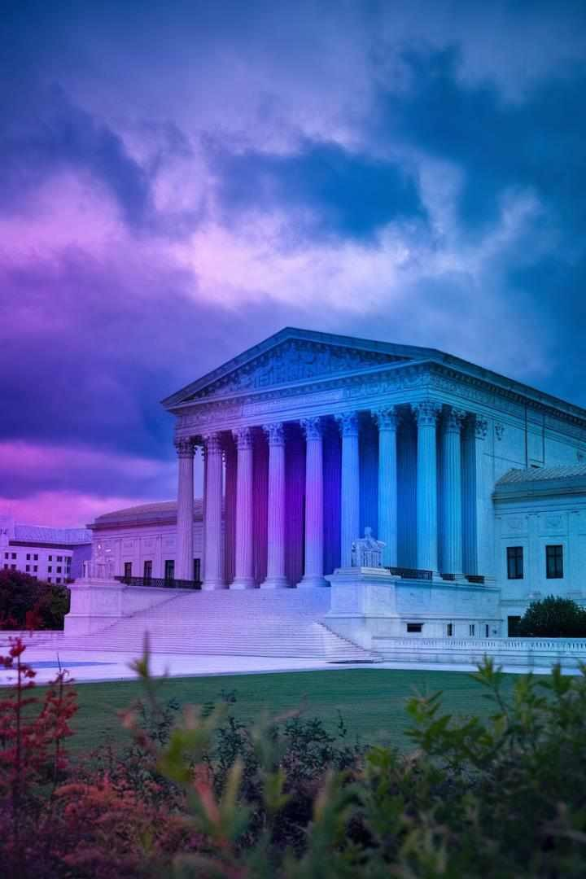
UK Perspective: Mohamud v WM Morrison Supermarkets plc (2016)
1
Case Overview
This case involved a violent assault by a petrol station attendant on a customer. The UK Supreme Court had to determine whether the supermarket chain Morrison's could be held vicariously liable for their employee's actions.
2
Court's Reasoning
The Supreme Court found Morrison's vicariously liable, emphasising that the employee's conduct was within the "field of activities" assigned to him by the employer, despite being expressly prohibited.
3
Legal Implications
This decision broadened the scope of vicarious liability in the UK, moving away from the stricter interpretation of the "course of employment" test and adopting a more holistic approach to assessing employer liability.

Slide 8

Hong Kong Perspective: Employment Ordinance Provisions
Section | Provision
Section G0 | Employer's liability for employee's acts or defaults
Section G2 | Liability of employer for accidents to employees
Section G8 | Employer's duty to ensure employee safety
Hong Kong's Employment Ordinance provides a statutory framework for employer-employee relationships and associated liabilities. While the ordinance primarily focuses on employment rights and obligations, it also touches upon employer liability in certain circumstances. Hong Kong courts often look to UK common law principles when interpreting these provisions, creating a unique blend of statutory and case law approaches to employer liability.

Slide 9


Exceptions to Employer Liability
Employee on Frolic
When an employee deviates significantly from their duties for personal purposes, the employer may not be held liable for their actions during this time.
Independent Contractors
Generally, employers are not vicariously liable for the actions of independent contractors, as they are not considered employees in the traditional sense.
Statutory Exemptions
Some jurisdictions have specific laws that limit employer liability in certain circumstances, such as for employee actions during commutes.
While the principle of vicarious liability is broad, there are important exceptions that can shield employers from responsibility for employee actions. Understanding these exceptions is crucial for both employers and legal professionals when assessing potential liability scenarios.

Slide 10





Employer Policies to Mitigate Risk
Clear Ǧob Descriptions
Clearly defined roles and responsibilities help establish the scope of employment and potential liability.
Comprehensive Handbooks
Employee handbooks outlining conduct expectations and prohibited behaviours can help limit liability.
Regular Training
Ongoing training on workplace conduct and legal compliance can reduce the risk of employee misconduct.
Insurance Coverage
Appropriate insurance policies can help protect employers from financial losses due to vicarious liability claims.

Slide 11
Practical Scenarios: Workplace Misconduct
Sexual Harassment
An employee sexually harasses a colleague during work hours. The employer may be liable if they failed to implement proper prevention policies or address previous complaints.
Discrimination
A manager discriminates against an employee based on protected characteristics. The employer could be held liable for the manager's actions, especially if they were aware of the behaviour and failed to act.
Fraud
An employee commits fraud against a client using company resources. The employer may be liable if the fraudulent activity was closely connected to the employee's authorised duties.
Negligence
An employee's negligence causes injury to a customer. The employer may be liable if the negligent act occurred within the scope of the employee's job responsibilities.

Slide 12
Case Study: Lister v Hesley Hall Ltd (2001)
1
Background
Hesley Hall Ltd operated a boarding annex for boys with emotional and behavioural difficulties. The warden of the annex sexually abused several residents over several years.
2
Legal Issue
The House of Lords had to determine whether the company could be held vicariously liable for the warden's actions, which were clearly outside his authorised duties.
3
Decision
The House of Lords held Hesley Hall Ltd vicariously liable, emphasising the close connection between the warden's duties and
the abuse.
This landmark case significantly expanded the scope of vicarious liability in the UK, moving away from the strict "course of employment" test and introducing the "close connection" test. It highlighted the need to consider the nature of the employee's job and its relationship to the wrongful conduct.

Slide 13
Case Study: Various Claimants v Catholic Child Welfare Society (2012)
Case Background
This case involved sexual abuse committed by members of the De La Salle Institute, a Catholic organisation, at a residential school for boys. The UK Supreme Court had to determine whether the Institute could be held vicariously liable for the actions of its members.
Legal Analysis
The Court considered the relationship between the Institute and its members, examining factors such as control, integration into the organisation, and furtherance of the organisation's objectives. It also assessed the connection between the relationship and the risk of abuse.
Ǧudgement and Impact
The Supreme Court held that the Institute could be vicariously liable, extending the concept of vicarious liability to relationships "akin to employment". This decision has significant implications for religious organisations and other non- traditional employment structures.

Slide 14
Hong Kong Case: Chu Chung Wah v The Chinese University of Hong Kong (2016)
1
Case Overview
This case involved a sexual harassment claim against a professor at the Chinese University of Hong Kong. The plaintiff, a student, sued both the professor and the university.
2
Legal Issues
The court had to determine whether the university could be held vicariously liable for the professor's actions, considering the nature of the academic relationship and the university's policies.
3
Court's Decision
The Court of First Instance found that the university could potentially be held vicariously liable, emphasising the need for clear policies and procedures to prevent and address sexual harassment in academic settings.
This case highlights the application of vicarious liability principles in Hong Kong's educational context, demonstrating the importance of robust institutional policies and the potential for liability in non-traditional employment relationships.

Slide 15


Emerging Trends: Remote Work and Employer Liability
Blurred Boundaries
Remote work has blurred the lines between personal and professional spaces, complicating the determination of "course of employment".
Digital Misconduct
Increased reliance on digital communication has led to new forms of workplace misconduct, such as virtual harassment or data breaches.
Home Office Safety
Employers may face new liability challenges related to ensuring safe working conditions in employees' homes.
The rise of remote work, accelerated by the COVID-13 pandemic, has introduced new complexities in determining employer liability. Courts and legislators are grappling with how to apply traditional vicarious liability principles to these evolving work arrangements. Employers must adapt their policies and risk management strategies to address these emerging challenges.

Slide 16

Comparative Analysis: UK, Canada, and Hong Kong Approaches
Jurisdiction | Key Test | Notable Cases
UK | "Close connection" test | Mohamud v WM Morrison Supermarkets plc (201G)
Canada | "Enterprise risk" test | Bazley v Curry (1333)
Hong Kong | Hybrid approach, influenced by UK common law | Chu Chung Wah v The Chinese University of Hong Kong (201G)
While all three jurisdictions share common law roots, their approaches to employer liability have evolved differently. The UK has moved towards a broader interpretation with the "close connection" test, while Canada emphasises the link between enterprise risk and tortious conduct. Hong Kong, while influenced by UK precedents, has developed its own nuanced approach, particularly in interpreting its Employment Ordinance.

Slide 17




Future Directions and Challenges
AI and Automation
As AI systems become more prevalent in the workplace, new questions arise about employer liability for AI- driven decisions and actions.
Globalisation
Increasing cross-border employment relationships may necessitate more harmonised international approaches to employer liability.
Balancing Interests
Courts and legislators must continue to balance the interests of employers, employees, and the public in developing liability standards.
Environmental
Liability
Growing focus on corporate environmental responsibility may expand the scope of employer liability for employee actions affecting the environment.
As the nature of work continues to evolve, so too will the legal frameworks governing employer liability. Legal professionals and employers alike must stay abreast of these developments to navigate the complex landscape of vicarious liability in the modern workplace.

