Slide 1

Occupiers' Liability:
Legal Responsibilities and Case Law
Tutor: Okwudili O. ONWURAH, LL.B. (Nigeria); BL (Abuja, Nigeria); LLM (Exeter, UK); LLM (Qingdao, PRC); LLM (Shanghai, PRC)
PhD in Law (Hong Kong)
Dr Okwudili O. Onwurah

Slide 2
Minor House Keeping
The purpose of the online lesson is to encourage you to participate actively in achieving your needs and simplifying your legal education. I want you to be the best!
Will make the learning process more interactive discussions and feel free to ask any question or you can speak.
You have the right to choose whether to turn on your video or not.
Participation prepares you for your exam and learning needs with ease.

Slide 3
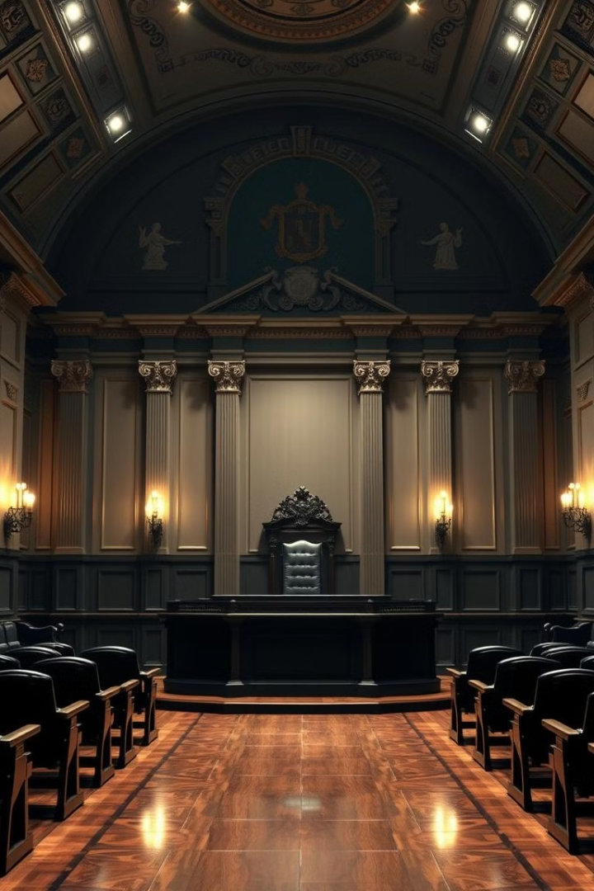
Introduction
Occupiers' liability is a crucial area of tort law that governs the duty of care owed by property occupiers to visitors and trespassers. This presentation explores the key principles, statutory framework, and landmark cases that have shaped this field in English and Hong Kong law. We will examine the Occupiers' Liability Acts of 1957 and 1984, analyse significant case studies, and discuss the nuanced application of these laws to various scenarios, including lawful visitors, trespassers, and children. By understanding the intricacies of occupiers' liability, legal professionals can better advise clients on property management, risk mitigation, and the balance between safety and personal responsibility.

Slide 4
Introduction to Occupiers' Liability
Occupiers' liability is a branch of negligence law that focuses on the responsibilities of those who control premises towards individuals who enter those premises. This concept emerged from common law and has since been codified in statutes, primarily the Occupiers' Liability Act 1957 and the Occupiers' Liability Act 1984 in England and Wales. The fundamental principle underlying this area of law is that those who have control over property should take reasonable care to ensure the safety of those who come onto it.
The term 'occupier' is broadly interpreted and does not necessarily mean the owner of the property. It can include tenants, licensees, or anyone with sufficient control over the premises to be able to exclude others from it. The duty of care extends to various types of premises, including buildings, land, and even vehicles or vessels.
1
Common Law Origins
Occupiers' liability developed through case law, establishing different duties based on visitor categories.
2
Statutory Codification
The Occupiers' Liability Act 1957 consolidated and reformed the law for lawful visitors.
3
Extension to Trespassers
The Occupiers' Liability Act 1984 extended a modified duty of care to trespassers.
4
Modern Application
Courts continue to interpret and apply these acts in light of evolving societal norms and expectations.

Slide 5
Occupiers' Liability Act 1957: Duty to Lawful Visitors
The Occupiers' Liability Act 1957 marked a significant shift in English tort law by abolishing the common law distinctions between invitees, licensees, and contractual visitors. It established a unified statutory duty of care owed by occupiers to all lawful visitors. Section 2(2) of the Act states that an occupier must take such care as is reasonable in all circumstances to ensure that visitors will be reasonably safe in using the premises for the purposes for which they are invited or permitted to be there.
This duty extends to all aspects of the premises, including the state of the property, activities carried out there, and the conduct of third parties. The Act also allows for the duty to be extended, restricted, modified, or excluded by express agreement or notice, subject to the requirement that any such limitation must be reasonable.
Scope of Duty
Reasonable Care
Covers all aspects of premises safety, including physical condition and activities.
Occupier must take steps that a reasonable person would take to ensure visitor safety.
Purpose of Visit
Contractual Modifications
Duty is tailored to the purpose for which the visitor is permitted on the premises.
Allows for adjustment of duty through agreement or notice, subject to reasonableness.

Slide 6
Case Study: Wheat v E Lacon & Co Ltd
The case of Wheat v E Lacon & Co Ltd [1966] AC 552 is a landmark decision that clarified the concept of 'occupier' under the Occupiers' Liability Act 1957. The case involved a fatal accident at a pub where a guest fell down a steep, unlit staircase. The House of Lords had to determine who could be considered an occupier for the purposes of liability.
Lord Denning's judgment established that there can be more than one occupier of premises, and that occupancy is a matter of degree. He stated that an occupier is someone with sufficient control over the premises to have a duty to protect those who come there. This decision expanded the potential liability beyond just the legal owner of a property.
Facts of the Case
Key Legal Principles
Impact
- Incident occurred in a pub - Guest fell down steep, unlit stairs - Multiple parties had different levels of control over the premises
- Multiple occupiers possible - Occupancy is a matter of degree - Control is the crucial factor - Duty extends to those with sufficient control
- Broadened the definition of 'occupier' - Increased potential liability for non-owners - Emphasized the importance of control in determining duty

Slide 7





Standard of Care and Reasonable Foreseeability
The standard of care required under occupiers' liability is that of 'reasonable care'. This standard is not absolute and varies depending on the circumstances of each case. Courts consider factors such as the likelihood of injury, the seriousness of potential harm, the social value of the activity, and the cost of preventative measures. The concept of reasonable foreseeability plays a crucial role in determining the extent of an occupier's duty.
In Glasgow Corporation v Muir [1943] AC 448, Lord Macmillan emphasized that the standard is not that of the "ideal citizen" but of an ordinary, reasonable person. This principle was further developed in cases like Bolton v Stone [1951] AC 850, where the House of Lords held that the mere possibility of injury is not enough to establish a breach of duty if the risk is so small that a reasonable person would disregard it.
Identify Risks
Assess potential hazards and their likelihood of causing harm.
Evaluate Severity
Consider the potential seriousness of injuries that could result.
Weigh Social Utility
Balance the usefulness of the activity against its risks.
Consider Precautions
Determine what reasonable steps could be taken to mitigate risks.
Apply Reasonable Person Test
Assess what an ordinary, prudent person would do in the circumstances.

Slide 8
Occupiers' Liability Act 1984: Duty to Trespassers
The Occupiers' Liability Act 1984 extended the duty of care to trespassers, addressing a gap in the 1957 Act. This legislation was partly a response to the controversial decision in British Railways Board v Herrington [1972] AC 877, where the House of Lords had struggled to define the duty owed to trespassers under common law. The 1984 Act provides a statutory framework for determining when an occupier owes a duty to persons other than their visitors.
Under Section 1(3) of the Act, a duty arises if: (a) the occupier is aware of the danger or has reasonable grounds to believe it exists; (b) the occupier knows or has reasonable grounds to believe that the trespasser is in the vicinity of the danger or may come into its vicinity; and (c) the risk is one against which the occupier may reasonably be expected to offer some protection.
1
Awareness of Danger
2
Presence of Trespassers
The occupier must have actual or constructive knowledge of the hazard on their premises.
There must be a reasonable expectation that trespassers might encounter the danger.
3
Reasonable Protection
4
Limited Scope
The duty only extends to risks against which it is reasonable to expect the occupier to guard.
The duty is more restricted than that owed to lawful visitors under the 1957 Act.

Slide 9
Children and Occupiers' Liability
The law recognizes that children require special consideration in the context of occupiers' liability. Both the 1957 and 1984 Acts acknowledge that occupiers may need to take additional precautions when children are likely to be present on their premises. This is based on the understanding that children may not have the same capacity as adults to appreciate risks or to take care for their own safety.
In cases involving children, courts often apply a higher standard of care, expecting occupiers to anticipate the natural curiosity and unpredictable behaviour of young visitors. The landmark case of Glasgow Corporation v Taylor [1922] 1 AC 44 established that where an occupier creates an allurement that is likely to attract children, they may be liable for injuries resulting from that attraction, even if the children are trespassers.
Factor
Consideration for Children
Legal Implication
Risk Assessment
Must consider child-specific risks
Higher duty of care
Attractive Nuisance
Features that may lure children
Potential liability even for trespassers
Warning Signs
May not be sufficient for young children
Need for physical barriers
Supervision
Expectations of parental oversight
Shared responsibility with guardians

Slide 10




Independent Contractors and Occupiers' Liability
The use of independent contractors by occupiers raises complex issues of liability. Generally, an occupier is not liable for the negligence of an independent contractor if they have taken reasonable care in selecting a competent contractor. However, this principle is subject to important exceptions and nuances that have been developed through case law.
In Woodward v Mayor of Hastings [1945] KB 174, the court established that an occupier cannot delegate their duty of care to an independent contractor for operations that are inherently dangerous. The case of Haseldine v Daw & Son Ltd [1941] 2 KB 343 further refined this principle, holding that an occupier may be liable for the negligence of an independent contractor if the task delegated involves a special danger of which the occupier knows or ought to know.
Selection of Contractor
Inherent Danger
Supervision
Non-Delegable Duties
Occupiers must exercise reasonable care in choosing competent contractors.
Liability cannot be delegated for operations that are inherently hazardous.
Occupiers may need to oversee contractors for high-risk tasks.
Certain statutory obligations remain with the occupier regardless of delegation.

Slide 11
Recent Developments and Future Trends
Recent years have seen evolving interpretations of occupiers' liability law, reflecting changes in societal attitudes towards risk and personal responsibility. Courts have shown a tendency to limit the scope of occupiers' liability in cases where visitors voluntarily accept obvious risks. The case of Tomlinson v Congleton Borough Council [2003] UKHL 47 marked a significant shift, with the House of Lords emphasizing that occupiers are not required to protect visitors against obvious dangers or self-inflicted harm.
In Hong Kong, the case of Gou Jun v The Incorporated Owners of Kingswood Villas [2017] HKCFI 1190 demonstrated a similar approach, with the court holding that occupiers are not obliged to warn against obvious risks that a reasonable person would be aware of. These developments suggest a trend towards a more balanced approach, recognizing both the occupier's duty and the visitor's responsibility for their own safety.
Tomlinson v Congleton (2003)
Future Considerations
Limited liability for obvious risks, emphasizing personal responsibility.
Potential reforms to balance safety, personal freedom, and economic factors.
1
2
3
4
Gou Jun v Kingswood Villas (2017)
Technological Impact
Hong Kong court aligns with UK approach on obvious dangers.
Emerging issues related to smart buildings and AI-controlled environments.

Slide 12
Conclusion: Balancing Safety and Responsibility
Occupiers' liability law continues to evolve, striving to balance the duties of property controllers with the personal responsibility of visitors. The legal framework established by the Occupiers' Liability Acts of 1957 and 1984, along with subsequent case law, provides a nuanced approach to determining liability in various scenarios. Key principles such as reasonable foreseeability, the standard of care, and the special consideration for children remain central to judicial decision-making in this area.
As society and technology progress, new challenges emerge in interpreting and applying occupiers' liability law. The trend towards recognizing personal responsibility and limiting liability for obvious risks is likely to continue, but must be balanced against the need to protect vulnerable individuals and maintain safety standards. Legal professionals must stay abreast of these developments to effectively advise clients on risk management and liability issues in property control and management.
1
Evolving Standards
2
Risk Assessment
Courts continue to refine the interpretation of 'reasonable care' in light of changing societal norms.
Occupiers must conduct thorough risk assessments and implement appropriate safety measures.
3
Personal Responsibility
4
Future Challenges
Increasing emphasis on visitors' duty to take care for their own safety in obvious risk scenarios.
Emerging technologies and changing property uses will present new legal questions in occupiers' liability.

