Slide 1

Vicarious Liability and Independent Contractors: Key Differences
Tutor: Okwudili O. ONWURAH, LL.B. (Nigeria); BL (Abuja, Nigeria); LLM (Exeter, UK); LLM (Qingdao, PRC); LLM (Shanghai, PRC)
PhD in Law (Hong Kong)
Dr Okwudili O. Onwurah

Slide 2
Minor House Keeping
The purpose of the online lesson is to encourage you to participate actively in achieving your needs and simplifying your legal education. I want you to be the best!
Will make the learning process more interactive discussions and feel free to ask any question or you can speak.
You have the right to choose whether to turn on your video or not.
Participation prepares you for your exam and learning needs with ease.

Slide 3

Introduction
Welcome to this comprehensive exploration of vicarious liability and independent contractors in tort law. This presentation delves into the intricate legal landscape surrounding employer liability, focusing on the crucial distinctions between employees and independent contractors. We'll examine landmark cases from both the UK and Hong Kong, analyse the evolving 'control test', and discuss the implications for modern work arrangements, particularly in the gig economy. Join us as we unravel the complexities of this dynamic area of law, providing valuable insights for legal professionals, law students, and academics alike.

Slide 4
Employer Liability for Independent Contractors
General Rule
Traditionally, employers are not vicariously liable for the torts of independent contractors. This principle stems from the notion that independent contractors have autonomy in their work methods and are not under the direct control of the employer.
Exceptions
However, exceptions exist where the employer may still be held liable. These include cases involving non- delegable duties, negligent selection of the contractor, or where the task itself is inherently dangerous.
Blurred Lines
Modern work arrangements have complicated this distinction, leading courts to scrutinise the nature of the relationship more closely. Factors such as integration into the business and economic reality are increasingly considered.
Legal Implications
The classification of a worker as an employee or independent contractor has significant legal ramifications, affecting not only tort liability but also employment rights, tax obligations, and social security benefits.

Slide 5
Key Distinction: "Control Test" and Economic Reality
1
Traditional Control Test
Historically, courts relied heavily on the 'control test' to determine employment status. This test focused on the degree of control an employer exercised over the worker's tasks and methods. A high degree of control typically indicated an employer-employee relationship.
2
Evolution of the Test
As work arrangements became more complex, courts recognised the limitations of the control test. This led to the development of a
multi-factorial approach, considering various aspects of the working relationship beyond mere control.
3
Economic Reality Test
Modern courts now often apply the 'economic reality' test, which examines the worker's economic dependence on the employer. This
test considers factors such as integration into the business, provision of equipment, and financial risk.
4
Current Approach
Today, courts employ a holistic approach, balancing elements of control, economic reality, and the intention of the parties. This nuanced
analysis aims to reflect the true nature of modern working relationships more accurately.

Slide 6
Case Law: Ready Mixed Concrete (South East) Ltd v Minister of Pensions and National Insurance (1tG8)
Case Background
Court's Decision
Impact and Significance
This landmark case involved owner- drivers who delivered concrete for Ready Mixed Concrete Ltd. The company argued that these drivers were independent contractors, not employees, to avoid national insurance contributions.
Justice MacKenna established a three-part test to determine employment status: 1. The servant agrees to provide work or skill in return for remuneration. 2. The servant agrees to be subject to the master's control. 3. The other provisions of the contract are consistent with it being a contract of service.
This case significantly refined the 'control test' and introduced a more comprehensive approach to determining employment status. It remains a cornerstone in employment law, influencing subsequent cases and legislative reforms in the UK and beyond.

Slide 7
Hong Kong Perspective: Contractor Provisions under EO
1
Employment Ordinance (Cap. 57)
Hong Kong's primary legislation governing employment relationships is the Employment Ordinance (EO). It provides a framework for distinguishing between employees and independent contractors, though the distinction is not always clear-cut.
2
Contractor and Sub-contractor Provisions
The EO contains specific provisions relating to contractors and sub-contractors, particularly in industries like construction. These provisions aim to protect workers' rights and ensure proper classification of employment status.
3
Judicial Interpretation
Hong Kong courts have generally followed the UK approach in interpreting employment status, considering factors such as control, integration, and economic reality. However, they also take into account local business practices and economic conditions.
4
Recent Developments
Recent cases in Hong Kong have shown a tendency to look beyond contractual terms and examine the practical realities of the working relationship. This approach aligns with global trends in addressing the complexities of modern work arrangements.

Slide 8
Case Law: Barclays Bank v Various Claimants (2020)
Supreme Court Ruling
Case Background
This UK Supreme Court case involved sexual assaults committed by a self-employed doctor during medical examinations of Barclays Bank job applicants and employees. The claimants sought to hold Barclays vicariously liable for the doctor's actions.
The Supreme Court unanimously overturned the lower court decisions, holding that Barclays was not vicariously liable. The court emphasised the importance of the formal employment relationship, reaffirming the distinction between employees and independent contractors.
1
2
3
4
Lower Court Decisions
Both the High Court and Court of Appeal held Barclays vicariously liable, applying a broad interpretation of the employer-employee relationship based on the integration of the doctor's work into the bank's business.
Impact and Significance
This ruling marked a shift back towards a more traditional approach to vicarious liability, providing clarity on the limits of employer responsibility for independent contractors. It has significant implications for businesses using self-employed individuals or consultants.

Slide 9




Practical Examples: Contractors in Construction Disputes
Site Accidents
In construction, determining liability for site accidents often hinges on the status of workers. If a worker is deemed an independent contractor, the principal contractor may avoid vicarious liability, but could still be liable for breach of statutory duty or negligence in site management.
Defective Work
When defects arise in construction projects, the classification of workers becomes crucial. Principal contractors may attempt to shift liability to subcontractors classified as independent contractors, but courts will scrutinise the true nature of the relationship and the level of control exercised.
Delay Claims
In delay claims, the status of workers can affect the allocation of responsibility.
Independent contractors may bear more risk for delays within their scope, while employees' delays are more likely to be attributed to the employer.
Payment Disputes
The classification of workers impacts payment disputes, affecting issues like withholding tax, liability for social security contributions, and entitlement to certain statutory payments. Courts will look beyond contractual labels to determine the true nature of the relationship.

Slide 10

Employer Risk Mitigation Strategies
Clear Contractual Terms
Employers should ensure contracts clearly define the nature of the relationship, specifying whether the individual is an employee or independent contractor. However, it's crucial to remember that courts will look beyond contractual labels to the reality of the working relationship.
Regular Status Reviews
Implement a system for regularly reviewing the status of workers, particularly long-term contractors. This helps identify any shifts in the working relationship
that might alter their classification and associated liabilities.
Training and Supervision
Provide adequate training and supervision to all workers, regardless of their status. This can help mitigate risks of negligence claims and demonstrate responsible management practices.
Insurance Coverage
Maintain comprehensive insurance coverage that accounts for potential liabilities arising from both employees and independent contractors. Consider
specialised policies that address the unique risks associated with different types of working relationships.
Legal Consultation
Regularly consult with legal experts to stay abreast of changes in employment law and ensure compliance with current regulations. This proactive approach can help identify potential issues before they escalate into disputes.

Slide 11
Discussion: Blurring Boundaries in the Gig Economy
Rise of the Gig Economy
Legal Challenges
Future Implications
The gig economy has introduced new complexities in worker classification. Platform-based work, such as ride-sharing and food delivery services, often blurs the lines between traditional employment and independent contracting. This ambiguity challenges existing legal frameworks and raises questions about worker protections and employer liabilities.
Recent cases, such as Uber BV v Aslam (2021) in the UK, have grappled with these issues. Courts are increasingly willing to look beyond contractual terms to the practical realities of working relationships. This approach has led to some gig economy workers being classified as 'workers', a category that sits between employees and independent contractors in UK law.
The evolving nature of work in the gig economy may necessitate new legal categories or a reimagining of existing ones. Legislators and courts face the challenge of balancing worker protections with the flexibility that attracts many to gig work. This ongoing debate has significant implications for vicarious liability, employment rights, and the broader structure of the labour market.

Slide 12
Case Study 1: The Delivery Driver Dilemma
Scenario
A major online retailer uses a mix of employed drivers and independent contractors for deliveries. An independent contractor driver causes an accident while making a delivery, injuring a pedestrian. The pedestrian sues both the driver and the retailer.
Legal Issues
The court must determine whether the retailer is vicariously liable for the driver's actions. Key considerations include the level of control exercised by the retailer, the integration of the driver into the business, and the economic reality of the relationship.
Potential Outcomes
If the driver is deemed a true independent contractor, the retailer may avoid vicarious liability. However, if the court finds sufficient control or integration, the retailer could be held liable despite the contractual classification.
Implications
This case highlights the importance of carefully structuring relationships with contractors and the potential risks of misclassification. It also underscores the need for businesses to consider insurance coverage for both employees and contractors.

Slide 13
Case Study 2: The Freelance Web Developer
1
Initial Engagement
A tech startup hires a freelance web developer on a project basis to create their company website. The contract explicitly states that the developer is an independent contractor.
2
Evolving Relationship
Over time, the developer becomes increasingly integrated into the company's operations, attending regular team meetings and taking on additional responsibilities beyond the initial project scope.
3
Dispute Arises
A data breach occurs due to a security flaw in the website. Affected users sue the company, which in turn seeks to hold the developer responsible as an independent contractor.
4
Legal Analysis
The court examines the actual working relationship, considering factors such as control, integration, and economic dependence. Despite the contractual label, the court may find that the developer has become a de facto employee, potentially exposing the company to vicarious liability.

Slide 14
Case Study 3: The Construction Site Incident
Scenario
Legal Complexities
Key Considerations
A large construction project employs various subcontractors. A worker employed by one subcontractor is injured due to the negligence of another subcontractor's employee. The injured worker sues the main contractor and the negligent subcontractor.
The case involves multiple layers of contractual relationships and potential liabilities. The court must navigate the distinctions between employees and independent contractors at each level, as well as consider any non-delegable duties of the main contractor.
Factors such as the degree of control exercised by the main contractor over the subcontractors, site safety responsibilities, and the specific terms of the subcontracting agreements will be crucial in determining liability. The case may also involve considerations of joint and several liability among the various parties involved.

Slide 15
Discussion: Balancing Flexibility and Protection
1
Economic Considerations
The gig economy and flexible work arrangements offer economic benefits, including reduced overhead for businesses and increased opportunities for workers.
However, this must be balanced against the need for
worker protections and fair labour practices.
2
Legal Framework Challenges
Current legal frameworks struggle to adequately address the nuances of modern working relationships. There is a growing need for legislation that can accommodate the spectrum of work arrangements while ensuring appropriate protections and liabilities.
3
Social Impact
The classification of workers has broader social implications, affecting access to benefits, job security, and social mobility. Policy makers must consider these wider impacts when developing regulations for the evolving labour market.
4
Future Directions
Potential solutions may include creating new legal categories of workers, implementing portable benefits systems, or developing more nuanced tests for determining employment status. Ongoing dialogue between lawmakers, businesses, and workers will be crucial in shaping effective policies.

Slide 16
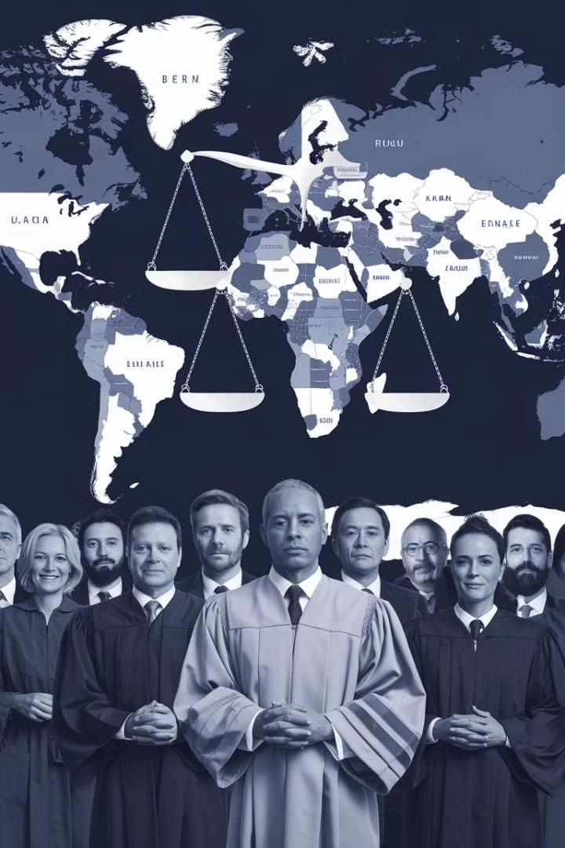
Global Perspectives on Vicarious Liability
Jurisdiction | Approach to Vicarious Liability | Key Cases/Legislation
United Kingdom | Multi-factorial approach, considering control, integration, and economic reality | Uber BV v Aslam (2021), Barclays Bank v Various Claimants (2020)
United States | Varies by state, generally uses 'right to control' test | Dynamex Operations West, Inc. v. Superior Court (2018) - California
Australia | Multi-indicia test, similar to UK approach | Hollis v Vabu Pty Ltd (2001)
Canada | Entrepreneur/integratio n test | 671122 Ontario Ltd. v. Sagaz Industries Canada Inc. (2001)

Slide 17

Conclusion: Navigating the Complex Landscape of Vicarious Liability
Evolving Legal Landscape
The distinction between employees and independent contractors remains crucial in determining vicarious liability, but the boundaries are increasingly blurred in modern work arrangements. Courts are adopting more nuanced approaches to reflect these complexities.
Practical Implications
Employers must carefully consider the true nature of their relationships with workers, looking beyond contractual labels. Regular reviews of working arrangements and comprehensive risk management strategies are essential.
Future Challenges
The rise of the gig economy and evolving work patterns will continue to challenge existing legal frameworks. Legislators and courts will need to adapt to ensure fair outcomes for both businesses and workers.
Ongoing Dialogue
Continued discussion among legal professionals, policymakers, and stakeholders is crucial to develop effective solutions that balance the needs for flexibility, worker protection, and clear liability frameworks in the modern economy.

