Slide 1
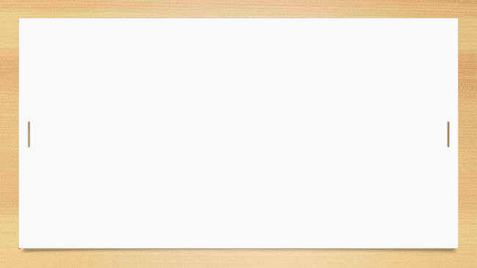



Breach of Duty of Care in Tort Law
Tutor: Okwudili O. ONWURAH, LL.B. (Nigeria); BL (Abuja, Nigeria); LLM (Exeter, UK); LLM (Qingdao, PRC); LLM (Shanghai, PRC)
PhD in Law (Hong Kong)
Dr Okwudili O. Onwurah
10/31/2024
1

Slide 2

The purpose of the online lesson is to encourage you to participate actively in achieving your needs and simplifying your legal education. I want you to be the best!
Minor House Keeping
Will make the learning process more interactive discussions and feel free to ask any question or you can speak.
You have the right to choose whether to turn on your video or not.
Participation prepares you for your exam and learning needs with ease.
10/31/2024
2

Slide 3
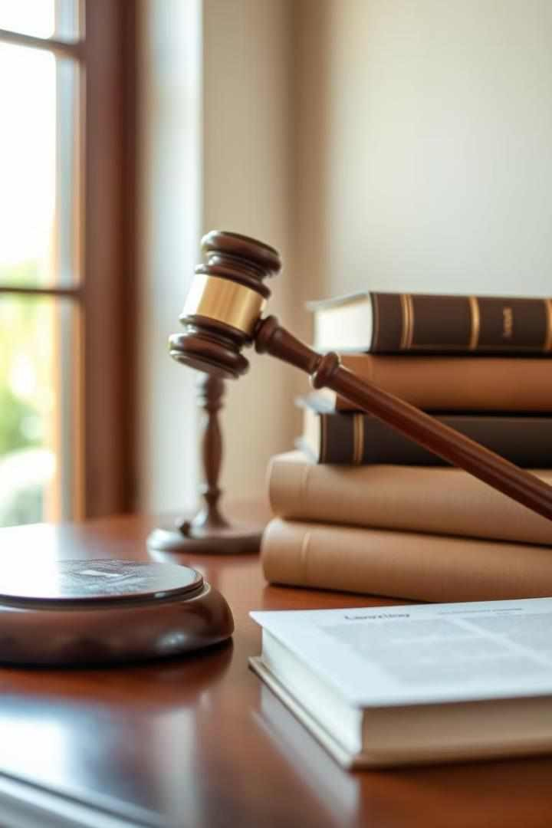
Introduction
Breach of duty is a crucial concept in tort law. It occurs when someone fails to meet the legally required standard of care, potentially causing harm. This element is central to negligence claims and requires careful analysis of circumstances and actions.
Importance: Central to negligence claims in tort law.
Example: A driver runs a red light and causes an accident, breaching their duty to follow traffic laws and ensure the safety of others on the road.
OO

Slide 4


Standard of Care
1
Reasonably Prudent
Person
The standard of care is based on what a reasonably prudent person would do. It varies depending on the specific situation and relationship between parties.
2
Professional Standards
For professionals, the standard is higher. It's based on the expected competence within their field.
3
Context-Dependent
The standard can change based on circumstances. Factors like expertise and potential risks are considered.

Slide 5

Reasonable Person Test
1
Identify the Situation
Analyze the specific circumstances of the case. Consider all relevant factors
and context.
2
Apply Reasonable Person Standard
Determine how a hypothetical reasonable person would act in this situation. Consider common sense and societal expectations.
3
Compare to Defendant's Actions
Evaluate the defendant's actual behavior against the reasonable person standard. Identify any discrepancies or shortcomings.
4
Determine Breach
Conclude whether the defendant's actions fell short of the reasonable person standard. This establishes breach of duty.

Slide 6
Factors Determining Breach
Foreseeability of Harm
Courts consider whether a reasonable person could have predicted the potential harm. This impacts the expected level of caution.
Magnitude of Risk
The potential severity of harm is evaluated. Greater risks typically require more stringent precautions.
Practicability of Precautions
The feasibility and cost of preventive measures are weighed. Courts consider what steps were reasonable to expect.

Slide 7
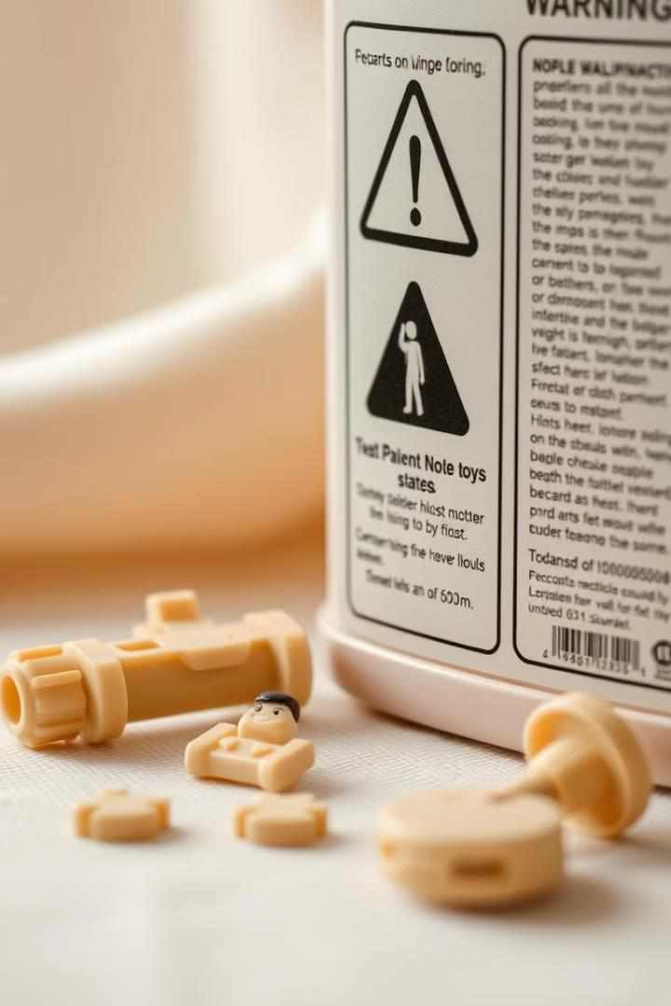

Foreseeability of Harm
Identify Potential Risks
Analyze the situation for possible dangers. Consider both obvious and less apparent risks.
Assess Likelihood
Evaluate the probability of harm occurring. Consider frequency and
predictability of the risk.
Consider Knowledge
Determine what a reasonable person should know. Factor in common knowledge and specific expertise.
Evaluate Preventability
Assess whether harm could have been prevented. Consider available safety measures and precautions.

Slide 8
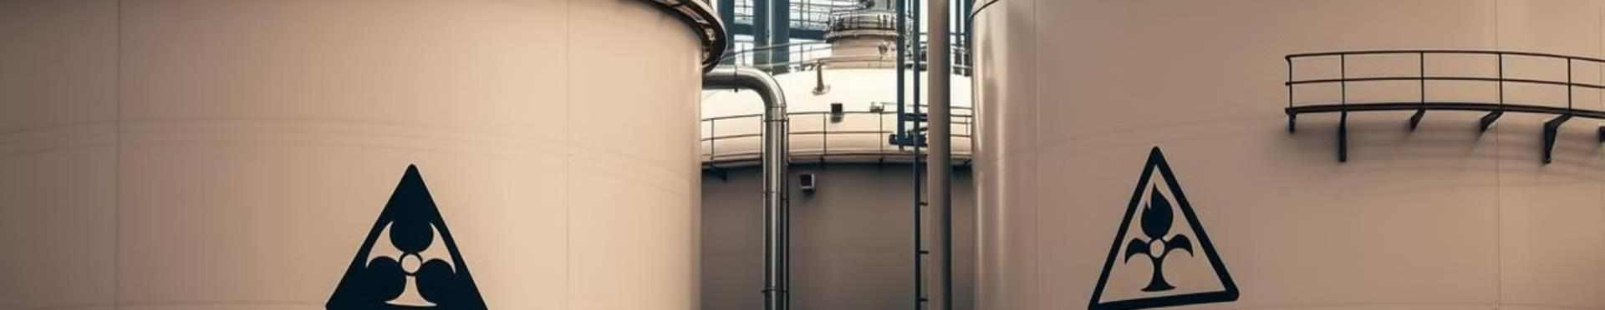
Magnitude of Risk
Risk Level | Description | Required Precautions
Low | Minor injuries or damages | Basic safety measures
Moderate | Significant injuries or financial loss | Enhanced safety protocols
High | Severe injuries, fatalities, or catastrophic damage | Extensive safeguards and monitoring

Slide 9
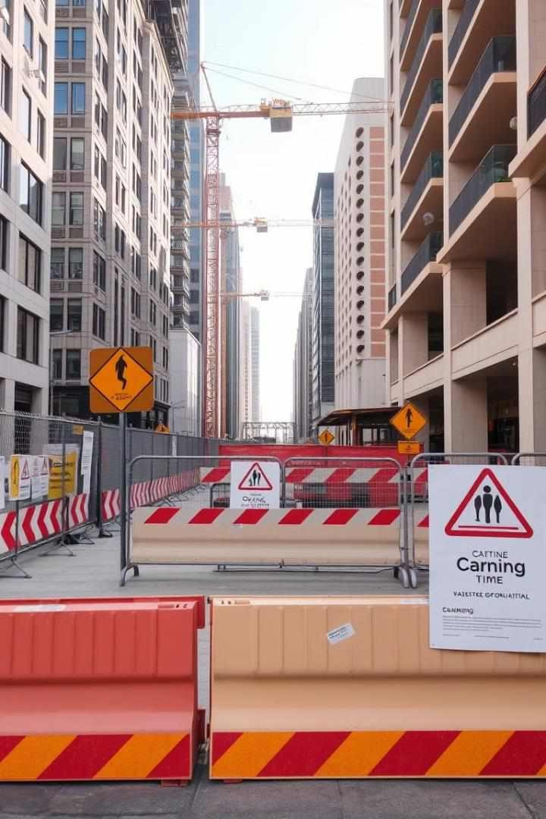
Practicability of Precautions
Cost Analysis
Evaluate the financial burden of implementing safety measures. Compare this to potential damages and legal consequences.
Technological Feasibility
Assess whether necessary technology exists. Consider industry standards and available safety innovations.
Time and Effort
Analyze the resources required
to implement precautions.
Balance this against operational needs and efficiency.
Effectiveness
Determine how well precautions prevent harm. Consider the reliability and comprehensiveness of safety measures.

Slide 10
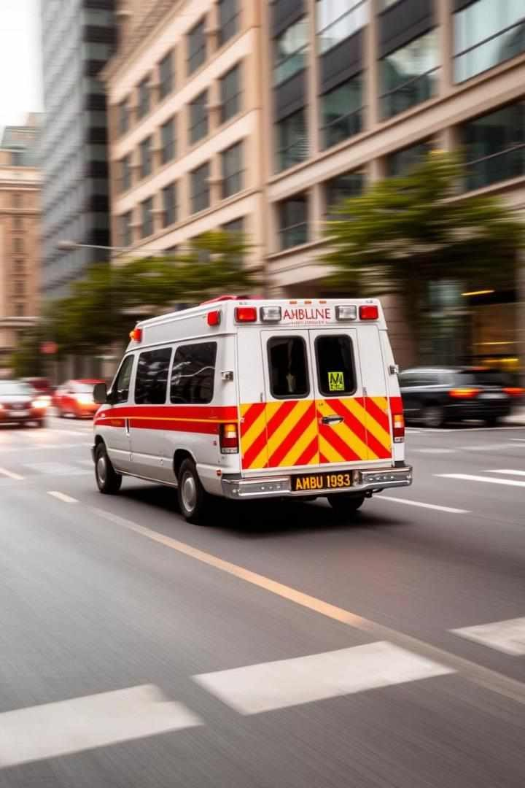




Social Utility of Defendant's Conduct
Balancing Act
Courts weigh social benefits against potential risks. This involves complex ethical and practical considerations.
Community Impact
The broader societal benefits of an action are considered. This may include economic, health, or safety contributions.
Risk Tolerance
Some beneficial activities inherently carry risks. Courts assess acceptable risk levels for valuable services.
Legal Precedent
Previous cases guide the evaluation of social utility. This ensures consistency in legal reasoning.

Slide 11
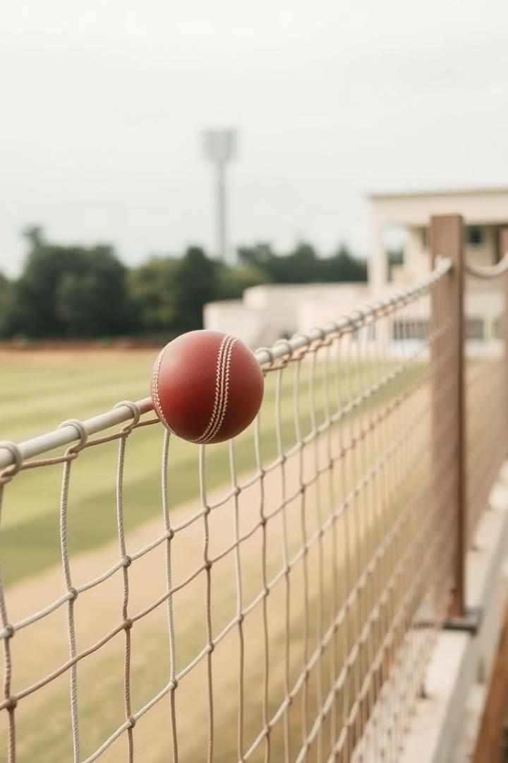
Case Study: Bolton v Stone
1
Incident
A cricket ball hit from the field struck a passerby. The rarity of such occurrences was a key factor.
2
Legal Analysis
The court considered the frequency of incidents and practicality of precautions. They balanced risk against the social value of cricket.
3
Ruling
No breach of duty was found. The risk was deemed so small that additional precautions weren't required.

Slide 12

Case Study: Paris v Stepney Borough Council
1
Employee Vulnerability
2
Employer's
Responsibility
The court emphasized the duty to consider individual employee needs. Standard practices may not suffice for all workers.
The mechanic's one-eyed condition increased his risk. This unique circumstance required special consideration from the employer.
3
Breach Determination
Failure to provide safety goggles constituted a breach. The employer
should have recognized the heightened risk.

Slide 13


Professional Standards and Duty of Care
1
Definition
Professional standards define the expected level of care in specific fields.
2
Influence
Guidelines and practices shape
the standards for each profession.
3
Example
An accountant's failure to follow
GAAP may result in financial loss.

Slide 14
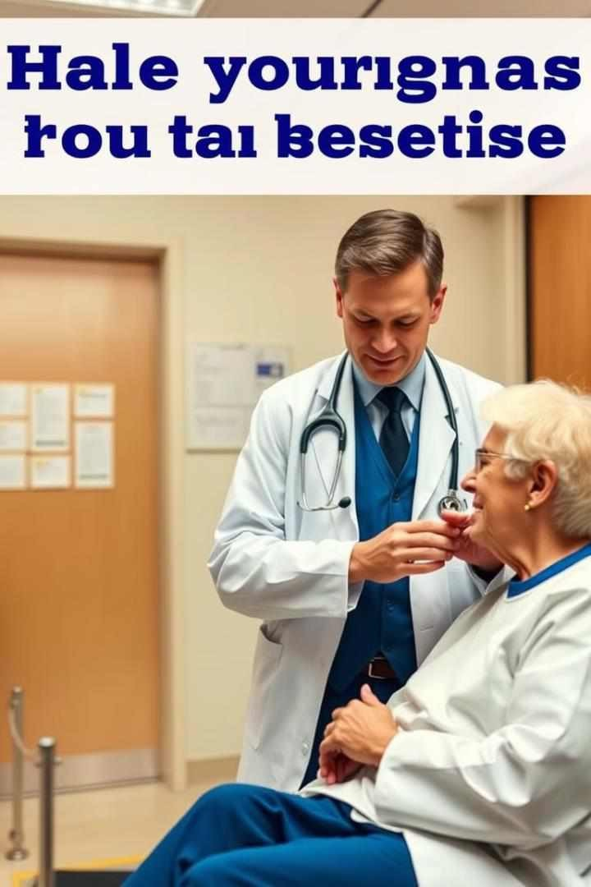

The Bolam Test in Medical Negligence
1
Explanation
The Bolam test compares a professional's actions to those of competent peers.
2
Application
Widely used in medical negligence cases to determine breach
of duty.
3
Example
A doctor's treatment decision is evaluated against peer
professional opinions.

Slide 15

Children and Breach of Duty
Special Considerations
The standard of care is adjusted for children based on age and intelligence.
Example
A child causing a fire is judged differently than an adult.
Legal Implications
Courts consider the child's capacity to understand and foresee potential harm.

Slide 16
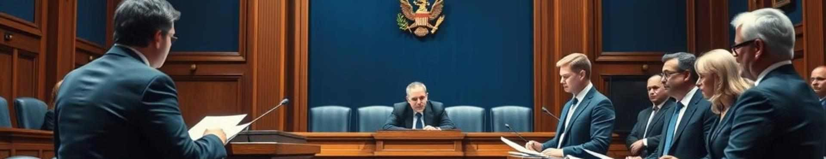
Case Study: McHale v Watson
Facts 12-year-old boy threw metal rod, injuring another child
Legal Issues Whether the boy breached his duty of care
Decision Court considered standard of care expected from a child

Slide 17
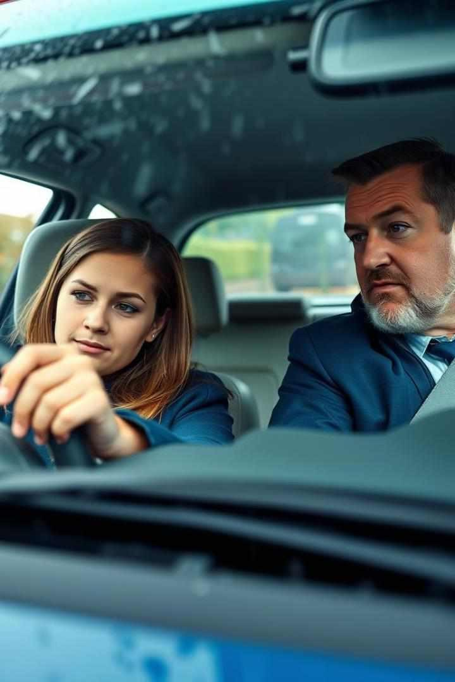
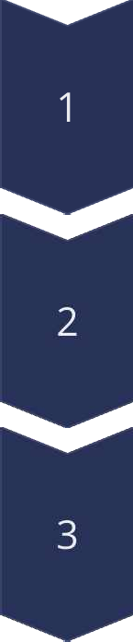
Nettleship v Weston: Learner Drivers and Duty
Facts
Learner driver caused an accident during a lesson.
Legal Issues
Whether the learner driver breached her duty of care.
Decision
Court judged learner by the standard of a competent driver.

Slide 18
Res Ipsa Loquitur Doctrine
Definition
Conditions
Example
Doctrine inferring negligence from the nature of an accident or injury.
The event must not ordinarily occur without negligence.
Surgical instrument left inside a patient after surgery.

Slide 19

Case Study: Scott v London and St Katherine Docks
1
Facts
Barrel of flour fell from warehouse window, injuring a passerby.
2
Legal Issues
Application of res ipsa loquitur doctrine to the case.
3
Decision
Court applied res ipsa loquitur, inferring negligence from the accident.

Slide 20
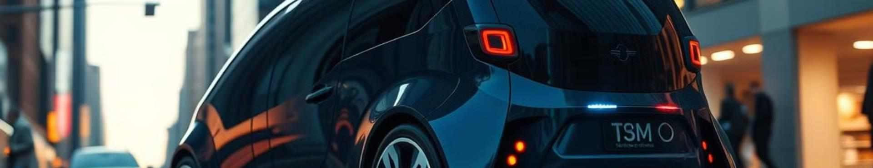



Recent Developments in Breach of Duty
Technology
Autonomous vehicles raise new questions about standards of care.
Reforms
Proposals for clearer guidelines in technological and medical fields.
Legal Challenges
Courts adapting to new scenarios in determining breach of duty.

Slide 21

Criticisms and Reforms
Criticisms: The reasonable person standard is often seen as too vague and subjective.
Reforms: Proposals for clearer guidelines and
standards.
Example: Reforms may include specific standards for different contexts, such as medical or technological fields.

Slide 22
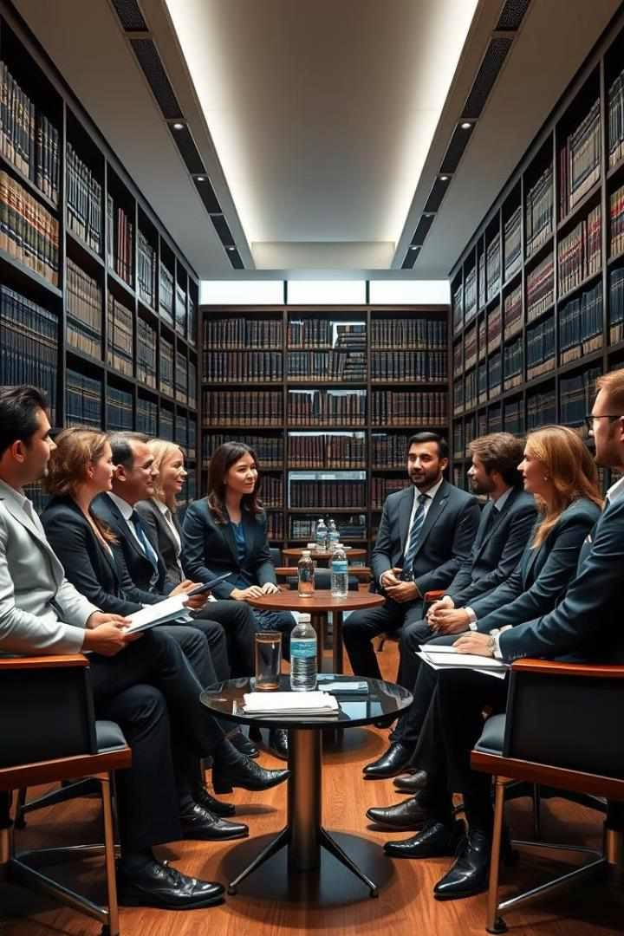
Conclusion: The Future of Breach of Duty
1
Summary
Breach of duty remains a crucial element in negligence law.
2
Importance
Understanding breach of duty is essential for ensuring justice.
3
Future
Balancing harm prevention and reasonable conduct will shape future developments.

