Slide 1

Defences to Trespass:
Necessity, License, and Justification
Tutor: Okwudili O. ONWURAH, LL.B. (Nigeria); BL (Abuja, Nigeria); LLM (Exeter, UK); LLM (Qingdao, PRC); LLM (Shanghai, PRC)
PhD in Law (Hong Kong)
Dr Okwudili O. Onwurah

Slide 2
Minor House Keeping
The purpose of the online lesson is to encourage you to participate actively in achieving your needs and simplifying your legal education. I want you to be the best!
Will make the learning process more interactive discussions and feel free to ask any question or you can speak.
You have the right to choose whether to turn on your video or not.
Participation prepares you for your exam and learning needs with ease.

Slide 3
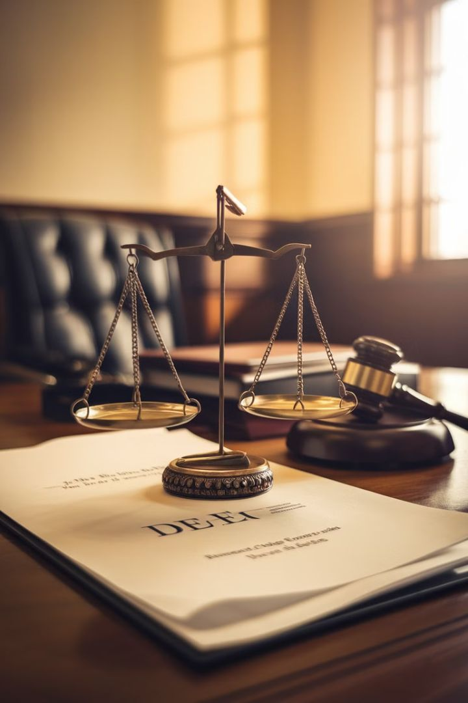
Intoduction
In the realm of property law, trespass is a fundamental concept that protects landowners' rights. However, the law recognises certain circumstances where trespass may be excused or justified. This presentation delves into the intricate world of defenses to trespass, focusing on necessity, license, and justification. We will explore landmark cases from English and Hong Kong courts, analyse relevant ordinances, and engage in practical scenarios to deepen our understanding of these complex legal concepts. Join us on this journey through the nuanced landscape of property rights and their exceptions.

Slide 4
Overview of Defenses to Trespass
Necessity
License
A defense that arises when an individual must enter another's property to prevent greater harm. This is often a contentious and narrowly applied defense.
Permission granted by the property owner, either expressly or implicitly, allowing entry onto their land. This defense negates the very essence of trespass.
Justification
Lawful Authority
A broader category that includes actions taken in the public interest or under lawful authority, such as police officers executing a warrant.
Specific to Hong Kong, this defense covers actions taken under statutory powers or in the execution of legal duties.
These defenses form a crucial part of property law, balancing the rights of landowners against broader societal needs and individual circumstances. Understanding their nuances is essential for legal practitioners and property owners alike.

Slide 5

Defense of Necessity: Southwark London Borough Council v Williams [1971]
1
Case Background
In this landmark case, homeless families squatted in empty council houses during a severe housing shortage. They claimed necessity as a defense against trespass charges.
2
Court's Decision
The Court of Appeal rejected the necessity defense, ruling that it cannot be used to justify squatting in another's property, even in dire circumstances.
3
Legal Principle Established
The case set a precedent that necessity as a defense to trespass is extremely limited and generally not applicable to long-term occupation of property.
4
Implications
This ruling emphasised the sanctity of property rights and the court's reluctance to allow necessity as a broad defense, fearing it could lead to anarchy in property law.

Slide 6
License as a Defense: Express vs Implied Licenses
Express License
Implied License
Legal Implications
An express license is a clear, often written, permission granted by the property owner to enter their land. This could be in the form of a formal document, a verbal agreement, or even a text message. Examples include invitations to parties, rental agreements, or permission to use a private road. Express licenses provide a strong defense against trespass claims as they demonstrate unambiguous consent from the landowner.
An implied license arises from the conduct of the parties or the circumstances of the situation. It's not explicitly stated but can be inferred from the landowner's actions or the general expectations of society. Common examples include postal workers delivering mail or visitors walking up to your front door to knock. The scope of an implied license is often more limited and can be revoked more easily than an express license.
Both types of licenses can serve as valid defenses to trespass, but implied licenses may be more challenging to prove in court. The onus is on the defendant to demonstrate that a reasonable person would have understood that they had permission to enter the property. Courts will consider factors such as custom, past practice, and the nature of the property when determining the validity of an implied license.

Slide 7
Justification in Public Interest Cases
1
Definition of Public Interest
2
Examples of Public Interest Justifications
In the context of trespass defenses, 'public interest' refers to actions taken for the greater good of society, often by public officials or in emergency situations. This justification balances individual property rights against broader societal needs.
Common scenarios include police officers executing search warrants, firefighters entering property to combat fires, or utility workers accessing land to repair essential services. These actions, while technically trespass, are justified by their service to the public good.
3
Legal Framework
4
Limitations and Controversies
The public interest defense is often codified in specific statutes or recognised in common law. Courts carefully scrutinise such claims to ensure they are not used to unjustly infringe on property rights. The defense must be proportionate to the public interest being served.
While widely accepted, the public interest defense is not absolute. Courts must balance competing interests and may limit its application in cases where private rights are excessively infringed. Controversies often arise in cases of civil disobedience or environmental protests.

Slide 8

Hong Kong Ordinances on Lawful Authority Defenses
Ordinance
Relevant Section
Key Provisions
Police Force Ordinance (Cap. 232)
Section 50
Authorises police to enter and search premises with a warrant
Fire Services Ordinance (Cap. 95)
Section 13
Allows firefighters to enter premises to extinguish fires or conduct rescues
Buildings Ordinance (Cap. 123)
Section 22
Permits building inspectors to enter premises for safety inspections
Lands Resumption Ordinance (Cap. 124)
Section 13
Authorises government officials to enter land for survey purposes
Hong Kong's legal framework provides specific ordinances that grant lawful authority for certain individuals to enter private property without constituting trespass. These ordinances balance public safety and societal needs with individual property rights, offering a structured approach to justifiable entries.

Slide 9
Case Study: R (Bennett) v Horseferry Road Magistrates Court [1994]
Case Background
Bennett, a New Zealand citizen, was forcibly brought to the UK by police without following proper extradition procedures. He was wanted for criminal charges in the UK.
Court's Decision
The House of Lords ruled that the court had the power to stay proceedings where a defendant had been brought within the jurisdiction unlawfully.
1
2
3
4
Legal Issue
Implications
The case raised questions about the limits of police authority and whether their actions constituted justified trespass or an abuse of power.
This landmark case established that even when acting in the public interest, authorities must adhere to proper legal procedures. It set limits on the justification defense in cases of potential abuse of power.

Slide 10
Practical Scenarios: When Defenses Fail
Overstaying a License
Misinterpreted Necessity
A guest who refuses to leave after a party ends, despite the host's requests, cannot claim a valid license defense. The license expires when permission is revoked.
Entering private property to take a shortcut, even in bad weather, does not constitute necessity. The danger must be immediate and severe to justify trespass.
Exceeding Implied License
Unjustified 'Public Interest'
A door-to-door salesperson who enters a back garden after being told to leave cannot claim implied license. The scope of the implied permission has been clearly exceeded.
Environmental protesters occupying private land without legal authority cannot successfully claim a public interest defense, despite their intentions.
These scenarios illustrate the nuanced application of trespass defenses in real-world situations. They highlight the importance of understanding the precise limits and requirements of each defense to avoid legal consequences.

Slide 11
Comparative Analysis: Hong Kong vs. English Law
Hong Kong Law
English Law
Key Differences
Hong Kong's legal system, rooted in English common law, has developed its own nuances in trespass defenses. The concept of 'lawful authority' is more prominently codified in specific ordinances. Hong Kong courts tend to interpret necessity more narrowly, particularly in cases of long-term occupation of property. The territory's unique housing challenges have led to stricter enforcement against squatters, with less sympathy for necessity claims in such cases.
English law has a longer history of case law development in trespass defenses. The concept of necessity, while still limited, has seen some expansion in recent years, particularly in cases involving environmental or human rights issues. English courts have shown more willingness to consider implied licenses in a wider range of scenarios. Public interest defenses in England are more likely to be accepted in cases of civil disobedience or protest, reflecting a different balance between property rights and freedom of expression.
While both systems share common foundations, Hong Kong law tends to be more statute-driven in its approach to lawful authority defenses. English law relies more heavily on case law evolution. Hong Kong courts generally take a more conservative approach to expanding defenses, while English courts have shown slightly more flexibility in adapting to changing social norms. These differences reflect the unique social, political, and economic contexts of each jurisdiction.

Slide 12





Interactive Session: Hypothetical Example 1
Scenario
A hiker, caught in a sudden severe storm, breaks into an empty mountain cabin for shelter. The cabin sustains minor damage from the forced entry.
Legal Question
Can the hiker successfully claim the defense of necessity against a trespass charge?
Considerations
Assess the immediacy of the danger, availability of alternatives, and extent of damage caused. Compare with precedents like Southwark v Williams.
Discussion
Engage in a debate about balancing property rights with human safety in emergency situations. Consider potential liability for damages.

Slide 13
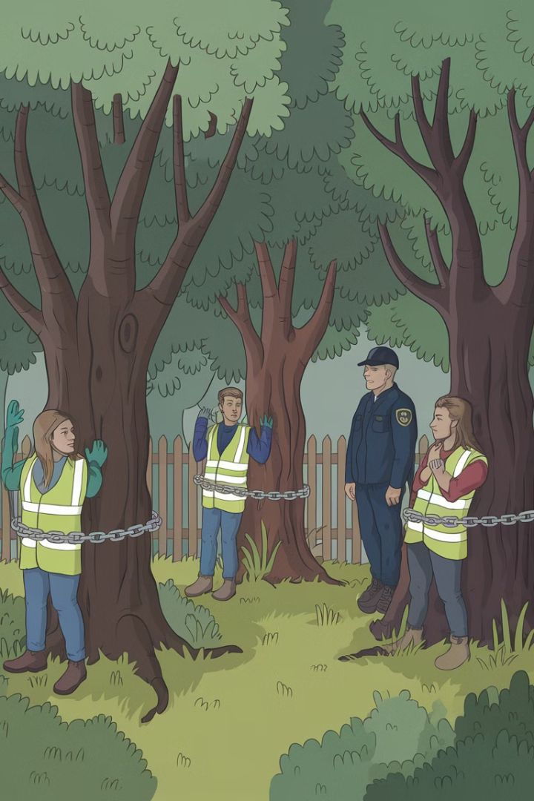




Interactive Session: Hypothetical Example 2
Legal Issue
Balancing Interests
Environmental activists occupy a private forest to prevent logging. They claim their actions are justified in the public interest to protect the environment.
Discuss the balance between property rights and environmental protection. Consider the limits of public interest justifications in trespass cases.
Relevant Laws
Group Activity
Examine applicable environmental regulations and property laws. Consider how different jurisdictions might approach this scenario.
Divide into groups representing different stakeholders: activists, property owners, local community, and government. Debate and propose resolutions.

Slide 14
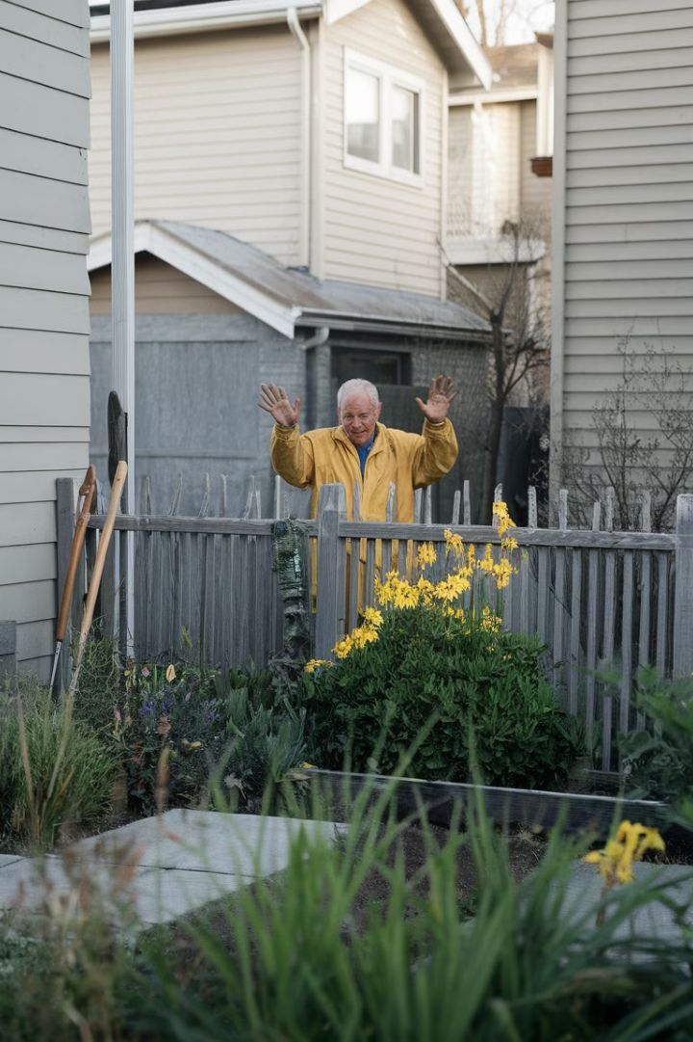
Interactive Session: Hypothetical Example 3
1
Scenario Setup
A homeowner regularly enters their neighbour's garden to tend to overhanging branches from their own tree, without explicit permission but also without objection for several years.
2
Initial Analysis
Discuss the concept of implied license. Consider factors such as duration of practice, lack of objection, and social norms in the neighbourhood.
3
Complication
The neighbour suddenly objects and accuses the homeowner of trespass. Analyse how this changes the legal situation.
4
Legal Strategies
Explore possible defenses for the homeowner and potential arguments for the objecting neighbour. Consider how different jurisdictions might view this case.

Slide 15
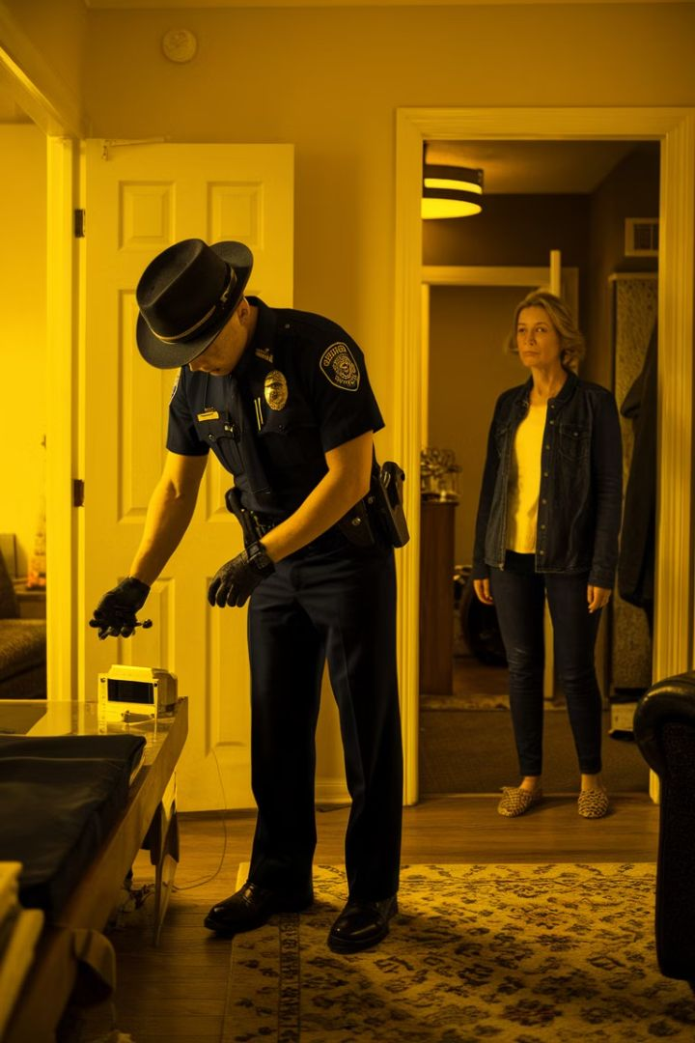
Interactive Session: Hypothetical Example 4
Scenario
Legal Issues
Police enter a private home without a warrant, claiming they heard cries for help. They find evidence of a different crime but no one in distress.
Examine the limits of police authority and the necessity defense. Discuss the admissibility of evidence found during potentially unlawful entry.
Comparative Law
Ethical Considerations
Compare how this scenario might be treated under Hong Kong law versus English law. Consider relevant ordinances and case precedents.
Debate the balance between public safety and individual privacy rights. Discuss potential consequences of strict vs. lenient interpretations of police authority.

Slide 16
Interactive Session: Hypothetical Example 5
Scenario
Legal Analysis
Group Activity
A utility company worker enters private property to repair underground cables without prior notice to the homeowner. The repair requires digging up part of the garden. The homeowner returns to find the work in progress and objects to the intrusion.
Examine the concept of lawful authority in this context. Consider relevant utility company rights and obligations. Discuss the balance between public service needs and private property rights. Analyse the importance of notice and potential compensation for damage.
Divide participants into roles: utility company representative, homeowner, legal advisor, and local authority. Conduct a mock negotiation or mediation session to resolve the dispute. Consider both legal requirements and practical solutions to balance all interests involved.

Slide 17
Conclusion: The Evolving Landscape of Trespass Defenses
1
Dynamic Nature of Property Law
2
Technological Impacts
Trespass defenses continue to evolve as society grapples with new challenges in property rights, public interest, and individual liberties. Courts and legislators must constantly balance these competing interests.
Emerging technologies like drones and virtual reality raise new questions about the nature of trespass and appropriate defenses. Future legal frameworks will need to address these novel scenarios.
3
Global Perspectives
4
Continued Importance
As legal systems become more interconnected, comparative analysis between jurisdictions like Hong Kong and England provides valuable insights for developing robust and fair property laws.
Understanding trespass defenses remains crucial for property owners, legal professionals, and public officials. It forms a cornerstone of how we balance individual rights with societal needs in the built environment.

